Slide 1
The World's 10 Weirdest Laws Not to Break
By Lark Gould (2011)

Slide 2
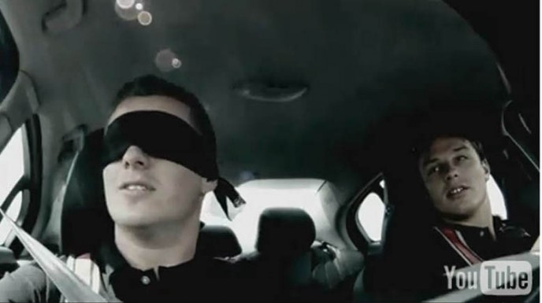
1. In Alabama, it is unlawful to wear a false mustache in church and cause "unseemly laughter."
The state also keeps a law against driving while blindfolded!

Slide 3
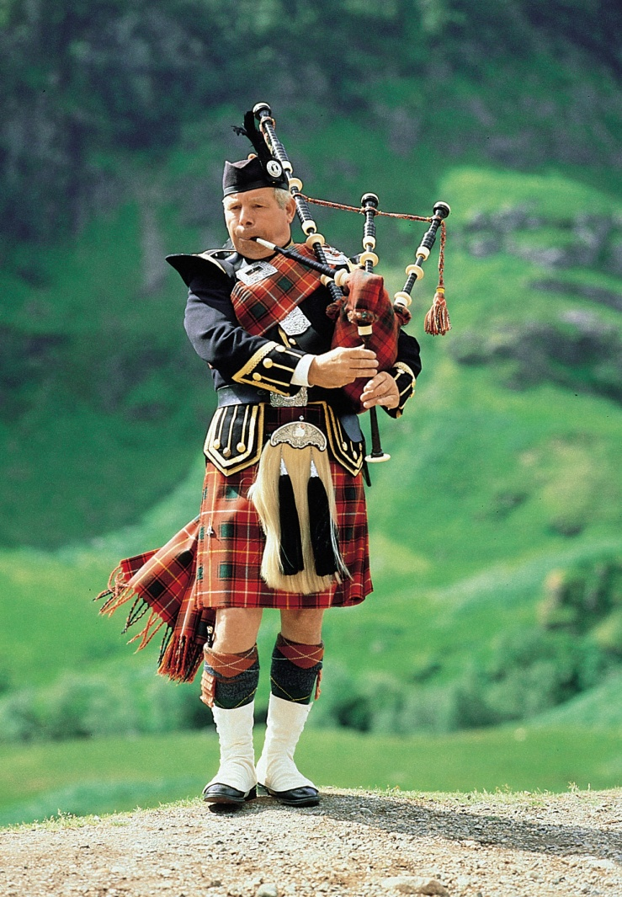
2. In Phoenix, Arizona, the law states that every man who enters the city limits must wear pants.
Maybe this was aimed at Scottish bagpipe players, but the law has ensured the city stays clean of men in skirts, no matter what instruments they play!

Slide 4
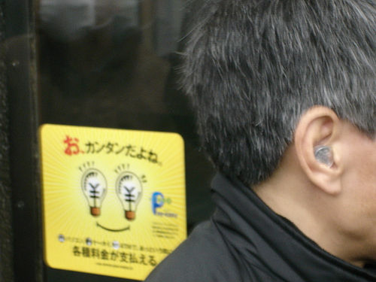
3. In Hawaii, coins may not be placed in one's ears. You can wear them in your nose, on your toes and under your arms but the ears are definitely out. Magicians take note!

Slide 5
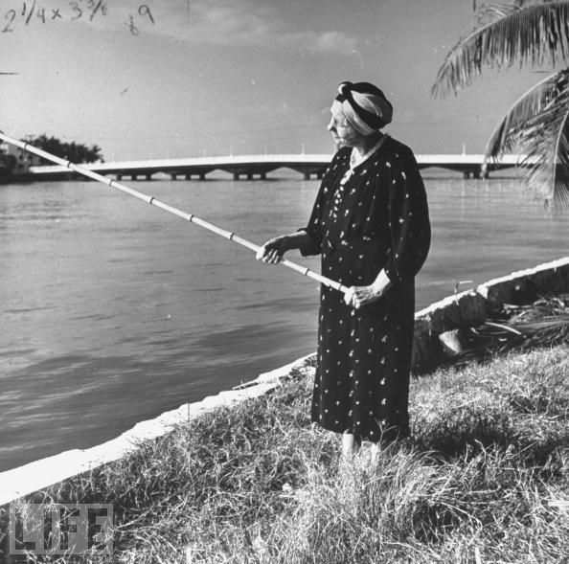
4. In Montana, it is illegal for married women to go fishing alone
on Sundays.
And it is illegal for unmarried women to fish alone at all!

Slide 6
5. In Vermont, women must obtain written permission from their husbands to wear false teeth.

Slide 7
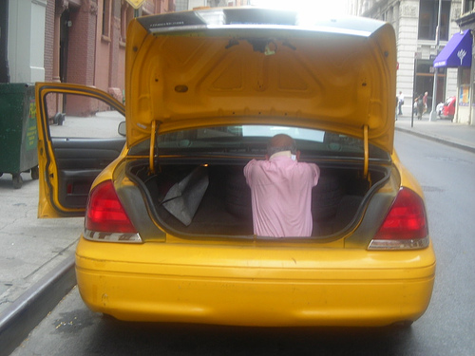
6. In Australia, you'll never be far from a comfortable bed of sorts if you are in a taxi. Taxicabs are required by law to carry a bale of hay in the trunk at all times.

Slide 8
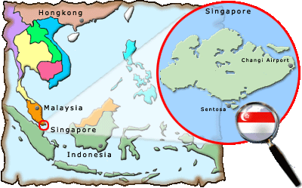
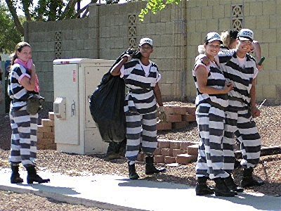
7. In Singapore –A litter law dating from 1968 states if you drop trash on the ground you can pay up to $1,000. Do it again and you might be forced to do community labor and pay another fine. Even worse you'll have to wear a bright fluorescent jacket that says in so many words, "I am a litter lout."

Slide 9
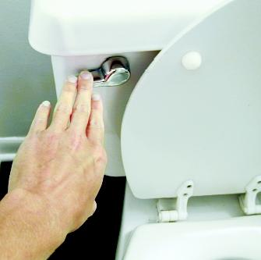
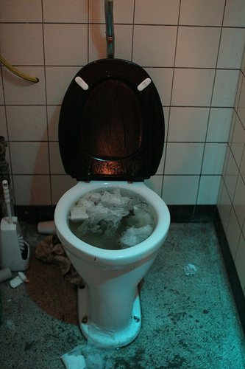
8. In Switzerland, it is illegal to flush the toilet after 10 p.m. in most apartment houses.
Polite as always, this considerate population would rather suffer a build up in the toilet bowl than a fight with neighbors over the roar of flushing through the midnight hours.

Slide 10
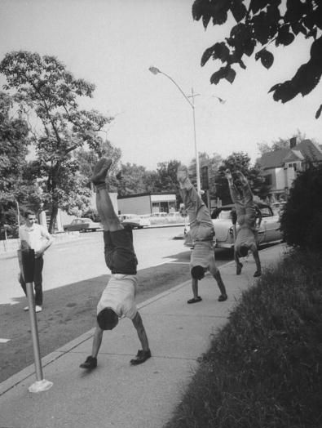
9. It is illegal to cross the street while walking on your hands in Hartford, Connecticut.

Slide 11
Any finally…

Slide 12
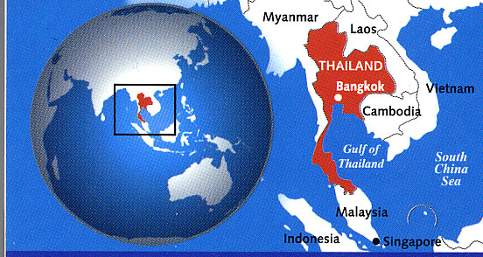
10. In Thailand, it is illegal to leave the house without wearing underwear!

