Slide 1
R
!
evolution

Slide 2
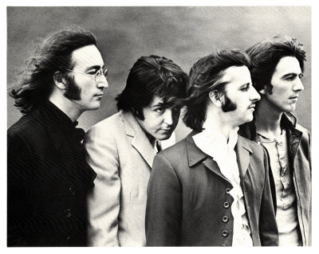
“Revolution 1”
The Beatles
White Album (1968)

Slide 3
Highlights of
The American Revolution

Slide 4
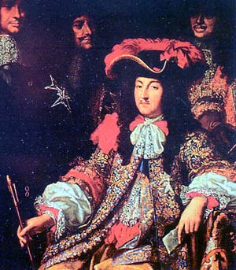
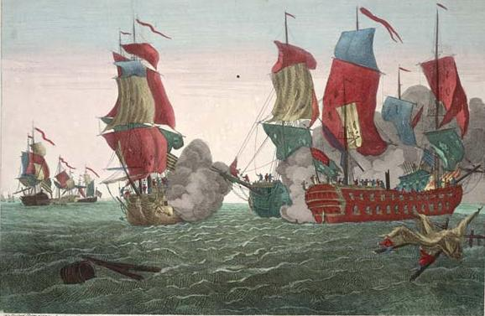
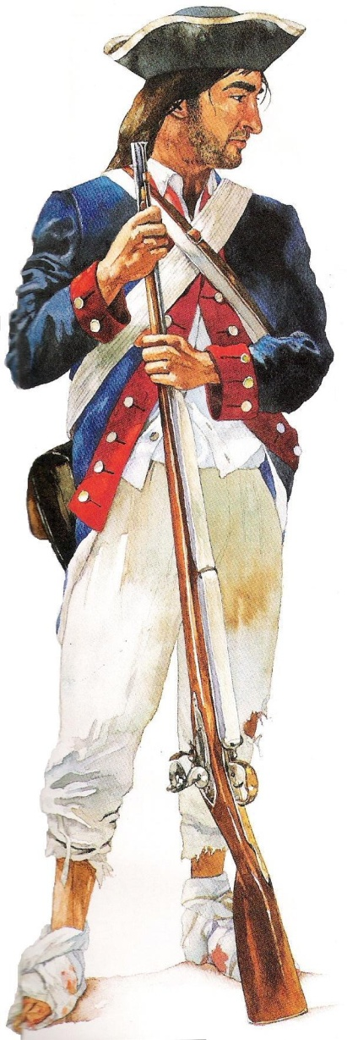
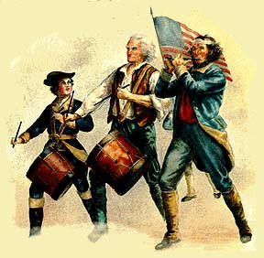
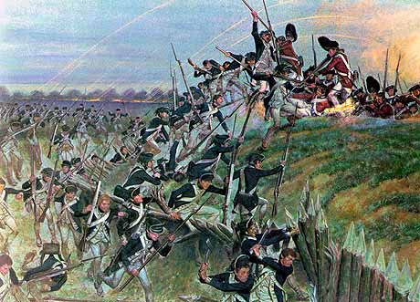
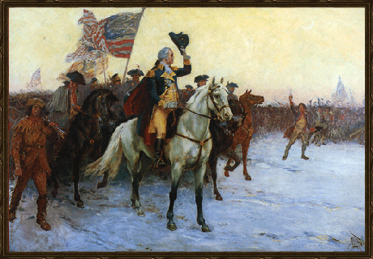
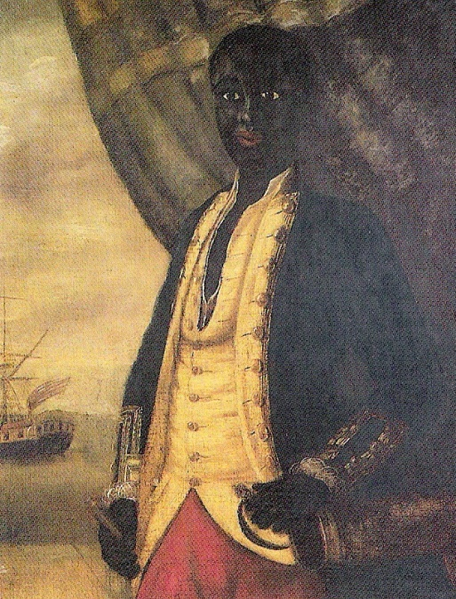
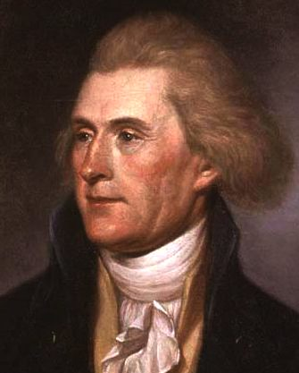
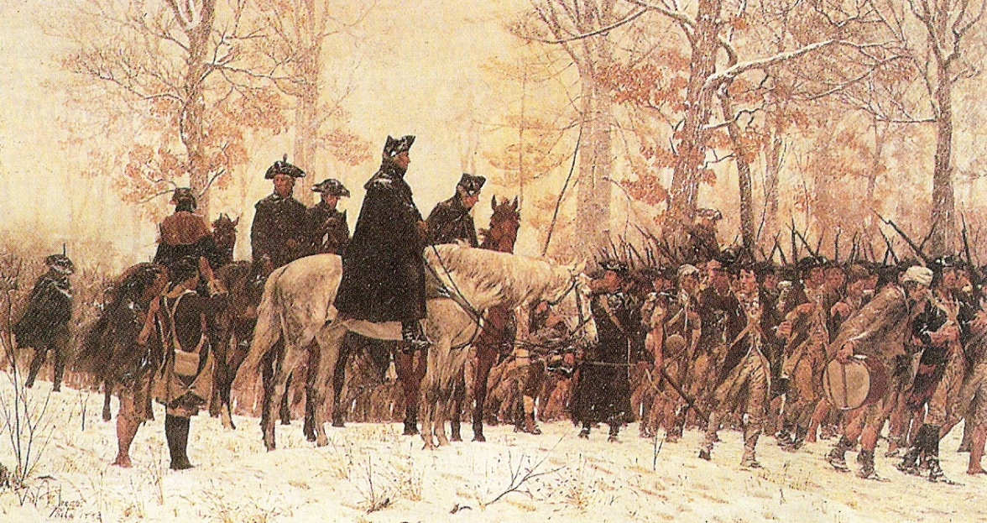
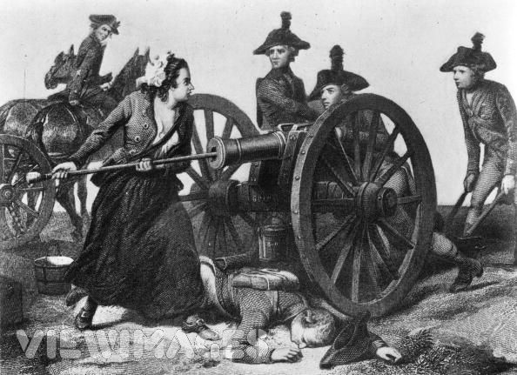
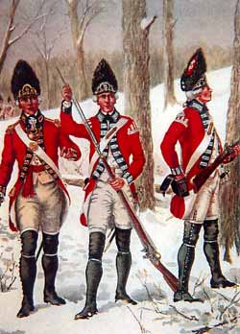
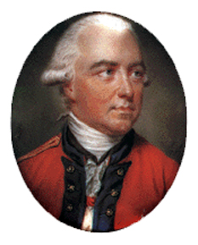
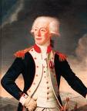
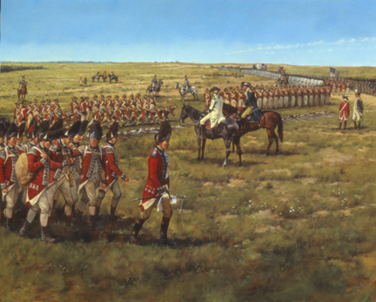
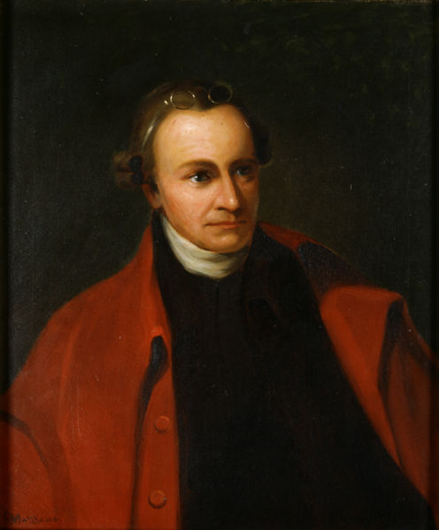
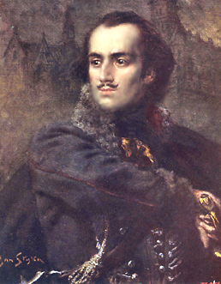
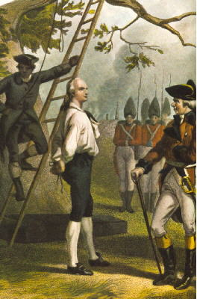
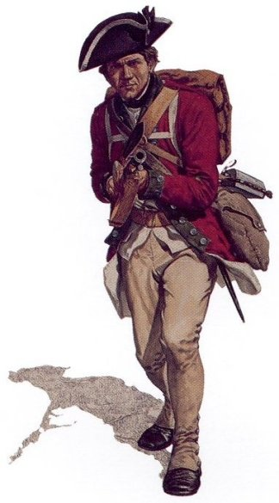
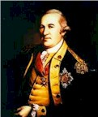
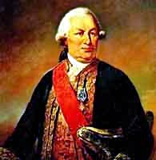
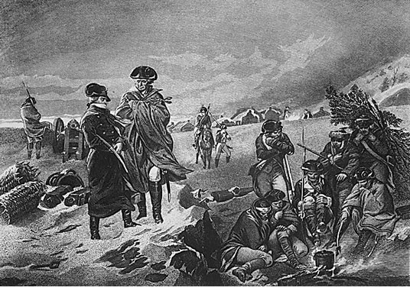
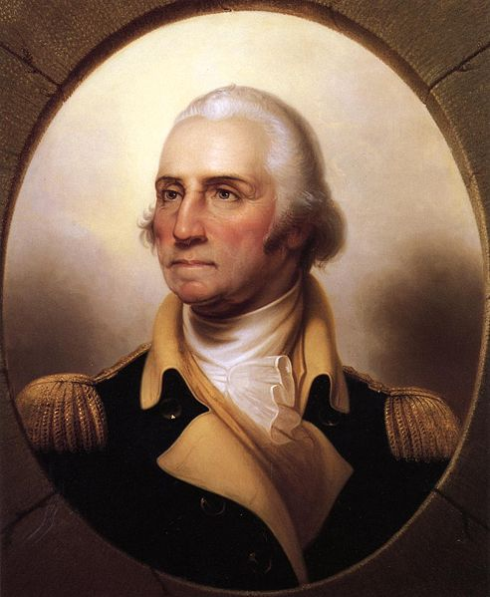
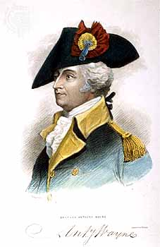
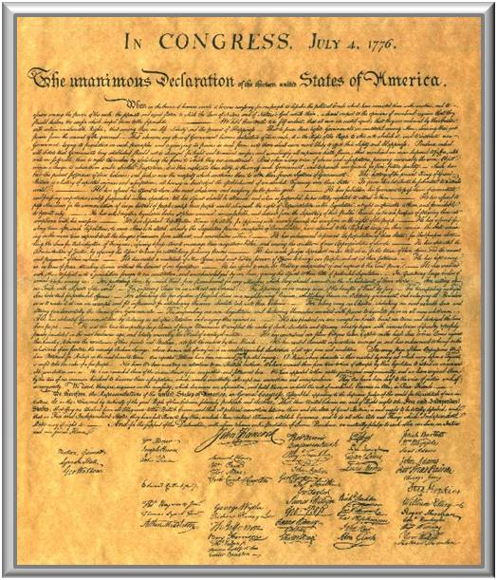
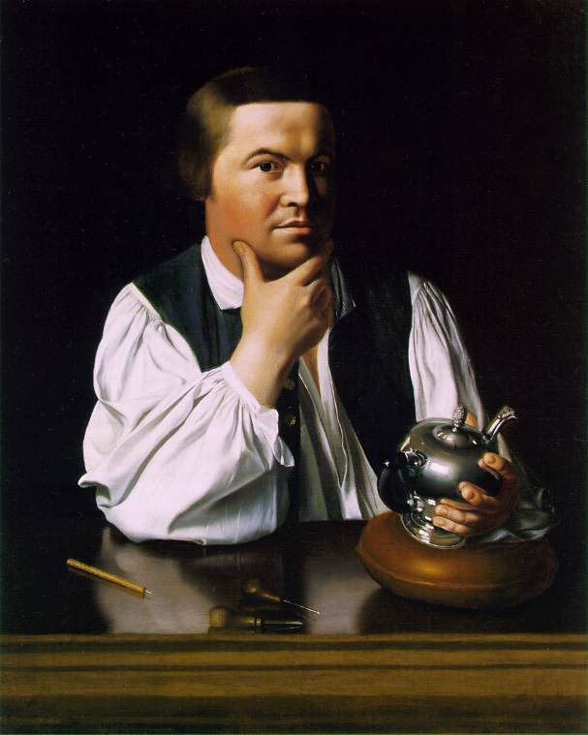
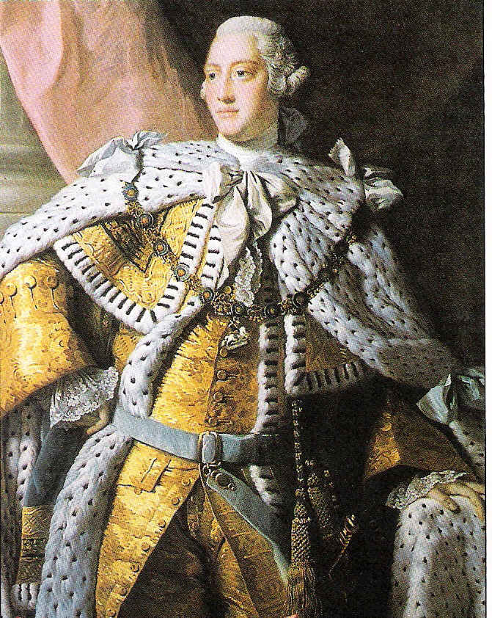
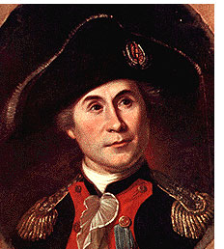
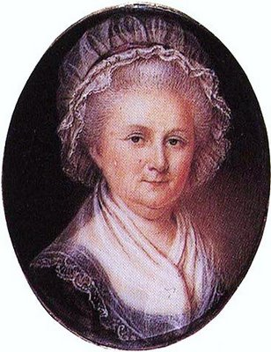
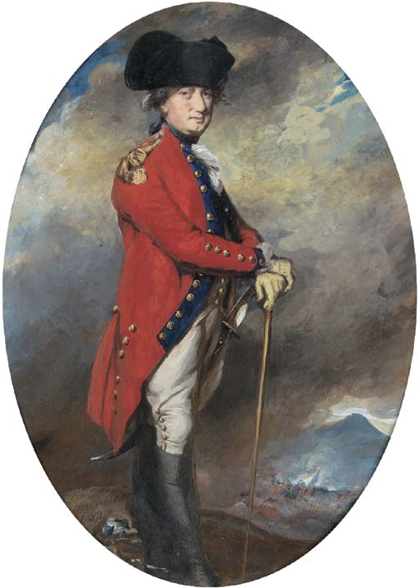
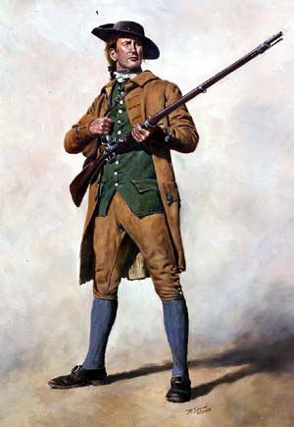
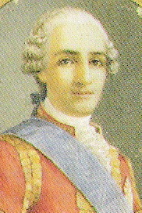
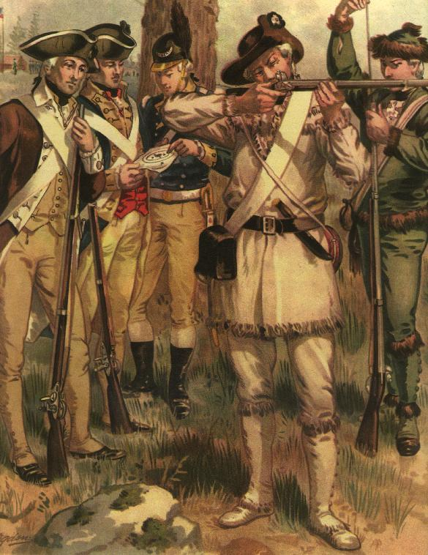
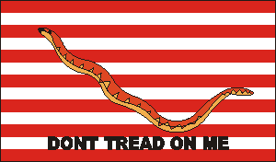
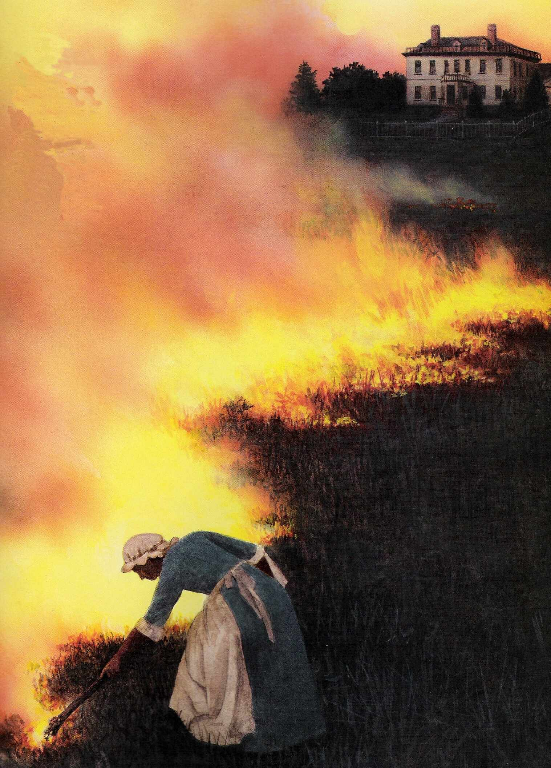
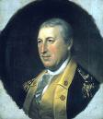
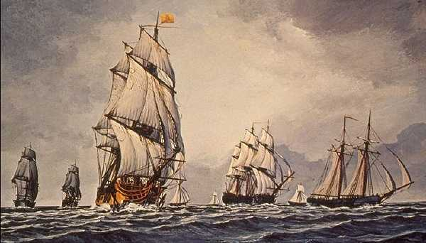
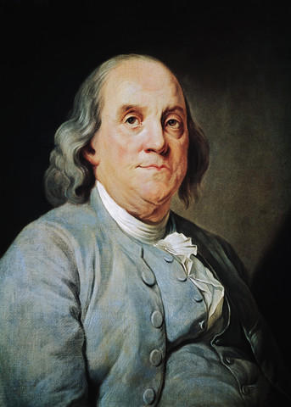
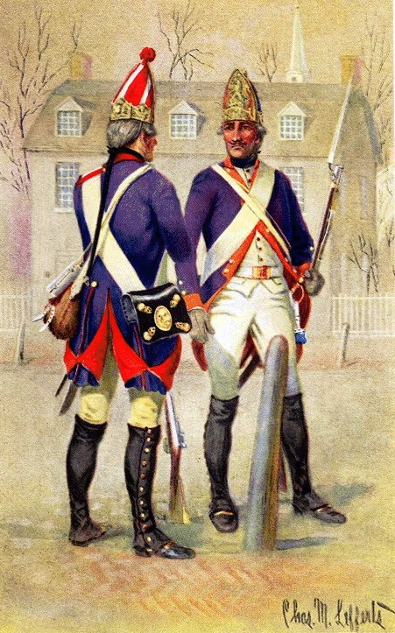
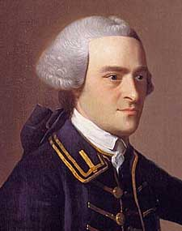
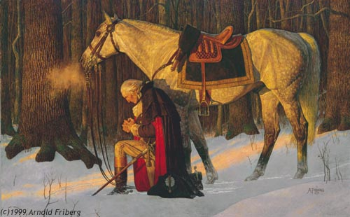
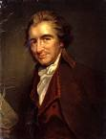
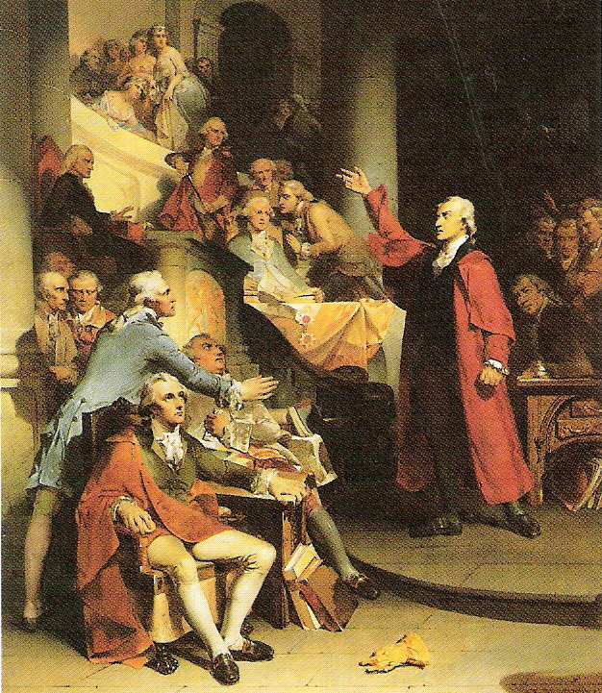
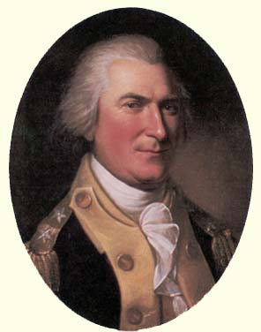
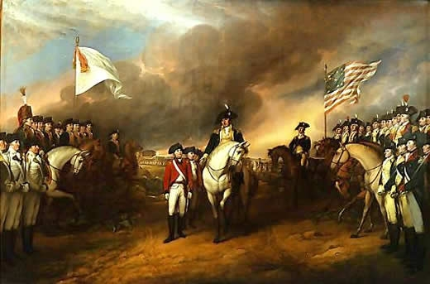
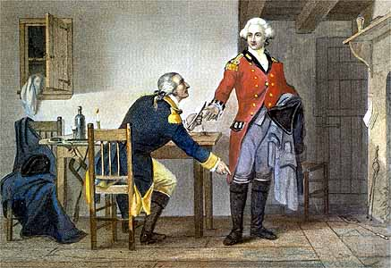
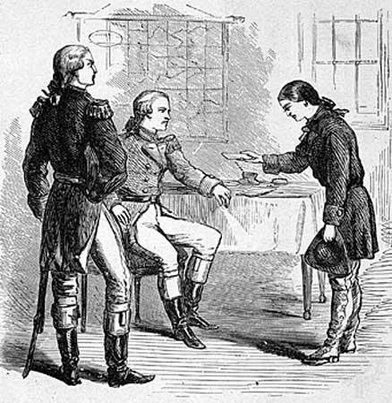
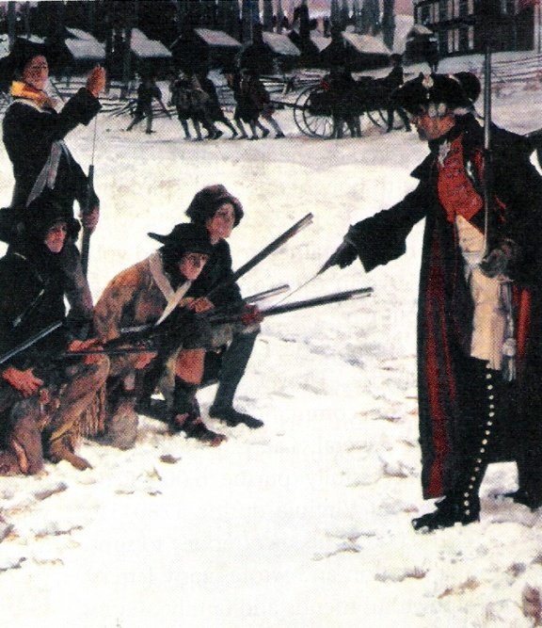
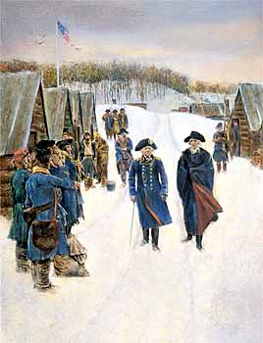
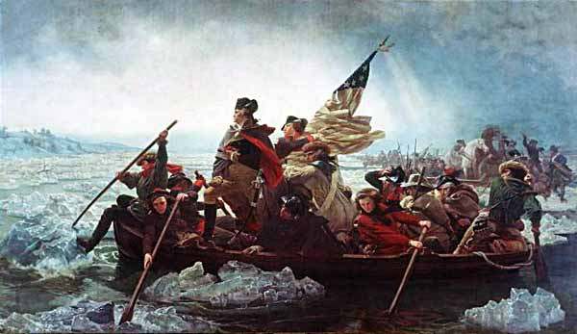

Slide 5
“The Tale of the Tape”
In every big professional boxing match you will more than likely come across a newspaper article such as this one. In it you will find a list of specific physical measurements for each boxer which other people use to help them decide the possible outcome of the fight. This list of measurements is called “The Tale of the Tape” (measuring tape). The boxer who has more physical advantages often stands a better chance to win. People will place bets on a fight based on this information, much as they would a race horse which appears to be bigger, stronger or faster than the rest of the field.

Slide 6
“The Tale of the Tape”
Let’s take a closer look at the “Tale of the Tape” and see if we can pick the boxer who has the best chance of winning the match!

Slide 7
Although Roldan got in a few good punches, Hearns sent him to the canvas early in the fight!
So, what happened?
Who do you think will win?
Hearns had too many important advantages over his opponent…

Slide 8
Let’s apply a “Tale of the Tape” comparison to the American Revolution!
Of course, we already know who won, but let’s pretend that we don’t know. Let’s pretend that we’re some sort of “cosmic gamblers” who bet on the outcome of mankind’s wars.
Here’s a list of strengths and weaknesses for the opponents in the American Revolution!

Slide 9
The Revolutionary War
“The Tale of the Tape”
= clear advantage
British
Colonials
___ Population___
12,000,000
2,750,000
1/3 of people were Tories;
many others were anti-war
Popular
___ Support ___
War was unpopular in England (been at war most of 18th century
No regular navy; many privateers
___ Navy ___
Best navy in the world
Fighting on home ground
Knowledge of
___ Territory ___
Fighting on unfamiliar ground.
Resourceful & intelligent leaders; junior officers poorly trained; much jealousy
___ Officer Corps___
Well-trained officers—followed orders without question
Unorganized; no teamwork among colonies; complained about leaders; many desertions
Military
___Organization___
Highly disciplined and organized; troops fought wherever needed.
9

Slide 10
1-year enlistment; Congress could not draft; Regular Army of 19,000;
(400,000 served at different times)
Soldiers were drafted; highly trained; used Hessian mercenaries
___Military Duty___
Wore ordinary clothing; no recognition for service; rarely received pay on time
Red uniforms for all; many awards and decorations to boost morale; paid on time!
___Uniforms & Awards___
Shortage of food, clothing, tents, blankets, medicine, weapons, ammunition; access only to land routes
Weapons, Supplies &
___Transportation_____
Had everything colonials lacked; controlled seacoast
Very little wealth; no power to tax; wealthiest colonists were Loyalists; limited manufacturing
Richest country in the world; many factories; world-wide supply network
___Wealth & Industry___
Protecting home and family; fighting for freedom
___Reason for Fighting___
Following orders; England was never threatened.

Slide 11
What often counts for more is what is on the inside.
Can you apply this notion to your own situations?
which is something that can’t be measured.
It’s about determination.
And yet, the Americans were victorious.
It’s about the reasons for which you struggle.
It’s about heart…
This comparison doesn’t look good for us!
On paper, the British should have easily won the war.
Why didn’t they?
It’s because what’s most important is not always about how things add up on the outside.
Do you have the heart to get through the storms of life?
It’s about the will to succeed.

Slide 12
This is a movie about the 1980 U.S. Olympic hockey team. It was made up of a bunch of young men who didn’t have the best hockey skills but were chosen to the team because their coach recognized something special inside them. They fought their way through the preliminary rounds and found themselves in the gold medal match against the best and most brutal hockey team in the world…the Russian National Team. They were serious underdogs. They didn’t stand a chance in the eyes of the world, but they believed in themselves—they had the heart.
They won the gold medal.

Slide 13
IT’S TIME TO BEGIN TAKING NOTES!
DON’T OVERDO IT. TAKE ONLY THE NOTES YOU NEED!
Remember that notes are NOT supposed to be written in complete sentences, but are bits and pieces of information designed to help you remember what was said in class.
REMEMBER THAT YOU ARE TAKING NOTES USING THE
CORNELL NOTE STYLE.
BEFORE THE REST OF THESE SLIDES, TAKE TIME TO SET UP YOUR FIRST TWO PAGES IN THAT WAY!
Also, remember not to write down something that you already know!

Slide 14
Topic
Slide #
The American Revolution PPT
Tale of the Tape
George
Washington
Details
Dates
Specific Information
goes here...
Everything that helps
to explain what is in the
column to the left
Underline the
words you put in
this first column
and be sure to
skip a line after
each entry
Use the last couple lines of the page to write any questions
you may have, or to write a couple summary sentences about the section or topic that is on this page.
THIS WILL HELP YOU REVIEW THE INFORMATION FOR QUIZZES!
Questions, etc.

Slide 15
Since this unit is about the Revolution, you need take shortcuts by using abbreviations for often-used terms or names like:
R for Revolution
K for King
B for British
L for Loyalist
P for Patriot
W for George Washington
A for Americans

Slide 16
I will be giving you a lot of information, but some of it is meant only to give you some extra explanations and will not be on your quizzes.
When you see this icon, it means that you will need to know most of the information on that slide!
A smaller one next to a sentence means you need to know that piece of information for a quiz!

Slide 17
British
Allies
In
America

Slide 18
Loyalists
Loyalists made up 1/3 of the population of Americans.
They were loyal to the King for different reasons:
They believed he had the right to rule and that his laws were fair.
2. They were afraid of British soldiers.
3. They had family in England and didn’t want the British to punish them if their American relatives helped the Patriots!
4. They felt that a government run by rich Patriots was worse!

Slide 19
LET’S GO BACK AND SEE WHAT INFORMATION WAS ON THAT LAST PAGE AND WHAT IT COULD LOOK LIKE IN YOUR NOTES!

Slide 20
Loyalists
1/3 of pop.
Made up 1/3 of the population of Americans.
Loyal to K
They were loyal to the King for different reasons:
1. K had right to rule/fair laws
They believed he had the right to rule and that his laws were fair.
2. Feared B soldiers
2. They were afraid of British soldiers.
3. Family in Eng….B revenge?
3. They had family in England and didn’t want the British to punish them if their American relatives helped the Patriots!
4. Rich P gov’t worse!
4. They felt that a government run by rich Patriots was worse!

Slide 21
Also known as “Royalists” and “Tories”
Loyalists
Many Loyalists lived in New York, Georgia and the Carolinas.
Some tried to help the British in secret.
Others openly gave them information and help!
Some Loyalists even joined the British Army!

Slide 22
Many families were split apart by their beliefs:
Loyalists
George Washington’s brother was a Loyalist!
The Royal Governor of New York was Ben Franklin’s son!
Loyalists were not popular in the Colonies!

Slide 23
African Americans
Many fought with the “Redcoats” in return for their freedom!

Slide 24
Most of the Native American Indian tribes, including the Mohawks and Iroquois fought with the British “Lobsterbacks!”
Native Americans
Others believed that the British were going to win and wanted to “side” with a winner!
Some had not been treated very well by the Americans.
Joseph Brant
Mohawk Leader

Slide 25
And then, there was another ally that the British used against the Americans….
25

Slide 26
Hessian Mercenaries
Mercenaries
But only for money!
We like to kill people!
The best and most feared mercenaries in the world at that time were called “Hessians.” They came from a German area known as “Hesse.”
The British hired them to fight the Americans!
They were scary!

Slide 27
Neutrals
About 1/3 of Americans did not choose sides!
A number of these people belonged to religious groups such as the “Society of Friends” (aka “Quakers”) and Mennonites . They were both pacifist groups.

Slide 28
A number of “Neutrals” sent some of their family members to live in England.
Neutrals
This meant that they would be on the winning side no matter what happened!
*Slaves and “indentured servants” were expected to go along with the views of their households!
QUIZ 1

Slide 29
The Patriot Cause

Slide 30
Patriots made up 1/3 of the total population of Americans.
The Patriots
They were also known as “Rebels” or “Continentals.”
freedom
self-rule!
They wanted and

Slide 31
They were organized into “The Continental Army”
The Patriots
and led by…
George Washington.

Slide 32
George Washington
He was the son of a Virginia planter (farmer).
He became famous as a British Army officer in the French and Indian War.
He served in the Revolution without pay!
A very strong-willed leader…
He was loved by the soldiers, but envied by some of his officers!

Slide 33
Thomas Paine
He fought the war with pen and ink!
He wrote pamphlets, the two most famous of which were called “Common Sense” and “The Crisis.”
He encouraged Americans to fight for freedom!

Slide 34
Thomas Paine
He once wrote:
“These are the times that try men’s souls. The summer soldier and the sunshine patriot will in this crisis shrink from the service of their country; but he that stands it now deserves the love and thanks of man and woman.”
General Washington had Paine’s words read to his troops throughout the war to inspire them!

Slide 35
Patrick Henry
A fiery-tempered Virginia politician.
He inspired people with his patriotic speeches.
When his opponents accused him of treason he replied, “If this be treason, make the most of it!”

Slide 36
Patrick Henry
Some of his other quotations include:
“I am not a Virginian, but an American!”
and
“Give me liberty or give me death!”

Slide 37
Nathan Hale
He became a school teacher at age 19.
But what he really wanted was to live a dangerous and exciting life!
When Gen. Washington needed someone to spy on the British in New York,
When the war started, he joined the Continental Army.
Hale was the only one to volunteer!

Slide 38
To disguise himself for his secret mission Hale pretended to be a teacher from Connecticut looking for a job in New York!
Nathan Hale
He landed at a place called Oyster Bay, near New York City, and instructed his boatman to return to the same spot a week later.

Slide 39
When Hale had completed his mission, he returned to the spot at the appointed time. Through the darkness he heard the oars of a small boat coming to shore. As its shape began to appear in the mist, he made a signal to it, but….
Nathan Hale
it wasn’t his boat!
It was from an English ship anchored in the bay but hidden from Hale’s view by some trees. The men on the boat were coming ashore to get some fresh water!

Slide 40
Hale tried to make a run for it, but was captured. Hidden in the soles of his shoes were his “spy notes,” written in Latin.
Nathan Hale was in big trouble!
The sailors tied him up, threw him aboard the ship and sailed into the city!

Slide 41
Bad timing! New York was held by the British. The night before, the city had been set on fire—nearly ¼ of it had been destroyed!

Slide 42
The British general in command, Gen. Howe, was
furious and had blamed the fire on the Americans. He wasn’t in the mood to be merciful. He ordered the young spy to be hanged the next morning.

Slide 43
Although barely 21 years old, Hale remained brave. He asked for writing materials and wrote a letter to his mother and another to an officer friend.
The letters were never delivered.
They were destroyed because the British didn’t want his bravery to inspire other Americans.

Slide 44
Hale then asked for a Bible, but his request was refused.
He was marched out and hanged on an apple tree which is now near the intersection of East Broadway and Market Streets in New York City!
It was at this place that he uttered those very famous words…
“I regret that I have but one life to lose for my country.”
- Nathan Hale
QUIZ 2

Slide 45
Privateers
A “Privateer” was a privately-owned ship equipped with weapons.
A person who sailed aboard such a ship was also called a “Privateer.”

Slide 46
Privateers were allowed to keep the profits from every ship they captured.
They were sort of like “legal pirates!”
There was never any trouble finding men to become privateers!
Over 1000 such ships and crews saw action during the war!
Commodore Esek Hopkins used what was called the “Gadsden Flag” during his attacks against the British!

Slide 47
John Paul Jones
One of America’s greatest naval heroes.
John Paul Jones was a great hero of the American Revolutionary War. He was born John Paul in Scotland on July 6th, 1747. At twelve years old he had finished with school and wanted to have a career at sea.

Slide 48
John Paul Jones
He began to work on ships. After accidentally killing the
leader of a mutiny (revolt) he fled to America and took
the last name of “Jones.” When the war broke out he volunteered his services as a “Privateer.” He quickly established himself as a brave and clever sailor. After being given his first command, he captured many British supply ships.

Slide 49
This was the first flag of the American Navy!
The French greatly admired Jones. When France entered the war in 1778, French leaders gave him a small fleet of five vessels to command.
Jones named his flagship the Bonhomme Richard (“Gentleman Richard”) in honor of his friend and supporter, Ben Franklin. (“Poor Richard’s Almanac”)

Slide 50
“The Navy Jack”
Can you recognize the symbolism in this flag?

Slide 51
One of Jones’s most famous victories came in September, 1779, during a three-hour battle with the British warship Serapis.
The Bonhomme Richard was heavily damaged.
The Serapis sailed close enough for its captain to call “Have you struck?” This meant “Have you surrendered?”

Slide 52
In true American fashion, Captain Jones defiantly called back…
“I have not yet begun to fight!”
The bold American captain rallied his men to action.
The Serapis and her crew were captured!

Slide 53
When the war ended, he went to Russia and fought for Catherine II.
The secrecy and scheming of the Russian court was just too much for him.
He returned home to America a disappointed man.
In 1790 he went to live in Paris.
There, on July 18th, 1792, he died at the age of only 45 years.
But, that’s not the end of this story…
Queen Catherine

Slide 54
Officials of the Government of France, believing that this hero of the American Republic would one day be returned to soil in the United States, ordered that his body be especially prepared for reburial.

Slide 55
The remains were dressed in a shirt and then wrapped in a sheet of pure linen bearing his initials worked in silk thread. The body was then carefully preserved and packed in straw. His legs and hands were wrapped in tinfoil. The body was then placed in a casket made of lead and the lid tightly soldered on. Through a small opening above the face, the casket was then filled with alcohol and the hole sealed. The lead casket was then installed in one made of wood.
Jones was buried in a Protestant Church yard outside the walls of Paris.

Slide 56
In 1899, a plan was adopted to have John Paul Jones‘s body returned to the U.S.
The only problem was that no one knew exactly where the body was!
This is because, over the next century, the city had expanded and the old cemetery had been covered by streets and buildings.

Slide 57
Finally, in 1905, the cemetery was located and digging began:
Jones’ casket was found and opened.
The body had been preserved so well that it was easily identified!

Slide 58
The president at the time was Theodore Roosevelt.
He sent four Navy cruisers to bring the body back to America. When the ships arrived in American waters, they were escorted up Chesapeake Bay by seven battleships.

Slide 59
The remains of John Paul Jones were laid to final rest under the chapel in the United States Naval Academy in Annapolis, Maryland.

Slide 60
Would you like to see the corpse?
Would you like to see it?
John Paul Jones

Slide 61
America’s Most Infamous Traitor…
Benedict Arnold
He was one of General Washington’s best and most trusted commanders.
He fought bravely during the first part of the war, but…
before long, he became disillusioned, losing sight of why he was fighting.

Slide 62
He didn’t think he was treated fairly and that he wasn’t being given the credit he felt he deserved.
He began to put his needs above those of his country.
He became jealous, bitter and selfish.
He also had expensive tastes and soon got into heavy debt.

Slide 63
He contacted the British with a plan to surrender the American fort at West Point, NY to them.
This was a very strategic place and he had been made the commander of the fort by George Washington!
If the British had captured West Point, America’s hopes for a victory would be in serious jeopardy!

Slide 64
In return for the plans, the British were going to pay him a large sum of money and also give him a command in their army.
Arnold met with his British contact, Major Andre and gave him the plans, which Andre hid in his boot.
Luckily, the plot was uncovered. Major Andre was captured with the plans and hanged as a spy.
Arnold escaped, joined the British Army and even led troops against the Continental Army!

Slide 65
Benedict Arnold
After the war he fled to England, where he was looked down upon as a man without honor.
He lived an unhappy life.
1741-1801
Ever since then, the name “Benedict Arnold” has been synonymous with the worst sort of traitor!
QUIZ 3

Slide 66
“Revolutionary Women”
At the time of the Revolution, a woman’s role in society was limited. Most women were expected to devote their lives to taking care of home and family.
Taken from KIDS Discover magazine, Volume 15, Issue 3

Slide 67
Women prepared meals over an open fire. They milked the cows and fed the chickens. They churned butter and made candles and soap.

Slide 68
“Revolutionary Women”
Most made their family’s clothing. Poor women and enslaved African-American women did all this and worked for other people as well.
Women were not expected to take part in politics or business and especially not in fighting the war!

Slide 69
“Revolutionary Women”
Without the support of Patriot women, the war would have been lost!
They took care of the homes, farms and businesses while the men fought.
They also collected money and made clothing for the soldiers.

Slide 70
“Revolutionary Women”
But a number of Colonial women decided to stand up to the British on their own!

Slide 71
Some Patriot women set fire to their own property to keep Loyalists from using it.
Catherine Schuyler set fire to her family’s wheat fields in upstate New York so the British troops could not use the crop.
In revenge, the British burned Schuyler’s house to the ground.

Slide 72
“Revolutionary Women”
A number of women actually fought in the war!
Because there were a lot of boys from ages 14 to 18 that fought as soldiers, it was easy for some women to masquerade as one of them.

Slide 73
“Revolutionary Women”
Deborah Sampson
After her husband was killed in the war, Deborah Sampson disguised herself as a man.
She called herself “Robert Shurtleff” and served in the Continental Army for a year!

Slide 74
“Revolutionary Women”
“Molly Pitcher”
Mary Hayes followed her husband to war. He was a “cannoneer.” She helped wounded soldiers and carried water to cool down the cannons during the heat of battle.
The other soldiers called her “Molly Pitcher.”
When her husband fell during a battle, she took over the loading of the cannon!

Slide 75
“Revolutionary Women”
Betsy Ross
Betsy Ross was a well known flag maker in Philadelphia.
It’s not known whether or not she actually made the first “American” flag.
Still, the American flag with the 13 stars arranged in a circular pattern has been given the nickname, “The Betsy Ross Flag.”
QUIZ 4

Slide 76
African Americans
Nearly 5,000 African Americans fought on the American side during the war.
Among them were Lemuel Hayes and Peter Salem, who stood against the British at Concord!
They believed in the Patriot cause as much as anyone.
They received soldier’s pay and if they fought for one year they were given their freedom!

Slide 77
The Marquis de Lafayette
He was 19 years old and a member of a wealthy French family.
He admired America’s fight for freedom.
Louis XIV, King of France, did not want his country to get involved in the war until America could prove itself on the battlefield.
Lafayette defied his king, bringing a ship and money to help the Patriot cause!

Slide 78
The Marquis de Lafayette
He volunteered to join the Continental Army and served without pay.
He was an excellent soldier.
The Marquis relied on James Armistead, an enslaved African American, to gather military information about the British. Armistead was later freed and took the name James Armistead Lafayette!

Slide 79
The Marquis de Lafayette
He became a trusted aide to General Washington.
The two men were like father and son. They kept in contact with each other after the war.

Slide 80
Today, across the street from the White House, is a special place called “Lafayette Park.” It is full of beautiful flowers and statues of some of the other heroes of the Revolution who came from other countries to help us because they believed in our struggle for freedom!
80

Slide 81
This area is also the home to many protests about many issues. The longest lasting protest has been one against war, especially nuclear war. It’s been going on for 29 years. The protest area is marked by the arrow. As long as at least one protester is present, the police cannot dismantle the site .
Sometimes a tourist or two will even join in the protest….
81

Slide 82
America’s Allies
Sent money and troops.
France
Declared war against England in 1778!
Sent money.
The Netherlands
Declared war against England in 1779!
The King of Spain secretly helped the Americans by instructing the Spanish governor of Louisiana to quietly filter in money and supplies to them throughout the war!
Spain
Spain declared war against
England in 1779!

Slide 83
Baron von Steuben
General Washington sought the help of Baron Friedrich von Steuben to train his men.
The Baron was a German Army officer.
He was good at training soldiers…
but he was very strict and had a bad temper!
The men respected him, but mostly they were scared to death of him!

Slide 84
Baron von Steuben
He drilled the troops without mercy during winter camp at Valley Forge, Pennsylvania.
He couldn’t speak English, so he used a translator. When he cursed at the men (which was often), he cursed in German and the translator cursed at the men in English!

Slide 85
Baron von Steuben
But by spring he had turned them from a bunch of men with guns into an ARMY that General Washington could count on!
QUIZ 5

Slide 86
CONFLICT!
There were many battles fought during the Revolution.
The first few years of the war were difficult ones for the American Army, which lost more than it won.
We’re going to be taking a look at the following events …
The Battle of Trenton
The Battle of Bunker Hill
Valley Forge
The Battle of Saratoga
The Battle of Yorktown
The War in the South

Slide 87
Bunker Hill (Breed’s Hill)
Near Boston, MA- June, 1775
1. War officially begins with battles of Lexington & Concord (April 19, 1775)
2. Continental Army formed
a. attempts to drive the British from Boston
b. learns of British plan to occupy hills
outside of Boston (Breed’s Hill and Bunker Hill)
3. 1,600 Continentals arrive ahead of British and dig in.
4. 2,400 Redcoats attack
5. Boston citizens climbed out on their rooftops to watch the battle!

Slide 88
Bunker Hill (Breed’s Hill)
6. British launch unsuccessful uphill attacks
a. many casualties

Slide 89
Bunker Hill (Breed’s Hill)
7. overcome American advantage of high ground by “outflanking” Continentals
a. divided their troops and attacked from different sides.
8. Americans retreat
IMPORTANCE:
1. The battle demonstrates that relatively inexperienced colonial forces were willing and able to stand up to regular British troops.
AND
2. Washington made use of British tactics later in the War.

Slide 90
In these days, opposing armies did not usually fight during the winter.
Winter
Often times, they set up their camps very near each other.
1776-1777
They would stop and wait until warmer weather made traveling and fighting easier.

Slide 91
In the winter of 1776 to 1777 the Patriot cause was near collapse.
Winter
1776-1777
The size of the Continental Army had dwindled.
Some soldiers had completed their terms of service and had gone home.
Others deserted, leaving the rest to fight on without them.
These were the “Summer Soldiers and Sunshine Patriots” that Thomas Paine had described.

Slide 92
Winter
Washington wrote his brother that if new soldiers were not recruited soon, “I think the game is pretty near up.”
1776-1777
Still…
he did not give up hope.

Slide 93
In November 1776, the tattered Continental Army was on the run.
Winter
1776
It was bitter cold.

Slide 94
On December 7, Washington retreated across the Delaware River and into Pennsylvania.
Winter
1776
On the opposite side of the river was the small town of Trenton, New Jersey.
A force of about 1,200 Hessian mercenaries had taken it over.
They were waiting…
They knew the icy winter winds would soon freeze over the river so they could walk across…
and destroy Washington’s army.

Slide 95
General Washington had even more problems.
Winter
1776
His men were tired and discouraged.
The one-year contract for many of them would end on December 31.
Without a good reason to stay, they would leave.

Slide 96
Washington was a fighter, but up to this time had not been much of a winner.
Winter
1776
Some of his generals began to question his abilities as a leader.
He needed a convincing victory…
or he would lose his army.

Slide 97
He was about to make the boldest move he ever made.
He would bet his army,
his reputation,
and the Patriot cause…
on the outcome of a single battle.

Slide 98
The Plan
The General called his officers together to tell them of his plan.
They were going to attack the Hessians!
The attack would take place on December 26.
In those days, people held their year-ending celebrations on Christmas Day instead of New Year’s Day.
The Hessians would spend that entire day drinking and would celebrate into the early hours of the next morning.
It would be a good time to attack!

Slide 99
The Plan
They would “borrow” the flat-bottomed ore boats that they had seen docked up river.
On the evening of the 25th, they would load horses, cannons and their 2,400 men and row across the ice-clogged river.
Once on the other side, they would march to Trenton and take the Hessians by surprise.

Slide 100
When he finished speaking, his officers grew silent, their eyes darting from one to another.
He explained to them that there was no other way out and that no matter what happened, he would accept the blame.
They thought the General had lost his mind.
But, they trusted him.
So, they set about getting the job done.

Slide 101
The Battle of
Trenton
December 26, 1776
When darkness fell on the evening of December 25,
the first boats began the crossing.
Everyone, including General Washington, huddled underneath coats and blankets to keep warm.
There weren’t enough boats to move all the men at once so the oarsmen had to make trip after trip across the icy waters until the job was done.

Slide 102
The Battle of
Trenton
December 26, 1776
It took longer than planned to cross the river.
It was morning by the time the last boat reached the Jersey shore,
but they had not been discovered.
The army quickly began its march toward Trenton.

Slide 103
The Battle of
Trenton
December 26, 1776
Moving as quickly as they could, they reached the outskirts of the town by mid-morning.
By some miracle, no alarm was sounded.
They surrounded the town.
The Hessians were taken by complete surprise!
The Patriots had won a great victory!

Slide 104
The Battle of
Trenton
December 26, 1776
The Hessians fought back, but they were disorganized and confused.
They were no match for the determined Patriots.
A number of Hessians were killed and the rest were taken prisoner.

Slide 105
The Battle of
Trenton
December 26, 1776
The Patriots did not lose a single man.
General Washington had proven himself.
Throughout the rest of the war, no one ever questioned his leadership again.

Slide 106
Future president, James Monroe was a young lieutenant in the Continental Army and was a part of the Battle of Trenton in 1776. He came very close to dying from a bullet which grazed the left side of his chest, then hit his shoulder and injured the axillary artery (the major artery bringing blood to the arm).
The artery bled profusely.
Monroe's life was probably saved by the doctor who stopped the bleeding by sticking his index finger into the wound and applying pressure to the artery.
Surgeons later attempted to remove the bullet, but could not find it.
Monroe recovered from the wound in 11 weeks, but carried the bullet in his shoulder the rest of his life!
The Battle of
Trenton
106

Slide 107
Don’t take notes on this slide!
You may have seen this picture before.
It was painted in 1851 by a German-American artist named Emanuel Leutze.
He wanted those who saw his painting to be inspired.
He wanted American people to feel more patriotic about their country.
Do you think he accomplished his goal?
QUIZ 6
Notes:
This is a test

Slide 108
By the summer of 1777, the British came up with a new strategy.
Saratoga
October, 1777
They planned to isolate New England from the middle states.
General Burgoyne
The idea was to conquer America one section at a time!
British General Burgoyne’s army set out from Quebec, Canada and moved south.

Slide 109
Burgoyne was notorious for moving very slowly.
Saratoga
October, 1777
He was overconfident. He believed that no one could stand up to the British Army!
General Burgoyne
What made things worse is that he was a dashing general who enjoyed good food and drink and fine clothes. He traveled with 30 wagons of luxury goods so that he would be comfortable!
All this did was to slow his army down in the thick New England forests.

Slide 110
Saratoga
General Burgoyne
To make more trouble for the slow-moving column, the Americans blocked the British at every opportunity.
They chopped down large trees and dammed rivers to create obstacles.

Slide 111
They moved so slowly that they began to use up all their supplies!
Saratoga
Burgoyne had to send almost 1000 men ahead to capture supplies in the small town of Bennington, Vermont.
General Burgoyne
Unfortunately for the British, the Vermont militia discovered their presence and laid a trap!
The militia was waiting for Burgoyne’s men in a thick forest.
The Americans had been instructed to shoot anything that was red!

Slide 112
Saratoga
October, 1777
Of course, the British soldiers in their red uniforms made pretty good targets!
It was a “turkey shoot!”
Most of the British soldiers were captured.
General Burgoyne
Burgoyne was forced to retreat back to New York, near a town called “Saratoga.”
He was in trouble!

Slide 113
Saratoga
October, 1777
General Arnold
General Gates
General Burgoyne
Burgoyne’s army found even more trouble at Saratoga!
Two large American armies, under the command of Generals Horatio Gates and Benedict Arnold blocked Burgoyne’s escape from Saratoga.
The British made a last desperate attack on October 7.
The Americans held firm.

Slide 114
On October 17, 1777, Burgoyne surrendered his army.
Saratoga
October, 1777
General Burgoyne
As a patriot band played “Yankee Doodle,” 5,700 British soldiers lay down their weapons at the feet of the American soldiers.
Later, at a dinner with General Gates, Burgoyne offered a toast to George Washington!
The British plan to cut off New England had failed!

Slide 115
Saratoga
Saratoga was a very important victory for the Americans because It proved that they could out-wit and out-fight a large British army.
But that wasn’t the only reason it was important.
Since the war began, someone else had been watching and waiting…

Slide 116
Saratoga
French King Louis XIV wanted to help America fight against England…
but he wasn’t sure that the Patriots had what it took to be a winner.
The American victory at Saratoga convinced him that with his help, the Patriots could win the war.
He promised to send French soldiers and the French Navy to support the Patriot cause against the British!
Without the help of France, the American Revolution would have failed.
QUIZ 7

Slide 117
Valley Forge
Winter of 1777-1778
“The Crisis”

Slide 118
Valley Forge
Winter of 1777-1778
The Continental Army spent the winter of 1777-1778 in the open country at a place called Valley Forge, Pennsylvania.

Slide 119
Valley Forge
Winter of 1777-1778
The British Army was 20 miles away in Philadelphia.
The Patriots’ victory at Trenton was behind them.
These became the darkest days for the Continental Army.

Slide 120
During the worst weather, armies often did not fight.
It was too hard to move men and supplies around, so they waited for better weather to arrive so the fighting could continue!
Often times, opposing armies camp within just a few miles of each other!
A British camp:
Only a few cabins were built by the Americans.

Slide 121
Valley Forge
Winter of 1777-1778
The enemies that faced them now were the snow and the terrible cold…
the lack of food, clothing and shelter…
and a growing sense of helplessness with no relief in sight.

Slide 122
Joseph Martin, a 17-year-old private from Connecticut, spent the winter at Valley Forge.
Years later he wrote, “We had a hard duty to perform and little or no strength to perform it with.”
Most of the men lacked blankets, shoes and shirts.
Martin made a rough pair of moccasins for himself out of a scrap of cowhide.
Although they hurt his feet, they were better than going barefoot, “as hundreds of my companions had to do, till they might be tracked by their blood upon the rough, frozen snow.”

Slide 123
Valley Forge
The “Summer Soldiers” and “Sunshine Patriots” had deserted …
Some officers resigned.
The army seemed to be falling apart.
It was here that the American cause nearly perished in the frozen snow…

Slide 124
Valley Forge
It was here that Baron von Steuben transformed Washington’s men into an army.
It was here that General Washington had Thomas Paine’s words read aloud to give them hope.

Slide 125
Valley Forge
Volunteers—including General Washington’s wife, Martha—made clothes for the troops and cared for the sick.
General Washington did everything he could to help and inspire his men.

Slide 126
Valley Forge
Winter of 1777-1778
Those who stayed, suffered in silence until the spring, when the warmer weather cheered them and General Washington told them that the French were going to send help.
The men had done it…

Slide 127
Valley Forge
Winter of 1777-1778
We owe them something for this…..
They had stayed the course…..
They had endured….
They had sacrificed….

Slide 128
THE CURE MAY BE WORSE!
For every Patriot soldier killed by the British, about nine died from disease or poor medical practices! In some cases, doctors drained about three-fourths of a soldier’s blood to rid his body of “bad humors,” or imagined substances in the blood that kept one from healing. Then the soldier might be given calomel—a medicine sometimes used as an insecticide—which was sure to kill the already weakened patient!
QUIZ 8

Slide 129
By 1778, the British realized that the Patriot armies were becoming more difficult to defeat.
The South
They also knew that France had joined the American cause and would be sending troops to help.
1778
They decided to make one final push to win the war by concentrating their forces in the South.
They thought they could count on the many Loyalists who lived there.
Lord Cornwallis
Lord Charles Cornwallis was placed in charge of the British armies in the South.

Slide 130
In his first battle as the new commander, Cornwallis and his army defeated a Patriot army led by General Gates.
The South
1778
He and the rest of the British underestimated the Americans’ ability to fight.
Lord Cornwallis
He was sure that a bunch of farmers and shopkeepers couldn’t stand up against the professional soldiers of the British Army.
He was wrong!

Slide 131
Meanwhile, General Washington was putting together another plan!
Patriot Strategy
He kept his army near New York so that the British wouldn’t send any more troops to the South.
Washington knew that the British saw him as the key—where he moved, they moved.

Slide 132
General Washington
sent Lafayette
and General von Steuben south to fight Cornwallis.
Patriot Strategy
General Washington was planning to attack the army of British General Clinton in New York, but was waiting for the French to send the men and ships they had promised.
General Clinton

Slide 133
The South
Lord Cornwallis
1781
By 1781, the American army was running out of men and supplies in the South.
Being outnumbered as they were, they could never defeat Cornwallis in a standup, face-to-face shoot out.
The Americans decided to change their tactics.

Slide 134
As British troops moved through the countryside, small forces of Patriots attacked them from ambush.
These bands of soldiers appeared suddenly, struck their blows and then disappeared.
The South
1781
This type of fighting was called “guerrilla warfare.”
The British criticized the Americans for being cowards by not standing up in straight lines to fight.
But, it wasn’t about fighting fair, it was about surviving.

Slide 135
The most famous of these guerrilla leaders was Francis Marion.

Slide 136
Because he slipped in and out of the swamps of eastern South Carolina, Marion was called “The Swamp Fox.”
The Swamp Fox frustrated Cornwallis and his men to no end.
One British colonel grumbled that “the devil himself” could not catch Marion.
The main character of the successful movie, The Patriot, was patterned after Francis Marion, “The Swamp Fox” Fox.”http://www.televisiontunes.com/Swamp_Fox_(The).html
QUIZ 9

Slide 137
The South
Lord Cornwallis
1781
Many of the Loyalists that the British had counted on for help began to turn from them to help the Patriots.
They wanted to see an end to the war that was destroying their homes and farms.
As the British began to lose more men with every battle they fought…
Cornwallis began moving north, into Virginia.

Slide 138
The army of Lord Cornwallis camped on the outskirts of Yorktown, which is located on the Virginia coast…
It was here that Cornwallis waited for orders to come from General Clinton in New York.
Lord Cornwallis
It was here that the war would be won….

Slide 139
Meanwhile, in the North…
In July of 1780, the first French troops arrived in America.
General Jean Baptiste Rochambeau and 5,000 French soldiers landed in Newport, Rhode Island.
Gen. Rochambeau
Unfortunately, the British Fleet arrived shortly thereafter and blocked the French troopships from leaving.
Rochambeau’s army was trapped!

Slide 140
“The Master Strategist”
General Washington’s army was still in New York.
He was still planning to attack British General Clinton’s army…
but was waiting for a second French fleet to arrive so that the British could not escape to the sea.
Washington knew that the Patriot army had Cornwallis pinned up against the Atlantic coast at Yorktown.
He also knew that Cornwallis was waiting for a British fleet of ships to rescue his army.
140

Slide 141
In August, 1781, Washington learned that Admiral de Grasse, the commander of the second French fleet, was heading farther south, toward the Chesapeake Bay, instead of sailing to New York.
“The Master Strategist”
Admiral de Grasse
General Washington quickly changed his plans.
141

Slide 142
Washington decided to attack the British at Yorktown rather than at New York City.
He kept his plans a secret from all except a very few.
He wanted General Clinton to think that he still planned to attack New York City.
“The Master Strategist”
To further convince the British, he had General Rochambeau march his army on foot from Rhode Island to join him in New York.
This would keep the British general from sending help to Cornwallis.
142

Slide 143
Washington ordered Patriot soldiers from the western territories under the command of General Anthony Wayne to march toward Yorktown.
The three groups—Wayne’s troops, Washington and Rochambeau’s American-French army, and the French fleet under Admiral de Grasse—would meet at Yorktown…to end the war.
“The Master Strategist”
Rochambeau
General Wayne
De Grasse
143

Slide 144
The plan worked perfectly!
The British were thoroughly confused.
“The Master Strategist”
By the end of September, 1781, 17,000 American and French troops had trapped Cornwallis’s 8,000 British and Hessian troops at Yorktown.
144

Slide 145
Meanwhile, Admiral de Grasse’s fleet slipped in front of the British fleet , which had just arrived, and kept Cornwallis from escaping to the sea.
“The Master Strategist”
145

Slide 146
The Battle of Yorktown
On October 11, the Americans and French began a tremendous bombardment of the British Army, just outside of Yorktown.
A Hessian soldier described the dreadful scene in his diary:
“One saw men lying nearly everywhere who were mortally wounded and whose heads, arms, and legs had been shot off…”

Slide 147
British supplies began running low, and many soldiers were sick.
Victory!
Cornwallis realized the hopelessness of his situation.
On October 19, 1781, he surrendered.
Here’s a map to give you a better idea of just how lopsided a victory it was!

Slide 148
Surrender!
Handing over their weapons, the British marched between rows of French and American troops—the French in fancy white uniforms on one side…
and the raggedly-clothed Continental Army on the other!

Slide 149
Surrender!
A French band played “Yankee Doodle,” and a British band responded with a children’s tune called “The World Turned Upside Down.”
For the British, their world had indeed been turned upside down!

Slide 150
It was customary for a defeated general to surrender his sword to his conqueror…
Surrender!
But General Cornwallis refused to do it himself. He sent one of his other generals to deliver his sword to Gen. Washington.
Washington responded by selecting one of his other generals to accept the sword of surrender!
http://www.youtube.com/watch?v=7Ei9MxgmJUs

Slide 151
The war didn’t end with the American victory at Yorktown.
Fighting actually continued until the following spring.
“The Treaty of Paris”
1783
But the British defeat at Yorktown convinced King George III that the war was too costly to continue.
The two sides met in Paris and signed a treaty of peace to officially end the war on September 3, 1783.

Slide 152
The United States of America was now able to join the other independent nations of the world!
It may seem small in area, but in 60 years, the country would stretch across the continent!
QUIZ 10

