Slide 1
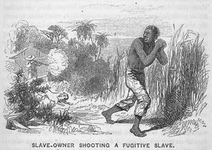
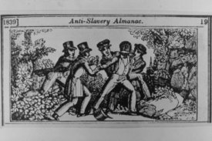
SLAVE CODES
-Slave codes were laws that were passed in states in the South. The laws tried to keep slaves from running away or fighting back. Each state had different laws. But all of the laws had parts that were the same.

Slide 2

JOHN BROWN
John Brown
(1800 - 1859)
a militant abolitionist, a "conductor" on the Underground Railroad, the organizer of a self-protection league for free blacks and fugitive slaves.

Slide 3

SECTIONALISM
Is to develop a distinct identity based on ethnicity, color, customs, laws, language, economics, or culture.

Slide 4
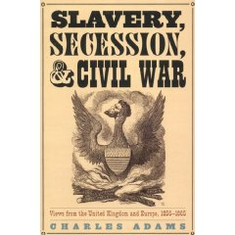
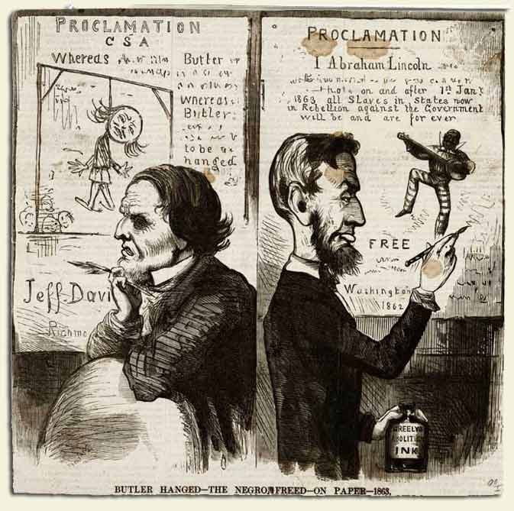
SECESSION (SECEDE)
-Secession of the South- To leave or separate from an organization or union.
-When Lincoln is elected in 1860 South Carolina decides to lead the secession of southern states.

Slide 5
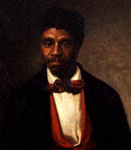
DRED SCOTT
Dred Scott first went to trial to sue for his freedom in 1847
He was not awarded freedom
The court also ruled that the federal government did not have the power to prohibit slavery in its territories.

Slide 6
BLEEDING KANSAS
a. People vote on slavery or not
b. ‘Bleeding’ Kansas (Mini-Civil War)
-Southerners fight ‘Free’ settlers
c. More free people move in, but president accepts ‘Slave’ constitution

Slide 7
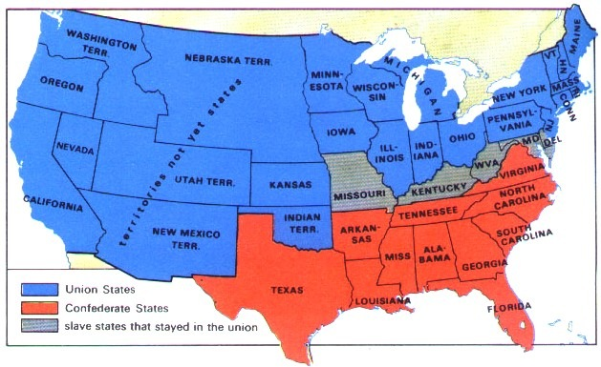
BORDER STATES
Slave states that did not join the rest in leaving the Union:
Delaware, Kentucky, Missouri and Maryland

Slide 8
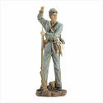
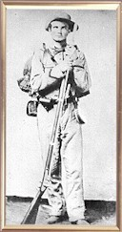
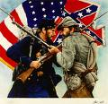
CONFEDERATE/REBELS
The average Confederate soldier was a young man in his early 20s, unshaven, unkempt, gaunt, but tough from months of difficult living.
The Rebel soldier's woolen hat and uniform was grey, ragged form either having been worn too long, or having been "handed down" from a dead soldier.

Slide 9

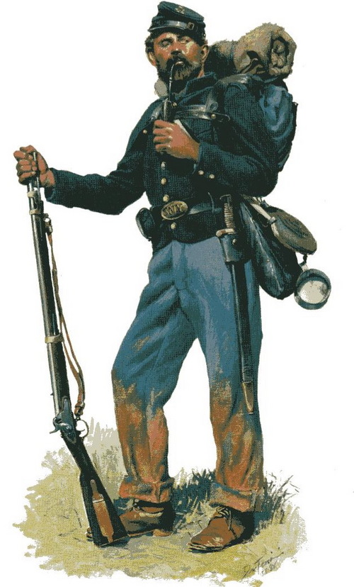
THE UNION/YANKEES
The Union soldier was typically a man in his early 20s.
In most cases, he was a farmer who had either enlisted to fight a war which he thought wouldn't last more than a few months, or near the peak of the Civil War, someone who had been drafted.

Slide 10
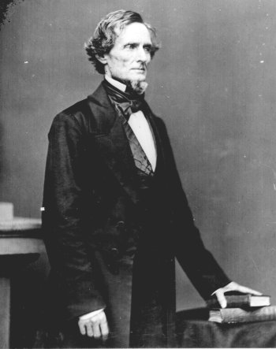
JEFFERSON DAVIS
President of the Confederate States of America
elected for a 6-year term and was inaugurated in Richmond, Virginia, the capital of the Confederacy, on February 22, 1862.

Slide 11
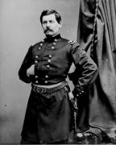
GEORGE B. McCLELLAN
"The Young Napoleon”
His engineering and organizational skills shined bright in the creation of the Army of the Potomac, a mighty machine.

Slide 12
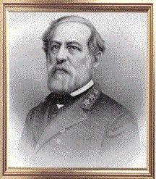
ROBERT E. LEE
Rejected the command of the Union's field forces on the day after Virginia seceded.
The idol of the South to this day
Retreated to Appomattox, where he was forced to surrender.

Slide 13
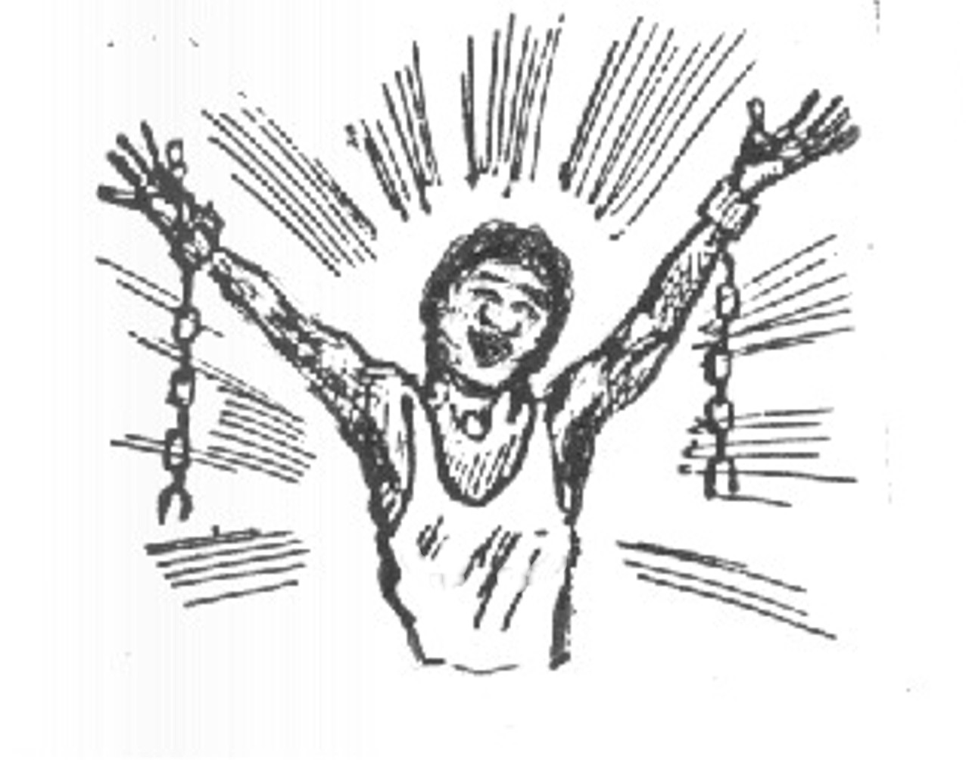

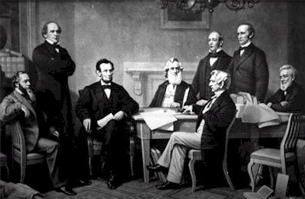
Emancipation Proclamation
President Lincoln’s order to free the Confederate Slaves; became effective January 1st, 1863

Slide 14
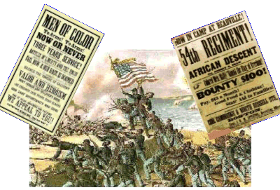
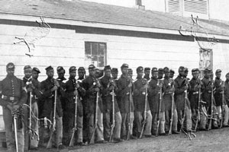
Massachusetts 54th
An infantry regiment composed mostly of African-Americans that captured Fort Wagner in South Carolina

Slide 15
BLACK CODES
Laws passed on the state and local level mainly in the rural Southern states in the United States to limit the civil rights and civil liberties of African Americans.
Laws such as African Americans forced into unfair labor contracts, second class civil rights.

Slide 16

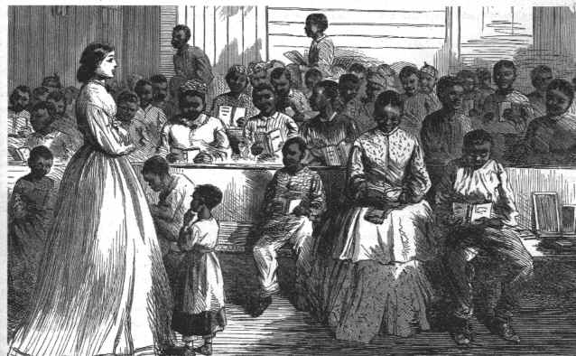
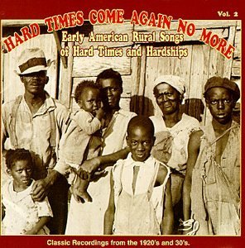
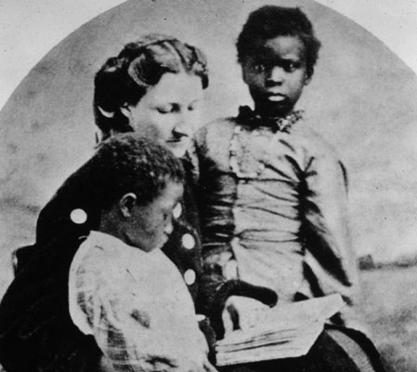
Freedmen's Bureau
An agency established by Congress in 1865 to help poor people throughout the south.
*Helped to provide education, food and legal help for former slaves in the south

Slide 17

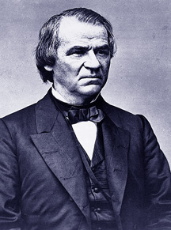


Amnesty
Process of restoring those who may have been guilty of an offense to the position of being INNOCENT
*Used by President Andrew Johnson when he pardoned more than 7,000 people after the Civil War

Slide 18
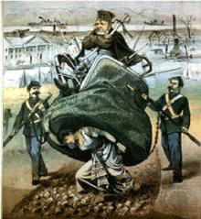

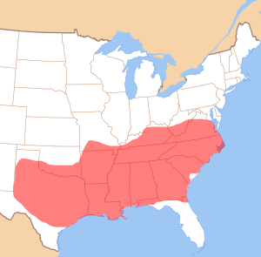
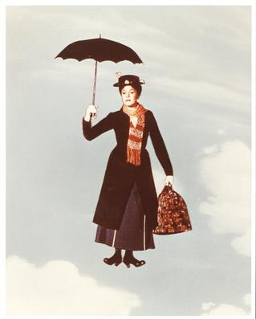


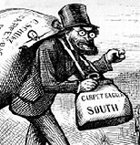
Carpetbaggers
Carpetbaggers: Northerners accused of profiting off of the south. Supposedly were in such a hurry to get there they threw all of their possessions in a carpet bag
Scalawags
White Southern Republicans who were called ‘greedy rascals’ by Southern Democrats who felt they betrayed the south by voting for the Republican Party

Slide 19
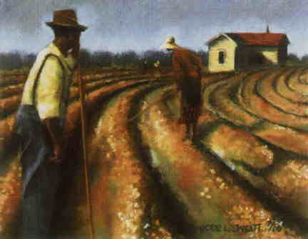
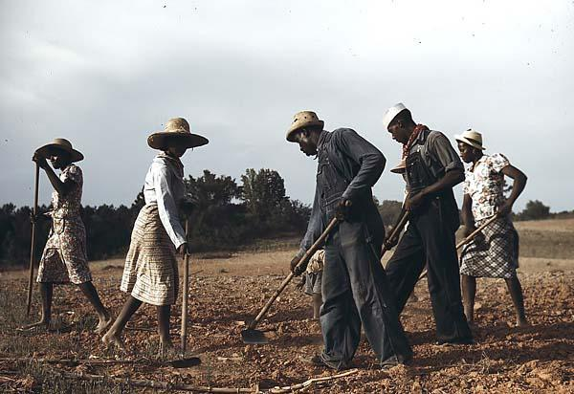
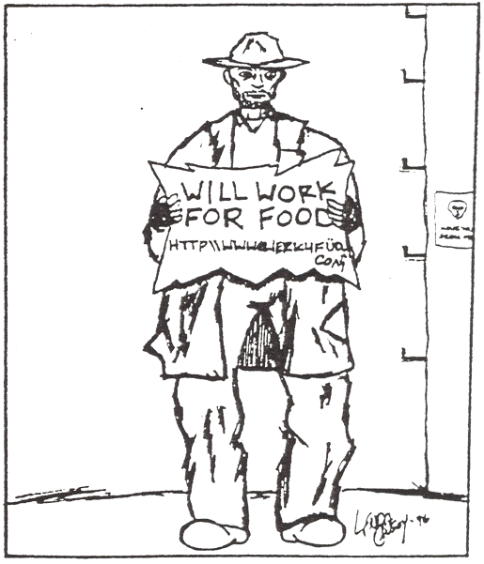

Sharecroppers
A system used on southern farms after the civil war in which farmers worked land owned by someone else in return for a small portion of the crops

Slide 20
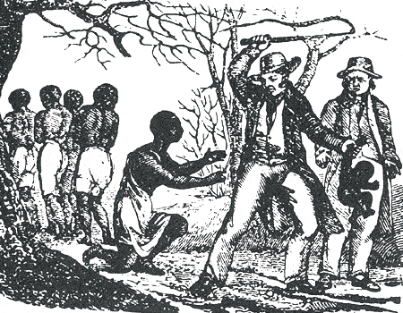

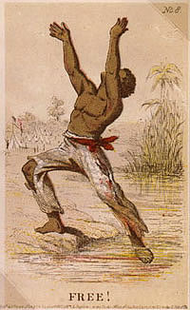
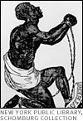
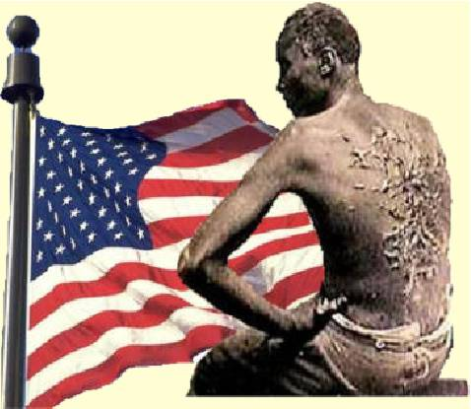
13th Amendment
Amendment ratified on January 31st, 1865
  Officially banned slavery in the United States

Slide 21
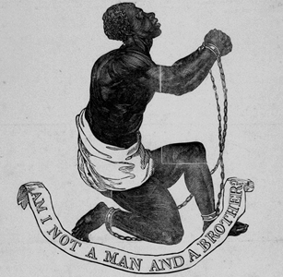
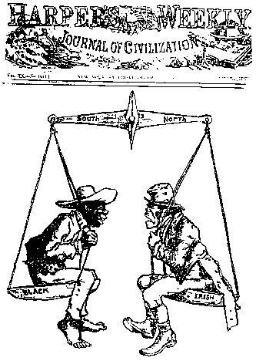
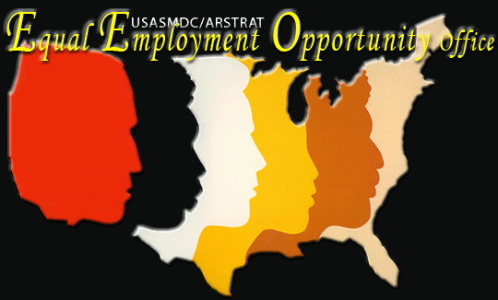
14th Amendment
Equal rights amendment; said that ALL people born or naturalized within the United States (except for NATIVE AMERICANS) were citizens
Also guaranteed the citizens ‘equal protection of the laws.’
*ratified July, 9th 1868

Slide 22

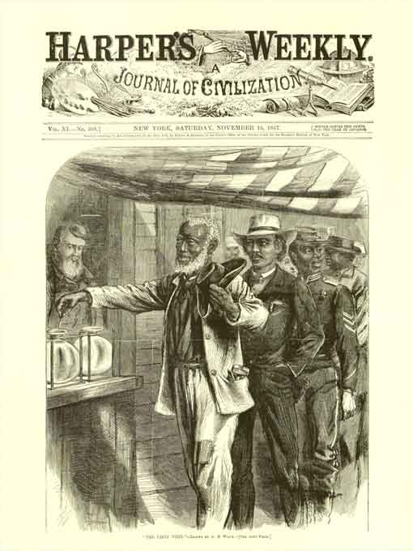


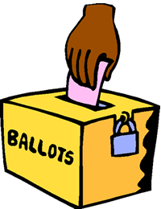
15th Amendment
Women
Gave African-American MEN the right to
vote, went into effect in 1870

