Slide 1
Quiz Taking Policy
1. You must use a pen or pencil to take the quiz.
2. You must grade your quiz with a writing instrument other than you
used to take the quiz.
3. You must circle only correct answers.
4. You must mark and circle the total of your correct answers at the top of
your quiz.
5. All of your scoring marks (correct answer & total grade) must be made
with the same writing instrument. If you take and grade your quiz with
the same writing instrument, you are in violation of the quiz policy and
will receive a zero score.
6. Quizzes which are not properly marked will be “Dead-filed”.
7. You have the number of days absent, plus one to see me about making
up a quiz due to an absence. If you miss this deadline, your score will
be a zero.

Slide 2
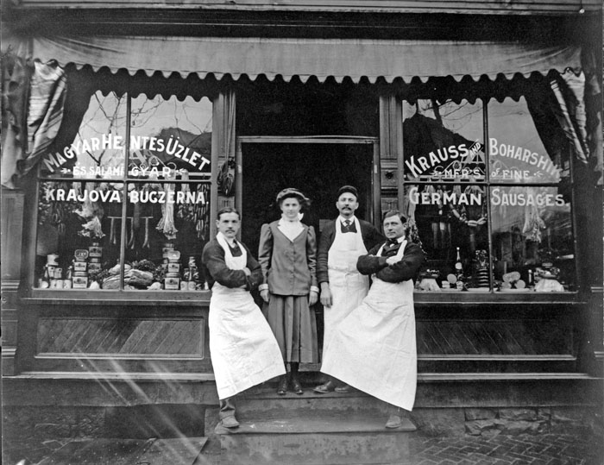
An Era of Immigration
NOTE QUIZZES

Slide 3
Immigration Note Qz. #1
1. What is the difference between an emigrant and an immigrant?
2. Between 1880-1890, from what parts of the world did most immigrants to the U. S. come?
3. What was the effect of this migration on American cities?
4. Name one problem created in the cities because of immigration.
5. Before 1865, most immigrants to the U.S. came from which one of three countries or areas. Name one.
6. Name one thing that made it easier for immigrants to “get along” with Americans.
7. What does the acronym “W.A.S.P.” mean?
8. What does the word “assimilate” mean?

Slide 4
Immigration Note Qz. #1 KEY
1. emigrant travels to another country or area – immigrant lives in a new country
2. Southern and Eastern Europe
3. massive urban growth/new technologies/ a new urban culture
4. Overcrowded tenements/ unsanitary conditions/opposition
from some Americans
5. Great Britain (England or Ireland), Germany, Scandinavia
6. education, a skill or trade, could speak English
7. “White Anglo Saxon Protestant”
8. to blend in / get along with the majority

Slide 5
Immigration Note Qz. #2
(2 points each)
1. Name the regions from which the “new” immigrants came after 1865.
2. Explain why religion caused a problem for these new people to assimilate
into American society.
3. Explain one reason why Europeans were “forced” to emigrate.
4./5. Name two attributes that made America attractive to immigrants.
6. By 1900, the average time for the ocean voyage to America was ______.
7. The many poor immigrants could only afford the cheapest third-class ticket
which was given the nickname of _________.
8. /9. What are the names and locations of America’s two immigration ports?
(1 point per each of four answers)
10. What “tool” did immigration inspectors use to look for the disease called
trachoma?
11. What percentage of immigrants were turned away from entering the U.S.?

Slide 6
Immigration Note Qz. #2 KEY
2 points each
1. Southern & Eastern Europe (Italy, Greece, Russia, Poland)
2. Immigrant Catholics & Jews didn’t fit in with Protestant Americans
3.
1. room to grow, opportunities, stable government, welcoming attitude
2. large ocean liners
3. steerage
4. Ellis Island (East Coast or NY) and Angel Island (West Coast or SF)
5. button hook
6. 2%
7. 8. They were not Protestants, like most Americans.

Slide 7
Immigration Note Qz. #3
3 points each answer
1. Give a reason to explain why many immigrants were
“trapped” in the city.
2. Give two examples of what it was like to work in a sweatshop.
3. Give the name of an ethnic neighborhood in New York City.

Slide 8
Immigration Note Qz. #3 KEY
3 points each answer
1. Little or no skills or no money
2. long hours, low pay, difficult work, dangerous work, cramped,
hot, unsafe, no protection against employer abuse
3. Little Italy, Little Warsaw, Chinatown, etc.

Slide 9
Immigration Note Qz. #4
3 points each answer
1. In speaking about immigration, what is the idea behind the
term “melting pot”?
2. What was the name of the area in lower Manhattan that
could be described as the “original American Melting Pot”?
3. Give two examples of the conditions that existed in this area.

Slide 10
Immigration Note Qz. #4
3 points each answer
1. all the different ethnic groups could blend their cultures
together
2. “Five Points”
3. crowded with many ethnic groups/breeding ground for disease,
infant & child mortality, unemployment, prostitution & violent
crime, numerous gangs roamed the area

Slide 11
Immigration Note Qz. #5
2 points each answer
1. Give two ways in which immigrants were “forced “ to assimilate.
2. Protecting interests of native-born or established inhabitants against those of immigrants is called “_______.”
3. Explain the “Chinese Exclusion Act”.
4. What term is used to describe the mass movement of people to the city?
5. Give two reasons to explain the Afr. American migration to the cities.
6. What is the difference between an immigrant and an emigrant?
7. What is a tenement?
8. Describe two conditions in a tenement. (“overcrowded” is not an answer)
9. Name two possible effects of living in tenement housing.

Slide 12
Immigration Note Qz. #5 KEY
2 points each answer
1. learn English; dress in American clothing; go to Amer. school
2. nativism
3. stopped Chinese immigration to U.S. for ten years
4. urbanization
5. loss of jobs to machinery/ escape “Jim Crow Laws”
6. emigrant travels to another land– immigrant lives in a new country
7. apartment buildings with small rooms with many people living there
8. unsafe buildings/ unsanitary conditions /scarce running water / poor
ventilation
9. diseases, high child death rates, fire, crime

Slide 13
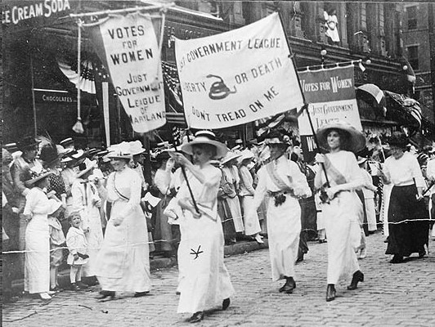
An Era of Progressive Reform
NOTE QUIZZES

Slide 14
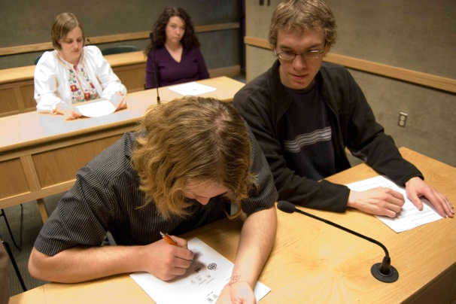
Progressive Era Note Quiz #1
Cheaters…
are lazy.
have no honor or self respect.
will probably always be cheaters.
don’t make good friends because they are not trustworthy.

Slide 15
Progressive Era Note Qz. #1
1.-2. Progressivism is the idea that _________, political and ________ reforms would improve the lives of people.
3. What was the name given to journalists who exposed social injustice
in America during this time period?
Match the subject to the reformer:
4. ___ Nellie Bly a. corrupt city government
5. ___ Ida Tarbell b. abusive monopolies
6. ___ Lincoln Steffens c. unsanitary meat- packing industry
7. ___ Jacob Riis d. poor treatment of the insane
8. ___ Upton Sinclair e. police corruption & unsafe living conditions
among the poor in New York City
9.-10. Give two of the “targets” of Progressive Reformers.
11. Give an example of political corruption during the Progressive Era.

Slide 16
Progressive Era Note Qz. #1 KEY
1.-2. social, economic
3. Muckrakers
4. d
5. b
6. a
7. e
8. c
9. - 10. government, business, social inequality, public well-being
11. took/gave bribes, Patronage/Spoils System, “fixed” elections

Slide 17
Progressive Era Note Qz. #2
1. President Theodore Roosevelt earned the name of “The _____ ______.
2. Roosevelt’s policy offered citizens a “_______ Deal”
3. “Laissez Faire” means __________________________________.
4.- 5. In what two ways was the Sherman Anti-Trust Act used?
6. Which act or law prohibits the sale of contaminated food and drugs?
7. T or F: Child Labor acts were passed by the Federal government before cities and states became involved.
8. Which agency or part of the government was created to preserve America’s natural resources?
9.-10. What were two reasons why child labor laws were not very successful?
11. What disastrous fire in New York City brought about calls for new workplace and safety standards?
12. Name two other ways that cities made improvements for people?

Slide 18
Progressive Era Note Qz. #2 KEY
1. “Trust Buster”
2. square
3. Government doesn’t interfere with business.
4.- 5. breaking up monopolies, regulation of business practices
6. Pure Food and Drug Act
7. False
8. U.S. Forest Service
9.-10. laws not effective/laws not enforced/ economic stress kept children
in the workplace/ children lied about their age to support family
income
11. Triangle Shirtwaist Factory Fire (“Triangle Fire”)
12. safer building codes/improve housing & education/ create public
parks/ proper waste disposal/purifying water supplies

Slide 19
Progressive Era Note Qz. #3
____1.primary election a. public can put issues on the ballot
____2. initiative b. the right of voters to approve or reject a law
____3. referendum c. voters nominate candidates
____4. recall d. voters can remove elected officials
5. What does the word “nominate” mean?
6. How did the 15th Amendment fail to be fair to all people?
7. The women at the Seneca Falls Convention used which famous
document as a model for stating their beliefs?
8. What does the word “suffrage” mean?
9. Which section of the U.S. lead the fight for women’s rights?
10. Which amendment gave women the right to vote?

Slide 20
Progressive Era Note Qz. #3 KEY
____1.primary election a. public can put issues on the ballot
____2. initiative b. the right of voters to approve or reject a law
____3. referendum c. voters nominate candidates
____4. recall d. voters can remove elected officials
5. What does the word “nominate” mean?
6. How did the 15th Amendment fail to be fair to all people?
7. The women at the Seneca Falls Convention used which famous
document as a model for stating their beliefs?
8. What does the word “suffrage” mean?
9. Which section of the U.S. lead the fight for women’s rights?
10. Which amendment gave women the right to vote?
c.
a.
b.
d.
to suggest the name of a candidate
only men could vote
Declaration of Independence
the right to vote
The West
19th

Slide 21
Progressive Era Note Qz. #4
1.-3. In 1889 Jane ______ and Ellen Gates ______ opened a place called
“______ House” in Chicago.
4. This and other places like it were called “__________ Houses”.
5. Give one purpose for such places.
6.-7. Give two names given to the movement to limit the use of alcohol.
8. One might say that Carrie Nation did her talking with a “_________”!
9.-10. Name two things the 18th Amendment made illegal.
11. What was the purpose of the 21st Amendment?
12. W.E.B. DuBois founded an organization known by what acronym (initials)?
13. Name one reason how this organization benefits society.
Bonus: What is the name given to the peaceful refusal to obey a law?

Slide 22
Progressive Era Note Qz. #4 KEY
1.-3. In 1889 Jane Addams and Ellen Gates Starr opened a place called
“Hull House” in Chicago.
4. This and other places like it were called “Settlement Houses”.
5. Give one purpose for such places. gave help to the poor/day-care/ educational
programs
6.-7. Give two names given to the movement to limit the use of alcohol.
Prohibition/Temperance
8. One might say that Carrie Nation did her talking with a “hatchet or ax”!
9.-10. Name two things the 18th Amendment made illegal.
manufacture, transportation, possession of alcohol
11. What was the purpose of the 21st Amendment? Repeal the 18th Amend.
12. W.E.B. DuBois founded an organization known by what acronym (initials)?
NAACP
13. Name one reason how this organization benefits society.
fights discrimination/provides free legal aid/promotes equality
Bonus: What is the name given to the peaceful refusal to obey a law?
“Civil Disobedience”

