Slide 1
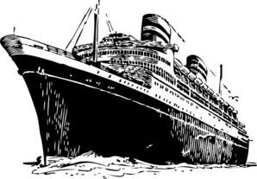
An Era of Immigration and Progressive Reform

Slide 2
emigrant vs. immigrant
An emigrant is someone who is in the process of moving from one area in order to live in another place.
An immigrant is a person who once lived in one country and is now settled and living in another country.

Slide 3
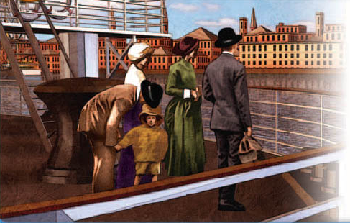
IMMIGRATION
CAUSE & EFFECT 1880 -1910
PEOPLE ARRIVED
New immigrants, mostly from southern and eastern Europe
Came for new opportunities and better lives
Mostly found jobs in cities
CITIES GREW
Massive urban growth
New technologies (skyscrapers & mass transit)
New urban culture
PROBLEMS DEVELOPED
Overcrowded tenements
Unsanitary conditions
Faced opposition from some Americans
SHALL WE GO OVER SOME OF MEANINGS OF THESE WORDS?

Slide 4
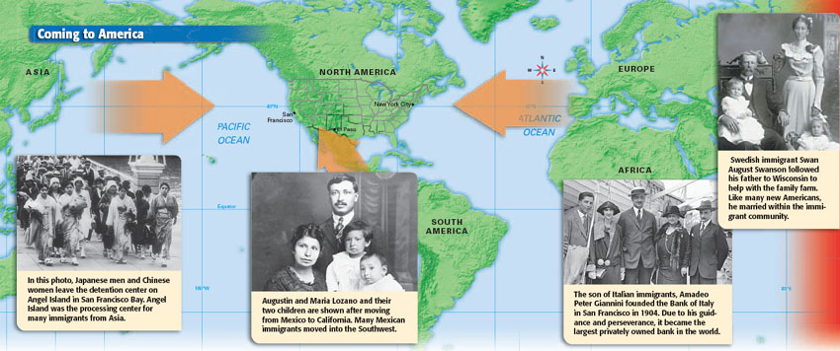

Slide 5
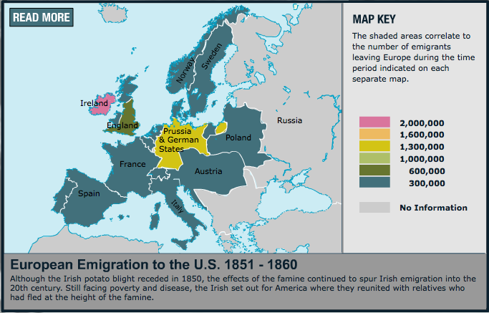
I. Immigration
A. Before 1865
1. Northern and Western Europe immigration
a. Great Britain, Germany, Scandinavia

Slide 6
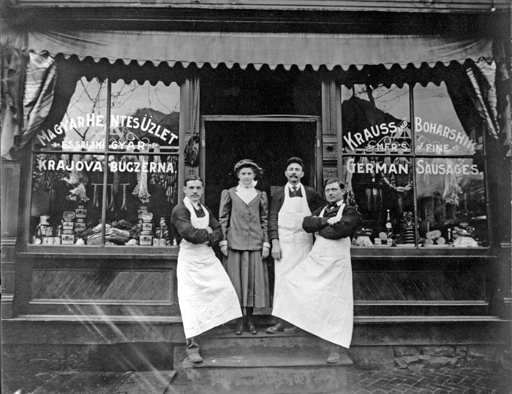
2. Better educated
a. most had a skill or trade
i. bookkeeper, carpenter, butcher, etc.
b. many spoke English
i. easier to “assimilate” (blend in or get along with majority)
c. many Protestants (WASP) & many Irish Catholics
i. White Anglo-Saxon Protestants
ii. Irish had an historical hatred of British as cruel landlords
iii. Irish often portrayed as drunkards and trouble-makers

Slide 7
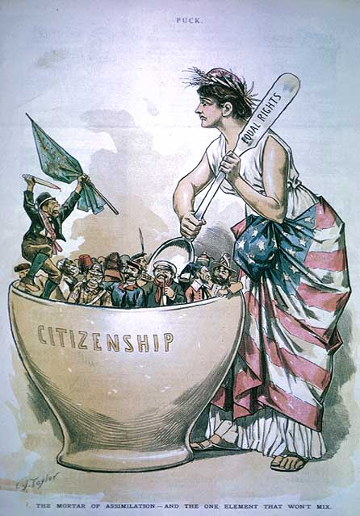
Can you interpret this cartoon?

Slide 8
It’s time to CLOSE YOUR NOTES and put your heads together to answer a few questions.
Without moving seats, please get into groups of 3 to 4. Without using your notes, answer the questions on the next slide as quickly as you can on a sheet of lined paper, to be turned in at the end of class.
(Names not necessary!)

Slide 9
1. Between 1880-1890, from what part of the world did most immigrants to the U. S. come?
2. What was the effect of this migration on American cities?
3. What problems were created in the cities because of this immigration?
4. Before 1865, people from what parts of the world first immigrated to the U.S.?
a. What made it easier for these immigrants to “get along”
with those who already lived in the U.S.?
b. Describe the negative feelings between the two groups
of immigrants from Great Britain.
5. What does the acronym “W.A.S.P.” mean?
6. What does the word “assimilate” mean?
Southern and Eastern Europe
urban growth, new technologies, new urban culture
overcrowded tenements, unsanitary conditions, opposition from Americans
Great Britain, Germany, Scandinavia
education, had a skill or trade, spoke English
Irish and English did not get along
White, Anglo-Saxon, Protestant
To blend in with or be absorbed into a larger society
Prepare for Note Qz. #1

Slide 10
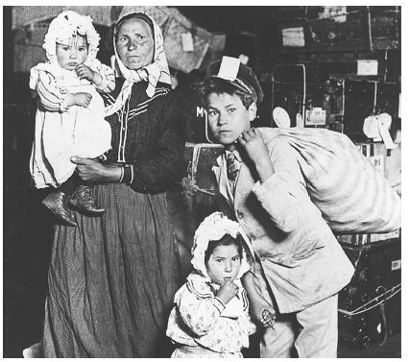
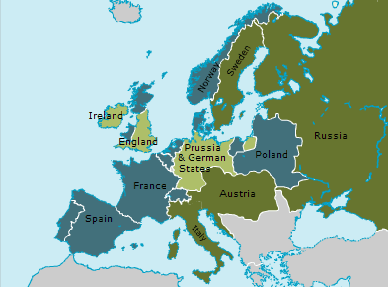
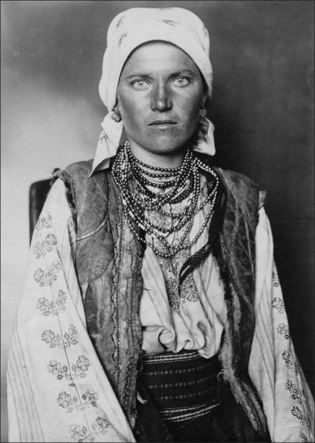
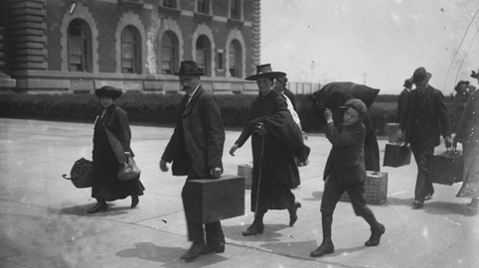
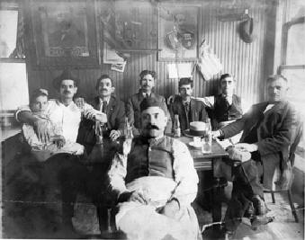
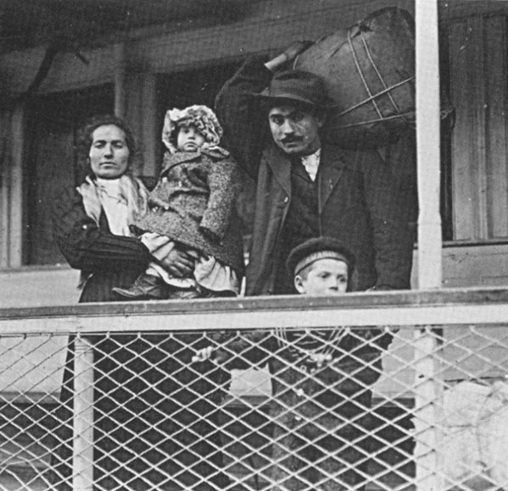
B. After 1865 – “new” immigrants arrived
1. Southern & Eastern Europe
a. Italians, Greeks, Russians, Polish

Slide 11
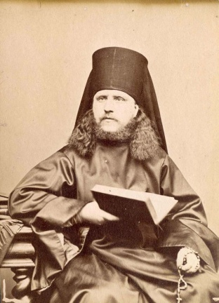
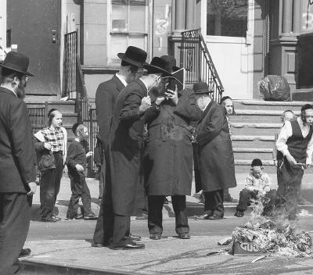
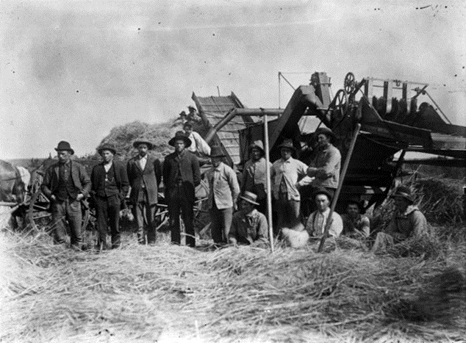
2. Difficult to assimilate
a. Language
i. little or no English
b. Religion
i. Catholic, Jewish, Eastern Orthodox
ii. Conflicted with “mainstream” American
Protestant beliefs!
c. unskilled laborers (mostly farmers)

Slide 12
By how much did the percentage of immigrants from northern and western Europe change from 1840 to 1900?

Slide 13
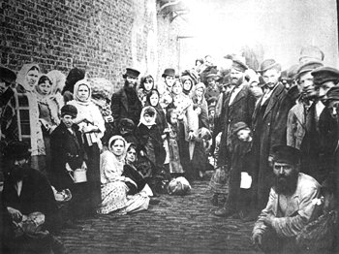
C. Why Emigrate?
1. Religious persecution
a. Russian“pogroms”
i. violent riots against Jews
ii. killings, destruction of homes, properties, businesses
and synagogues (religious centers)
Russian Jewish refugees in Liverpool, England

Slide 14
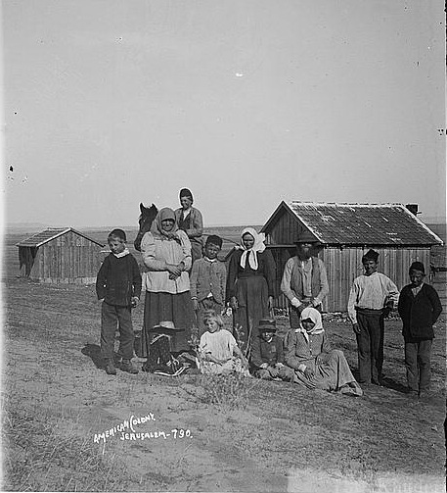
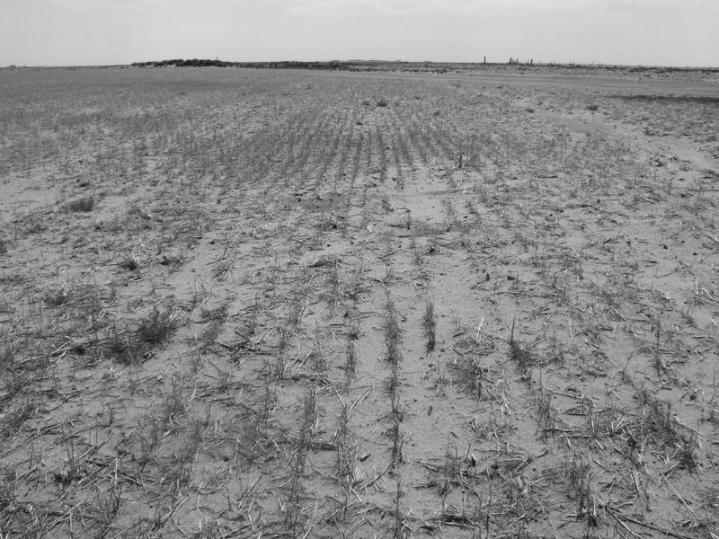
2. Economic problems
3. Crop failures/famines

Slide 15
D. Why Go to America?
1. room to grow and opportunities
2. many opportunities for success
2. stable government
3. officially welcomes immigrants

Slide 16
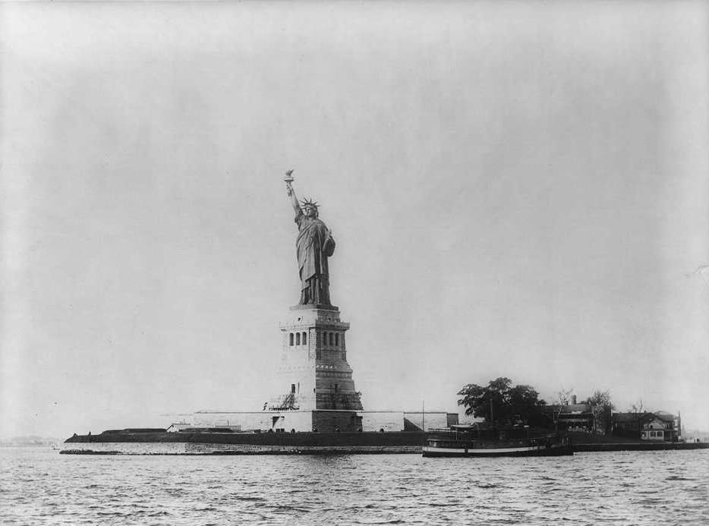

Slide 17
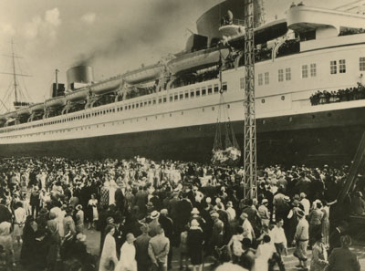
E. The Passage
1. Large ocean liners took most of the immigrants to
America
North German Lloyd Company’s steamship Lahn

Slide 18
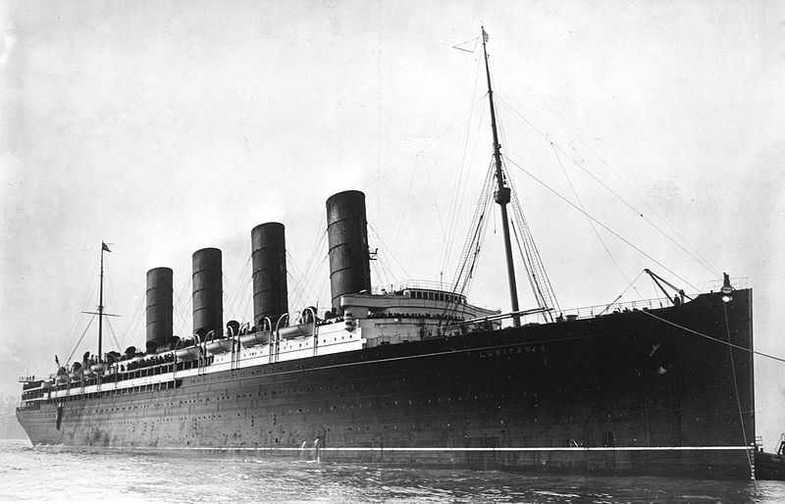
British Cunard Line steamship, “The Lusitania”

Slide 19
How much was a first-class ticket across the Atlantic?
1. In 1910, an average first-class ticket cost between $70 and
$125
a. In 1910, the average person made $20 a week.
b. A $125 ticket in today’s money is about $2,960.
c. The faster the ship, the more expensive the ticket.
d. The better the accommodations, the more expensive the ticket
i. the lower in the ship your were, the less you paid.
ii. luxury suites cost even more.
2. Travel time?
a. By 1900, the trip across the Atlantic took an average of
one week.

Slide 20
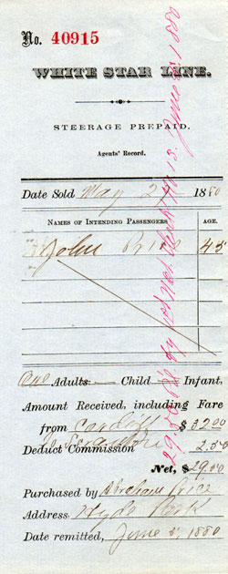
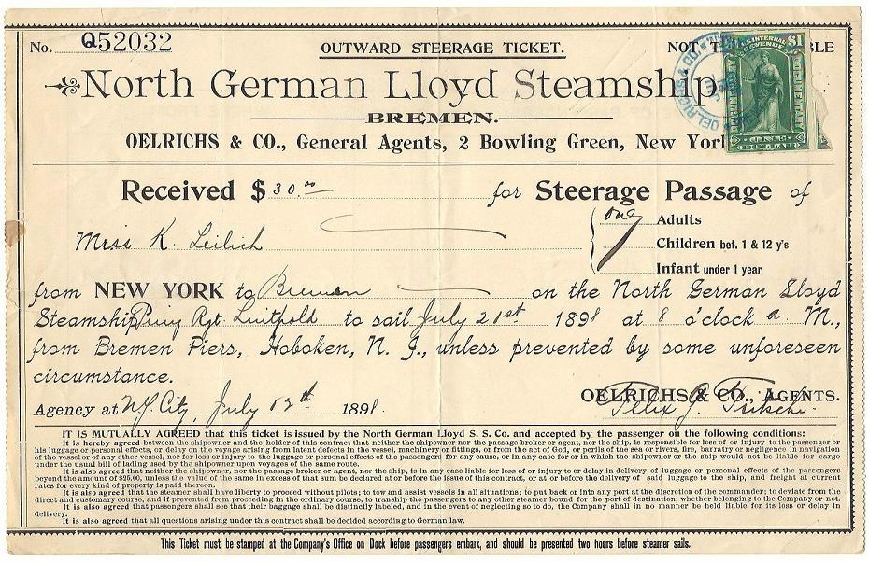
2. Most immigrants could only afford the cheapest ticket.
a. Third-Class (Steerage)
i. One-half as much as a second class ticket
ii. “steerage” = level of the ship where
rudder controls ran

Slide 21
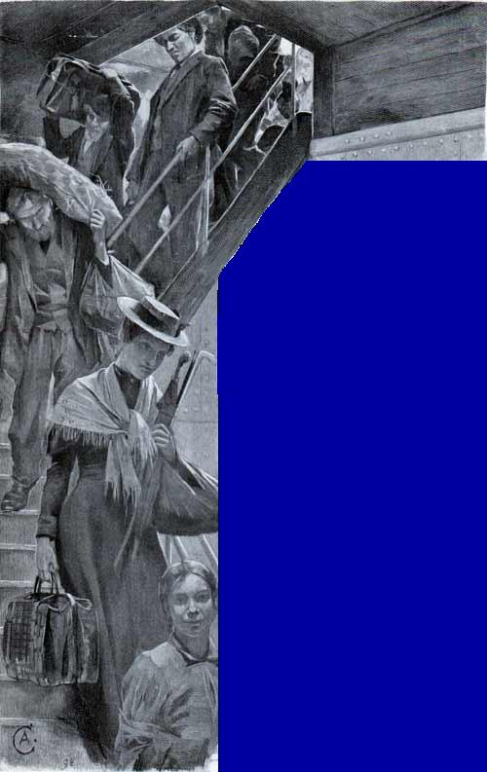
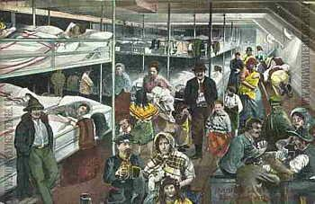
iii. basic amenities: limited toilet use, no privacy,
poor food.
iv. last to leave in an emergency

Slide 22
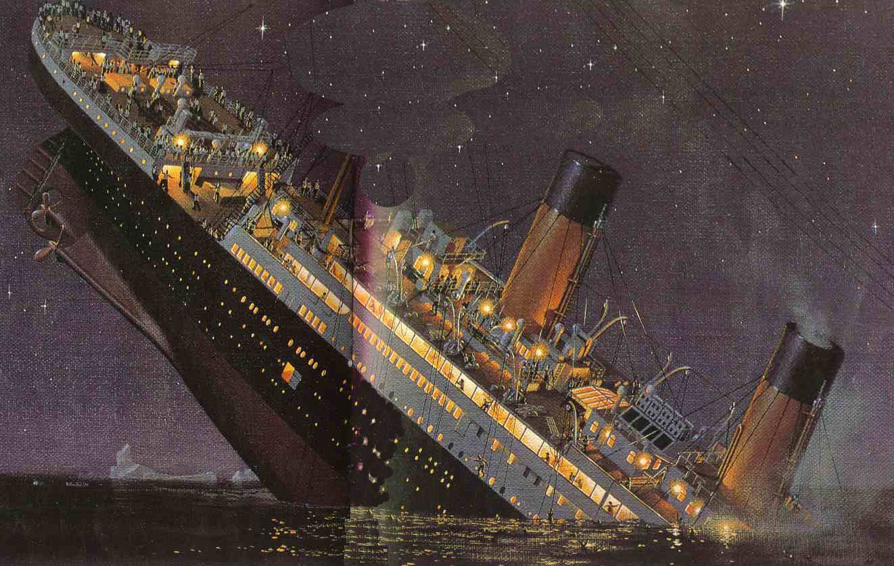
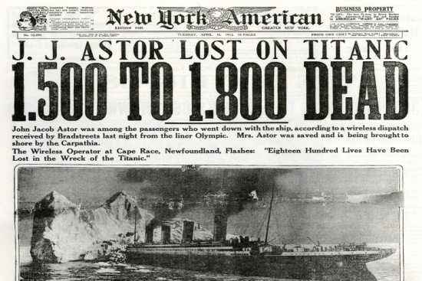

Slide 23
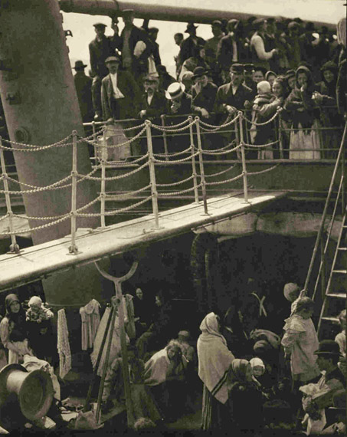
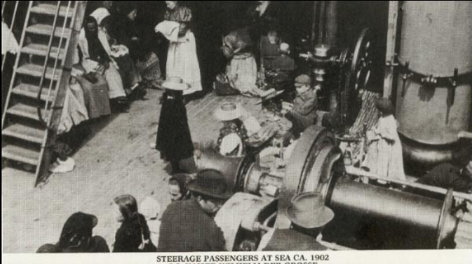
Steerage passengers loading last…
http://teacher.scholastic.com/activities/immigration/tour/index.htm

Slide 24
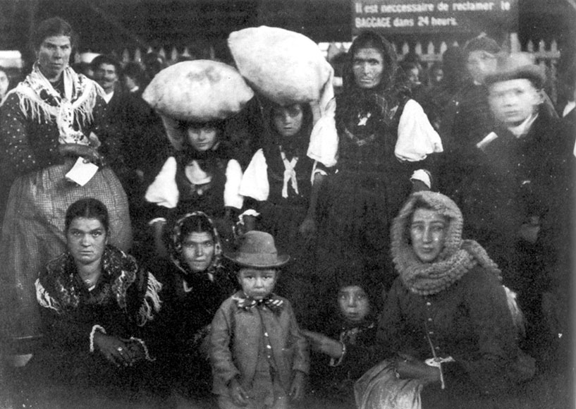
F. Ports of Entry
1. From Europe – Ellis Island, NY
a. years of operation: 1892-1954
i. 25 million immigrants processed
ii. OVER THE YEARS, ONLY 2% WERE DENIED ENTRY INTO THE U.S.

Slide 25
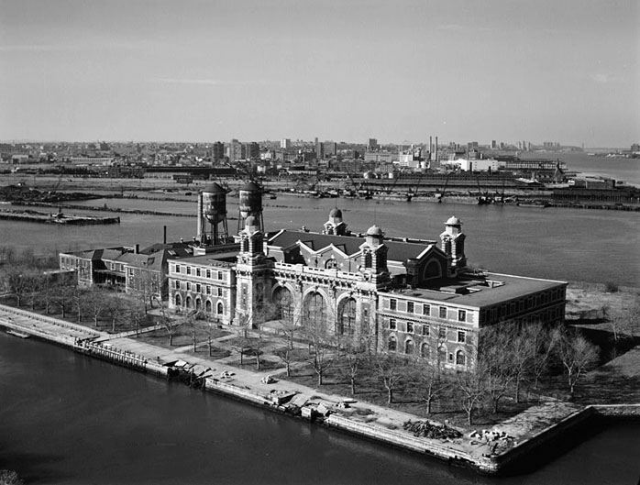
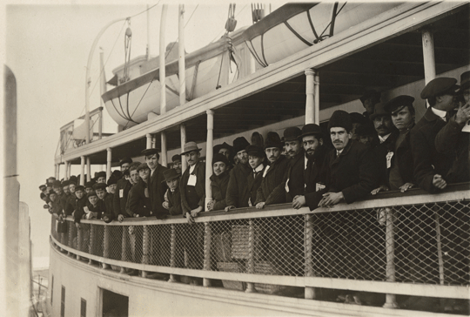
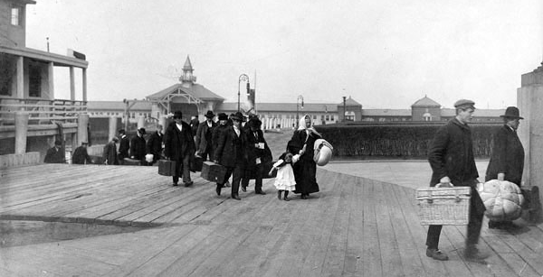
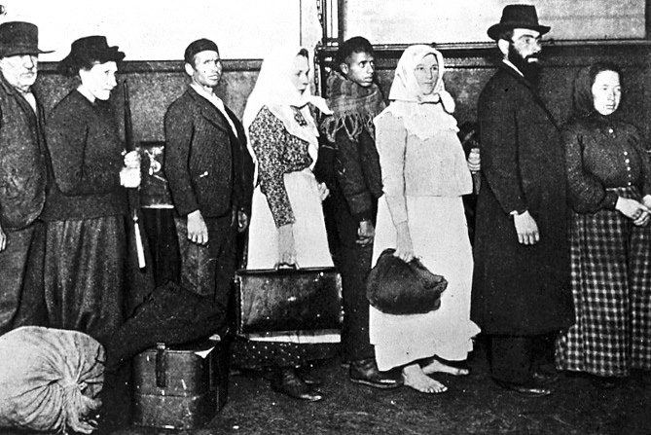
Ellis Island
Opened in 1892 to process the growing numbers of immigrants to America

Slide 26
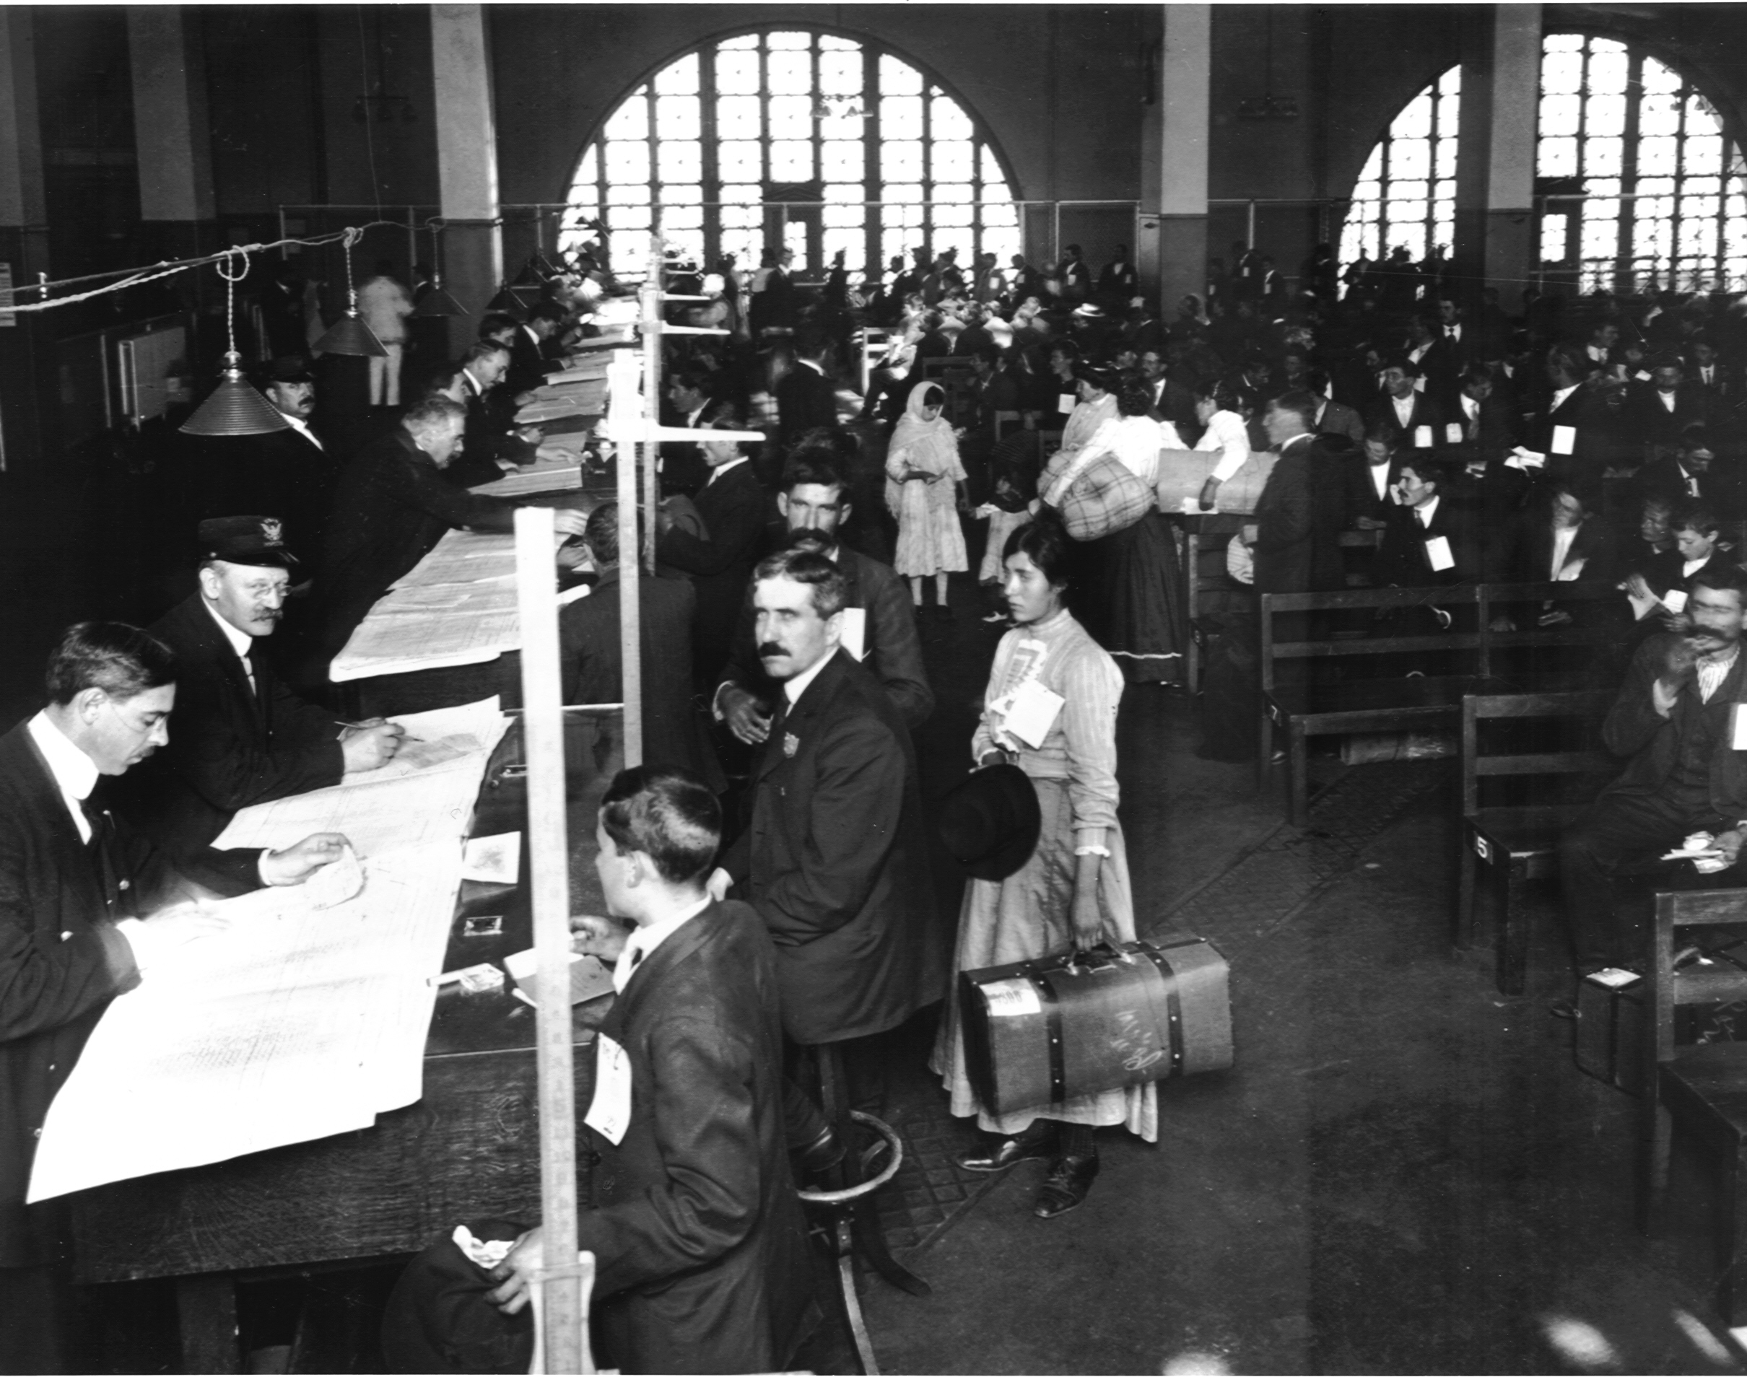
Ellis Island Grand Hall
Waiting to register and hopefully receive the “ticket” to pass through “The Golden Door”.

Slide 27
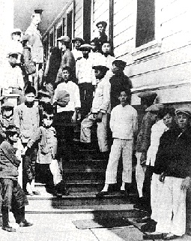
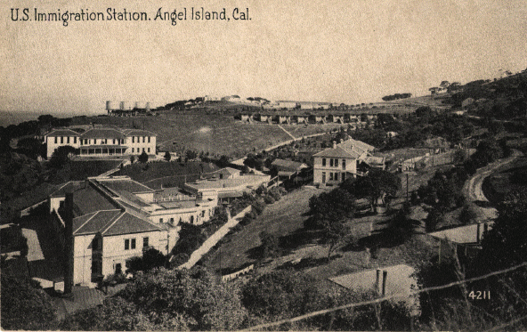
2. From Asia – Angel Island, CA (S.F. Bay)
a. years of operation: 1910-1940
i. 165,000 immigrants processed

Slide 28
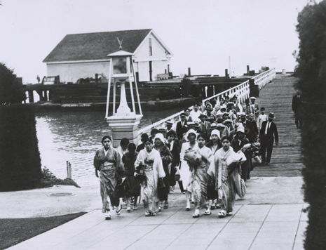
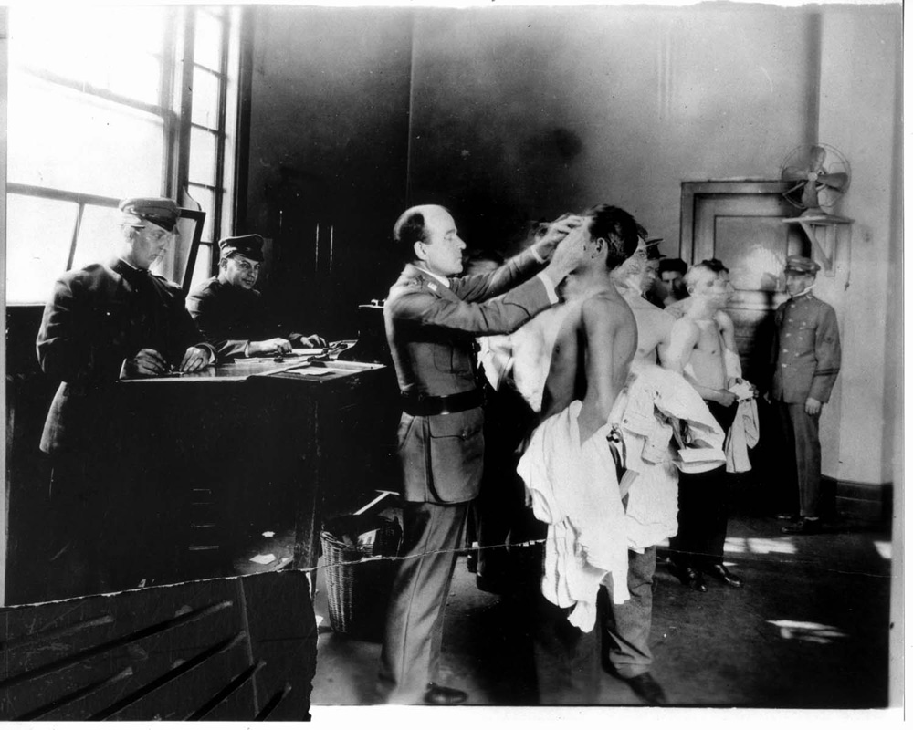
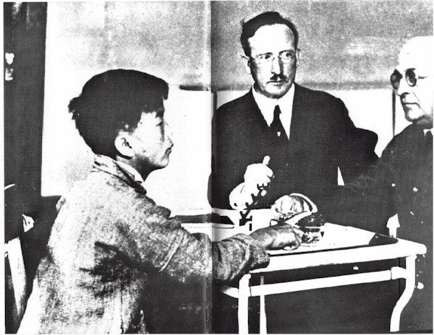
Angel Island Immigrants

Slide 29
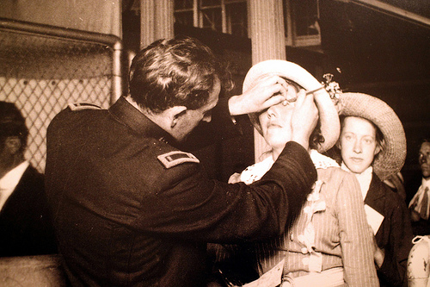
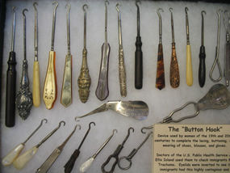
3. Processing Immigrants
a. interviews (background history– plans for future)
b. health exams (ex. “trachoma” – infectious eye disease)
“BUTTON HOOK INSPECTION” Immigrants were inspected for a variety of health problems. One such problem was trachoma, a very infectious disease that could cause blindness. A button -hook like instrument was used to pull up the eyelid for the inspection. Immigrants with diseases were kept on the island while being treated, but if they did not improve, they were not allowed into the country.

Slide 30
Immigrants who were suspected of having a health problem were marked for further inspection.
Prepare for Note Qz. #2

Slide 31
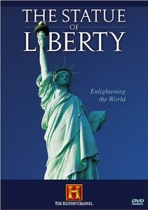
Film Clip:

Slide 32
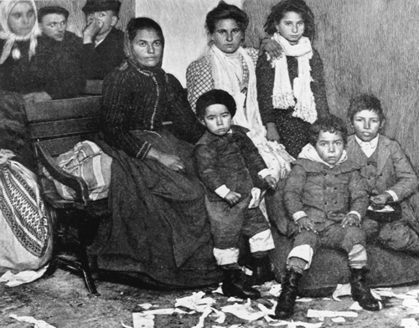
II. Immigrant Life in America
A. Trapped in the cities
1. little or no skills
2. no “sponsor”
a. someone who could give them employment and
help them get settled.
3. could not afford to move
B. “Sweatshops”
1. a shop or factory where employees work long hours
for small wages under unhealthy conditions

Slide 33
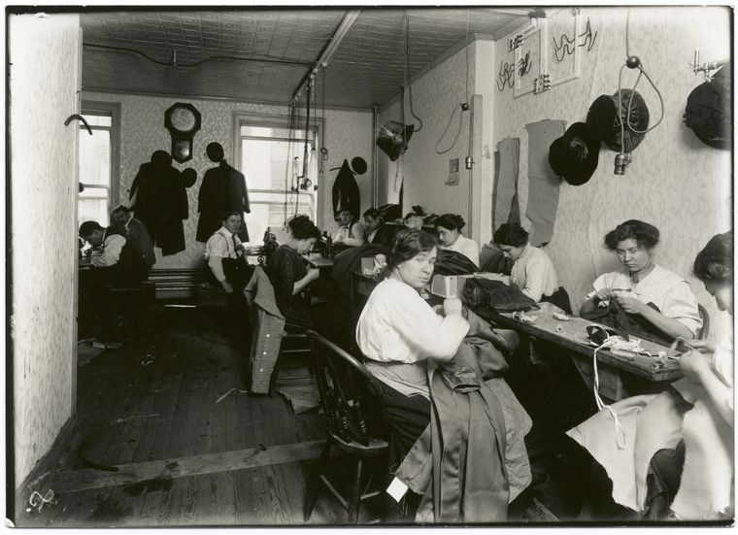
a. long hours for very low pay
b. very difficult and/or dangerous work
c. cramp, hot & unsafe work areas
d. no protection against employer abuse
e. involved children as young as 10 years old

Slide 34
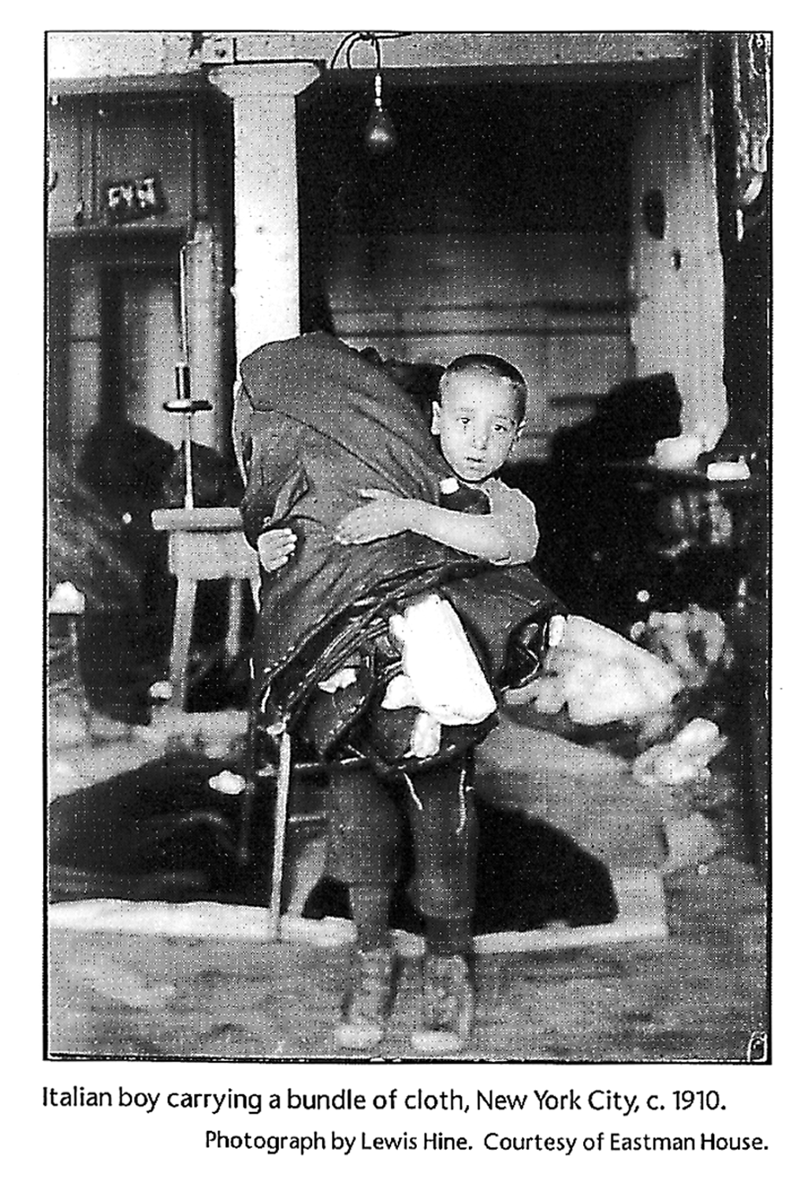
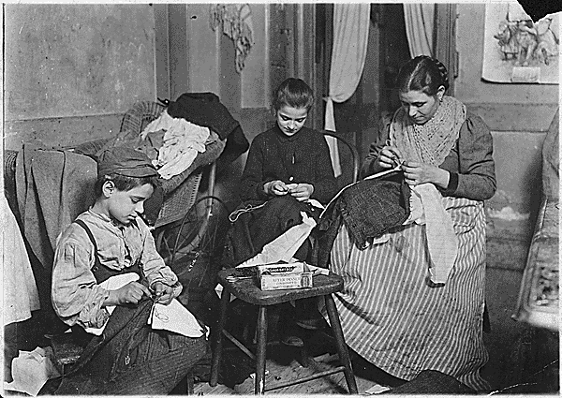
Necktie workshop in a Division St. tenement, NYC c. 1889 (Jacob Riis)
A tenement family taking in “piecework”
Italian boy carrying a bundle of cloth, NYC
c. 1910 (Lewis Hine)

Slide 35
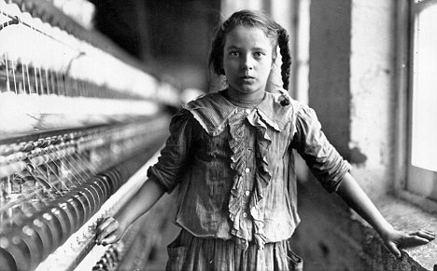
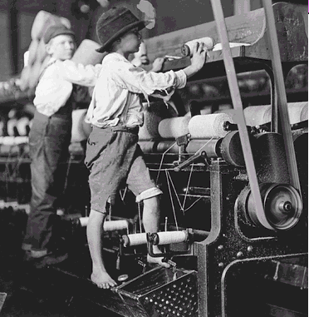
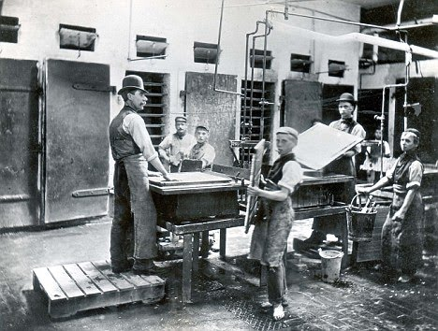
…forced into an adult world.

Slide 36
C. Settled in ethnic neighborhoods
1. Little Italy, Little Warsaw, Chinatown, etc.
“Mulberry Street, Little Italy” (NYC 1903)

Slide 37
“Little Italy” shoeshine boys c1900

Slide 38
Chinatown

Slide 39
2. “The Melting Pot” Theory
a. the idea that all immigrants
could be “blended” into a
common “American”culture.
Origin of the term:
The Melting Pot was a play by Israel Zangwill, first staged in 1908. It depicts the life of a Russian-Jewish immigrant family, the Quixanos. David Quixano has survived a pogrom, which killed his mother and sister, and he wishes to forget this horrible event. He composes an "American Symphony" and wants to look forward to a society free of ethnic divisions and hatred, rather than backward at his traumatic past.

Slide 40
3. “Five Points”
a. “The Original American Melting Pot”
i. central lower Manhattan in New York City
ii. crowded with many ethnic groups
iii. breeding ground for disease, infant & child mortality,
unemployment, prostitution & violent crime
iv. numerous gangs roamed the area
Mulberry Bend in Five Points c. 1880
c. 1827

Slide 41
Mullen’s Alley (February 12, 1888) “There were thousands of homeless children on the streets (of NYC), often abandoned by their parents… and in the summer months 3-4 babies would suffocate in the airless tenements every night.”
(Jacob Riis)

Slide 42
Five Points was dominated by rival gangs, dominated by Irish groups like the Roach Guards, Dead Rabbits, Bowery Boys and Kerryonians.
In the last 15 years before the filth-ridden, violent neighborhoods were demolished by New York officials, it was said that there was a murder every night .

Slide 43
The Kerryonians was made up exclusively of County Kerry (Ireland) ruffians.

Slide 44
This disturbingly violent film, made in 2002, received ten Academy Award nominations.
Prepare for Note Qz. #3-#4

Slide 45
D. Immigrants were forced to assimilate
1. children learn to speak English
2. wear American clothes
3. go to American schools

Slide 46
1902, New York City — A classroom full of children in the condemned Essex Market School. Note the open gas jets near the ceiling used for lighting. — Photo by Jacob Riis

Slide 48
E. Anti-Immigrant feelings
1. “Nativism”
a. “protecting interests of native-born or established
inhabitants against those of immigrants”
i. grew into a fear & distrust of immigrants

Slide 49
2. Congress Acts
a. Chinese Exclusion Act (1882)
i. no immigration from China for 10 yrs
ii. limits later extended until 1943!
iii. those who were legally here and left to visit China
became permanent “aliens”.
iv. a racist or an economic measure?
IF AMERICA HAD EXCLUDED ALL IMMIGRATION WOULD IT BE CONSIDERED A POLICY OF RACISM?

Slide 50
III. Urbanization (Moving to Cities)
A. Population explosion
1. Foreign immigration and American
migration
a. Many moving off the farms
i. droughts
ii. foreign competition
b. African Americans moving to
cities
i. escape “Jim Crow Laws” in the
South
ii. Many farm jobs lost to machinery
Hester Street, NYC (1899)
Rapid urban growth caused severe overcrowding in many American cities. New York’s Lower East Side became one of the most densely populated districts in the world.

Slide 51
PRIMARY SOURCE
Postcard - Chicago, 1900
Postcards like this one were one way people shared the experience of visiting or living in a big city like Chicago. This scene shows a bustling street corner at which modern transportation like streetcars mingle with horse-drawn carts.

Slide 52
B. Life in the Cities
1. immigrants and migrants very poor
2. filth, overcrowding, disease & poverty
a. most lived in slums
i. “slum” - from the Irish phrase 'S lom é, meaning
"it is a bleak or destitute place”

Slide 53
C. Tenement Life
1. tenements” – apartment buildings with small rooms with
many people living there.
a. unsafe buildings
b. unsanitary conditions
c. scarce running water
d. poor ventilation

Slide 55
2. Effects
a. diseases
i. tuberculosis – airborne transmitted disease-affects the lungs
ii. cholera & typhoid – consuming food or water contaminated by human waste
iii. influenza – a very infectious “flu”
b. high child death rates
c. fire
d. crime
Prepare for Note Qz. #5

Slide 56
An Era of Progressive Reform

Slide 57
V. Progressivism
A. the idea that social, political and economic reforms are
needed to improve the lives of people
B. “Progressives” worked to improve society in the late
1800’s - early 1900’s
C. Targets of Progressive Reform:
1. Government (all levels)
a. corrupt officials and practices
2. Business
a. monopolies
b. poor working conditions
i. long hours, low pay, unhealthy conditions, child
labor
3. Social Inequality
4. Public Well-being

Slide 58
VI. “Muckrakers”
A. late 19th-early 20th century journalists who
exposed society’s “ills”

Slide 59
1. Nellie Bly
a. undercover investigation of brutality & neglect
at Women’s Lunatic Asylum on Blackwell’s
Island (NYC)
i. convinced doctors that she was insane and
was committed
ii. published “Ten Days in a Mad House”

Slide 60
“The food consisted of gruel broth, spoiled beef, bread that was little more than dried dough, and dirty undrinkable water. The dangerous patients were tied together with ropes. The patients were made to sit for much of each day on hard benches with scant protection from the cold. Waste was all around the eating places. Rats crawled all around the hospital. The bathwater was frigid, and buckets of it were poured over their heads. The nurses were obnoxious and abusive, telling the patients to shut up, and beating them if they did not.”
iii. Grand Jury ordered more support funds
& more thorough exams

Slide 61
2. Ida Tarbell
a. targeted John D. Rockefeller & Standard Oil
i. dug into public documents across the country
ii. exposed Standard Oil's “strong-arm” tactics
against rivals
iii. helped to break up Standard Oil monopoly

Slide 62
3. Lincoln Steffens
a. exposed corruption in city governments
i. wrote newspaper series “ The Shame of
the Cities”

Slide 63
4. Jacob Riis
a. early photo-journalist
b. exposed NYC police corruption
c. exposed crime & living conditions in poor
NYC neighborhoods
i. wrote How the Other Half Lives

Slide 64
5. Upton Sinclair
a. exposed unsanitary meat-packing industry
i. wrote The Jungle
ii. caused public uproar

Slide 65
An excerpt from:
“There was never the least bit attention paid to what was cut up for sausage;
There would come all the way back from Europe old sausage that had been
rejected, and that was moldy and white – it would be dosed with borax and
glycerin, and dumped into the hoppers, and made over again for home consumption.
There would be meat that had tumbled out on the floor, in the
dirt and sawdust, where the workers had trampled and spit uncounted billions
of consumption germs.
There would be meat stored in great piles in rooms; and the water from leaky roofs would drip over it, and thousands of rats would race about on it.
It was too dark in these storage places to see well, but a man could run his hand over piles of meat and sweep off handfuls of the dried dung of rats.
These rats were nuisances, and the packers would put poisoned bread out for them; they would die, and then rats, bread and meat would go into the hoppers together…
There was no place for the men to wash their hands before they ate their dinner, and so they made a practice of washing them in the water that was to be ladled into the sausage."

Slide 66
ii. caused public uproar
iii. helped pass Pure Food and Drug Act
and Meat Inspection Act. (1906)
BEFORE:
AFTER:

Slide 67
VII. Political Corruption
A. Patronage
1. AKA “Spoils System”
2. jobs given to unqualified “friends”
B. “Political Machines”
1. gave/took bribes for political “favors”
2. used illegal means to elect candidates to office
a. “fixing” elections
3. William “Boss” Tweed (“Tweed Ring”) took control of N.Y.C.
government (1869)
a. embezzled millions from citizens of NY
Prepare for Note Qz. #1

Slide 68
VIII. Reforms
A. Federal Actions
1. Pres. Theodore Roosevelt: “The Trust Buster”
a. “Square Deal” Policy
i. fair treatment for all
b. ends “Laissez Faire”
i. no gov't interference with
business
c. new era of gov’t involvement
1901 - 1909

Slide 69
“In any moment of decision, the best thing you can do is the right thing… and the worst thing you can do is nothing.”
Roosevelt Clip:
http://www.youtube.com/watch?v=nlrdsWAXiEQ&feature=related

Slide 70
2. enforcement of Sherman Anti-Trust Act
a. breaking up monopolies
b. regulation of business practices

Slide 71
3. Pure Food and Drug Act
a. prohibits manufacture, sale and transportation
of mislabeled or contaminated food and drugs.
4. Work Place Reforms
a. health and safety codes
b. No federal child labor laws
i. none until Fair Labor Standards Act (1938)
Pres. Franklin Roosevelt signs law into effect

Slide 72
5. Environment Protection
a. U.S. Forest Service created
i. preserves natural resources
President Roosevelt with John Muir at Yosemite National Park

Slide 73
B. State & City Reform Attempts
1. passed some child labor laws
a. In 1900 more than 1.75 million children worked in factories,
mines & mills
b. laws were neither effective nor enforced
i. economic stress kept children in the workplace
ii. children lied about their age to support family income

Slide 74
2. safer building codes
a. The Triangle Shirtwaist Factory Fire (NYC 1911)
i. 146 killed in sweatshop blaze
ii. unsafe conditions

Slide 76
iii. public demands new workplace & safety standards

Slide 77
Film:

Slide 78
3. improve housing & education
4. create public parks
5. providing proper waste disposal
6. purifying water supplies
construction of Newark, NJ sewer system
c. 1915
water treatment plant
Fargo, ND
c. 1910
Prepare for Note Qz. #2

Slide 79
C. Election Reforms
1. gave citizens more control over gov’t
a. "primary elections"
i. voters for each party nominate candidates
ii. "nominate" - to officially suggest the name of a candidate
iii. “candidate” – a person who wants to be elected to office
b. "initiative"
i. public can put issues on the ballot
ii. "ballot" - the document on which a voter marks his choices
c. "referendum"
i. the right of voters to approve or reject a proposed law
d. "recall"
i. voters can remove elected officials

Slide 80
IX. Women Rights & Social Issues
A. Women take on a larger social role
1. better educated
a. many attend college
2. promote a social conscience
3. demand equal rights as citizens
Alice Paul stood up for women’s rights in England and the U.S.
(Film: “Iron Jawed Angels” )
Rush Medical College students c. 1910

Slide 81
B. Womens’ Suffrage
1. “suffrage” - the right to vote
a. “suffragist” – someone who supports the
right of women to vote
2. 15th Amendment gave vote to men only
3. Seneca Falls Conference
a. early attempt at suffrage (1848)
i. leaders: Elizabeth Cady Stanton & Lucretia Mott
b. Seneca Falls “Declaration of Sentiments”
i. modeled after Dec. of Independence
ii. “….all men and women are created equal…”
Elizabeth Cady Stanton
Lucretia Mott

Slide 82
4. Created clubs and suffrage associations
a. led protests & hunger strikes
i. risked arrest

Slide 84
Suffrage Posters:

Slide 85
Why would men be opposed to voting rights for women?

Slide 87
5. Western states take lead in women’s suffrage
a. 1890’s – Wyoming, Utah, Idaho, Colorado
b. Women worked side by side with men.
i. farming, ranching & homesteading

Slide 88
c. Montana elects first woman to U.S. House of Rep. (1916)
i. Jeannette Rankin
ii. able to vote in Congress but not in a presidential election
1880-1973

Slide 89
By 1929, eleven more women had been elected to the House of Representatives.
Hattie Wyatt Caraway (AR) was the first woman elected to the U.S. Senate in 1935.
2011: Women hold 90, or 16.8%, of the 535 seats in the 112th US Congress — 17, or 17.0%, of the 100 seats in the Senate and 73, or 16.8%, of the 435 seats in the House of Representatives.
Shelley Berkley represents Nevada in the U. S. Congress.

Slide 90
5. 19th Amendment (1920)
a. gave women the right to vote
b. required ¾ of states to approve
i. number of eligible voters double
ii. increases involvement of citizens in government
Prepare for Note Qz. #3

Slide 91
C. Help for the Underprivileged
1. Jane Addams & Ellen Gates Starr open “Hull House” in Chicago (1889)
a. “Settlement House”
i. gives help to poor
ii. day-care & educational programs
b. grew to 500 branches across the country
i. model for modern community centers
Addams
Starr

Slide 92
D. Prohibition (Temperance) Movement
1. “Alcohol is the root of all evil in society.”
b. called for moderate use of alcohol
2. Carrie Nation
a. radical leader of movement in Kansas
b. marched into saloons , singing, praying and smashing
liquor bottles with a hatchet
Between 1900 and 1910 she was arrested some 30 times for "hatchetations," as she came to call them.

Slide 93
3. 18th Amendment (1917)
a. Illegal to make, transport or sell alcohol
b. partly a response to anti-German sentiment during WWI
i. majority of beer suppliers were from Germany
c. repealed with the 21st Amendment (1933)

Slide 94
E. Race Relations
1. W.E.B. DuBois founded the NAACP in 1909.
a. “National Association for the Advancement of Colored People”
i. watchdog organization against discrimination
ii. “discrimination” – unfair treatment of others based on race, religion
economics, etc.
b. provides free legal aid
i. supports programs to promote equality among all people
c. active to the present day
W.E.B. DuBois

Slide 95
THINK ABOUT ALL THE WAYS WE ARE PROTECTED IN OUR DAILY LIVES.
MANY OF THESE SAFEGUARDS CAME FROM AMERICANS WHO STOOD UP DURING THE PROGRESSIVE ERA AND WON THEM FOR FUTURE GENERATIONS.

Slide 96
The peaceful practice of making sure that unfair situations are brought to the public’s attention is still part of the basic rights of all American citizens.

Slide 97
When people peacefully refuse to obey a law, it’s called “Civil Disobedience”.

Slide 98
Prepare for Note Qz. #4
And
for the FINAL EXAM

