Slide 1
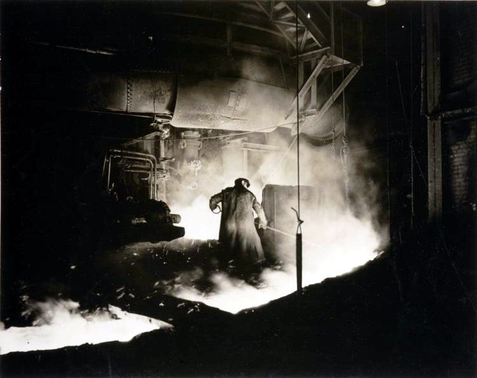
“The Second Industrial Revolution”
(An Age of American Innovation)

Slide 2
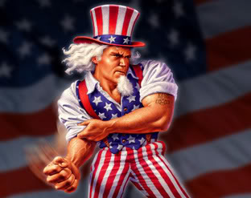
This new unit is all about how in a period of about 30 years, America started getting serious about growing into a powerful nation.

Slide 3
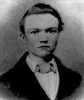
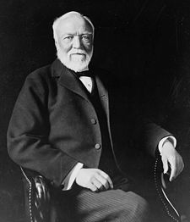
It’s about people who had great ideas that improved the quality of life…
and it’s also about people who made LOTS of money!
For instance, one of these people was a man named
Andrew Carnegie. His family were immigrants who
came to America from Scotland in 1858. Andrew
was as poor as poor could be, but he was determined
to be a success.
In 1901 he sold his business, the “Carnegie Steel Company” for 480 million dollars!

Slide 4
Do you know how much this is?
In 1901, what you could buy with one dollar would take about $26.00 in today’s money to buy!
The $480 million he made in 1901 is worth the same as 12.5 BILLION DOLLARS today!
Let’s say that you live to be 80 years old. On the day you were born and every day after that for the next 80 years, you would have to spend $428,000 in order to spend the amount of money Mr. Carnegie earned when he sold his company 110 years ago.

Slide 5
Nowadays we talk about spending not only millions and billions of dollars, but also trillions of dollars.
Let’s take a look at some zeros:
One thousand dollars = $1,000
One hundred thousand dollars = $100,000
One million dollars = $1,000,000
One billion dollars = $1,000,000,000
One trillion dollars = $1,000,000,000,000
Most people can’t even imagine what a trillion dollars really means!

Slide 6
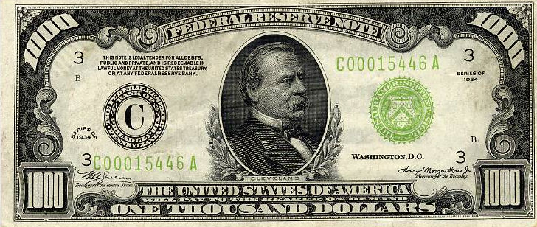
Here is a $1,000 bill:
One hundred of these makes $100,000.
One thousand of these makes 1 million dollars.
One million of these makes 1 billion dollars.
One billion of these makes 1 trillion dollars.
So, a trillion is a thousand billions or a million millions, but what does that mean? Can you really grasp how much this is or is it just a word we use to describe a number we don’t really understand?

Slide 7
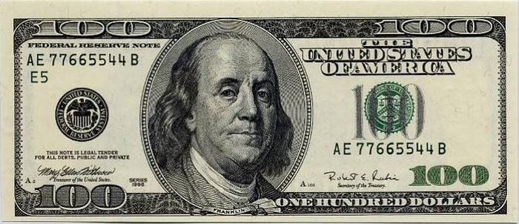
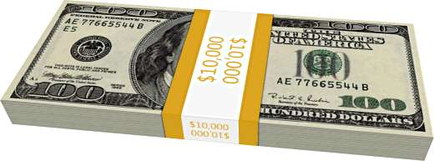
Since $1,000 bills are no longer in circulation, we’re going to use a $100 bill instead!
A packet of one hundred $100 bills is less than 1/2" thick, contains $10,000 and can easily fit in your pocket.

Slide 8
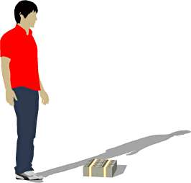
Believe it or not, this next little pile is $1 million dollars (100 packets of $10,000).
You could stuff that into a grocery bag and walk around with it!

Slide 9
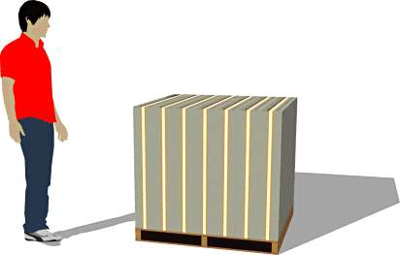
While a measly $1 million looked a little unimpressive, $100 million is a little more respectable. It fits neatly on a standard pallet...

Slide 10
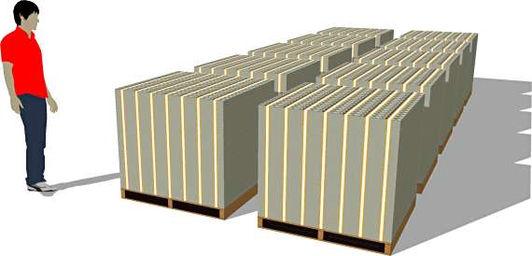
And one BILLION dollars... now we're really getting somewhere...

Slide 11
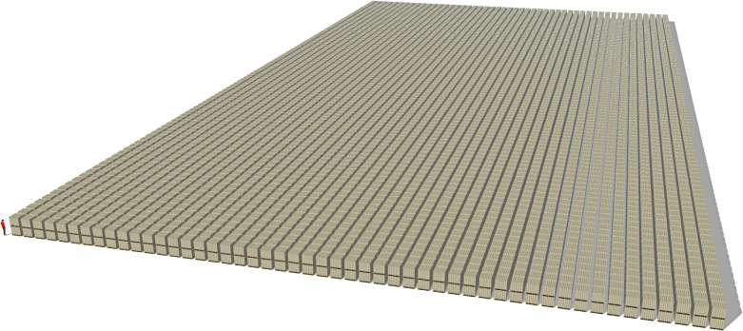
Now, check this out…
one trillion dollars…
Notice those pallets are double stacked...and remember those are $100 bills. So the next time you hear someone toss around the phrase "trillion dollars"... this is what they're talking about!

Slide 12
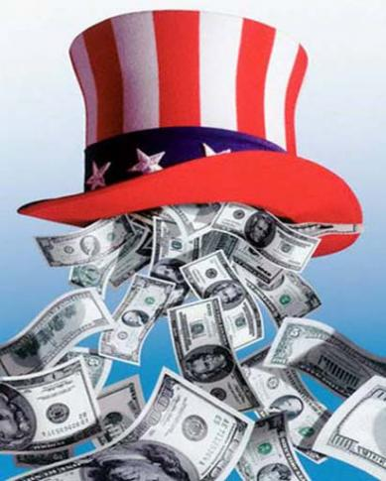
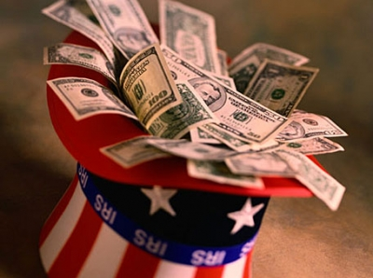
So, the question arises:
JUST HOW MUCH MONEY IS ENOUGH?

Slide 13
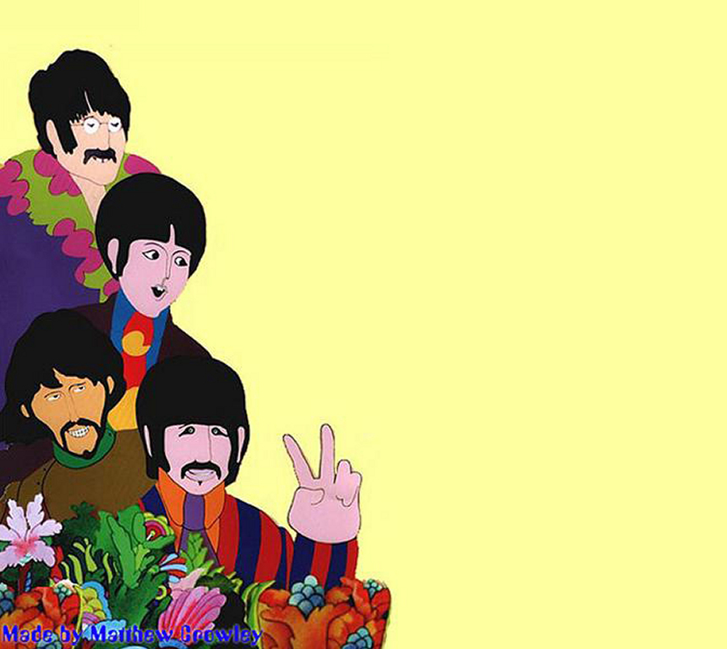
And yet another question arises:
People need money to survive, but is it really the money that makes you happy?
Some people will say yes. But there are a lot of people who say that it’s something else…
All you need is love!

Slide 14
Once again, our new unit of study is…
“The Second Industrial Revolution”
(An Age of American Innovation)
U.S. History Text: Ch. 19, Section 1, Page 614

Slide 15
Please make flash cards of the numbered information in this presentation.
Please neatly print the term in the center on one side of a flash card and then turn the card over and neatly print its definition on the other side in the center as well!
DEFINITION
TERM

Slide 16
1. necessity – something that cannot be
done without; something
that is needed.

Slide 17
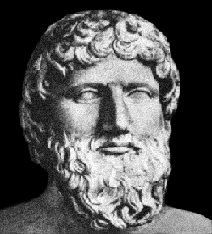
2. Plato was a Greek author & philosopher
who lived in Athens , Greece. (427 BC - 347 BC).
He once said: “Necessity is the mother of invention.”
What does this mean?
Can you give examples of something that was needed and an invention that met the need ?

Slide 18
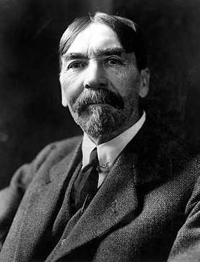
3. Thorstein Veblen (1857-1929) was an economist (someone who studies about how business works).
He once said: “Invention is the mother of necessity.”
What does this mean?
Can you give some examples of things that people can do without, but believe they must have?

Slide 19
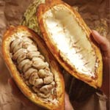
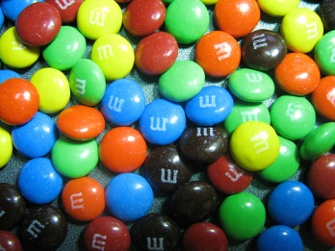
4. manufacturing- making something out of a raw product.
An example of manufacturing is when you take the beans of a cacao plant and use them to make M&M’s!
=

Slide 20
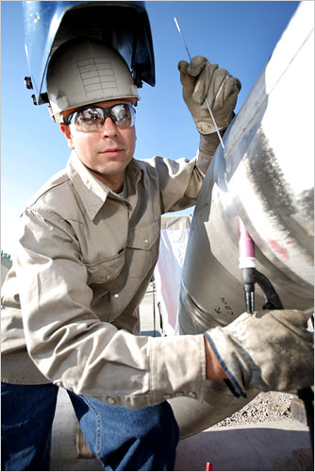
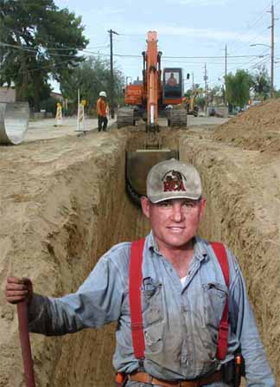
5. skilled worker – a worker who has been trained in special skills.
6. unskilled worker – a worker with no special training.

Slide 21
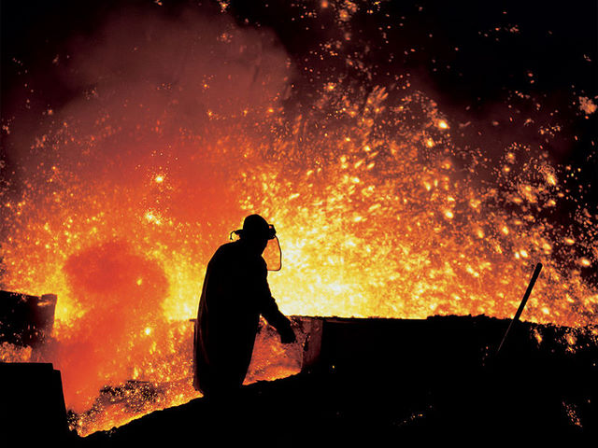
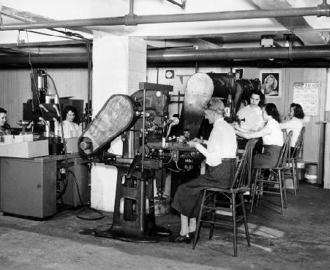
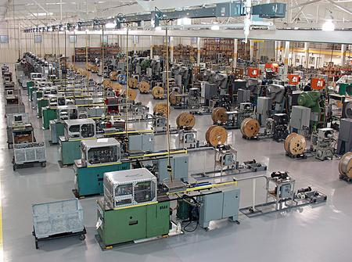
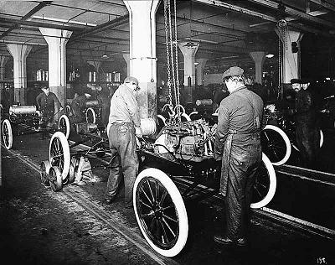
7. industrial – anything that has to do with the making of
products

Slide 22
8. breakthrough – a major accomplishment that leads
to further progress.

Slide 23
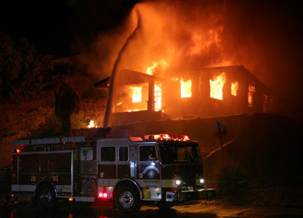
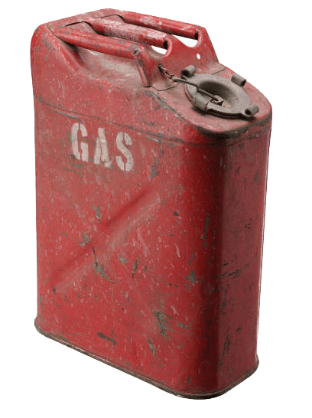
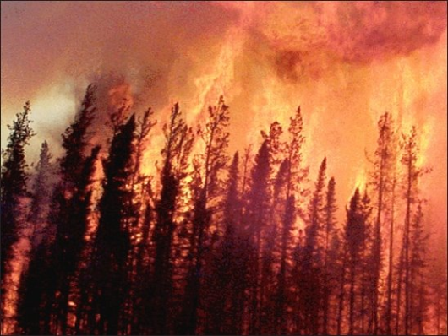
9. cause and effect – a chain of connected events: something happens which causes something else to happen, which causes something else to happen and so on.
Six years later…

Slide 24
10. innovation – something new; a new idea

Slide 25
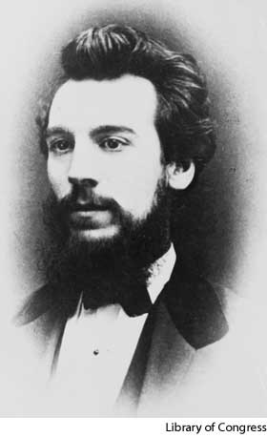
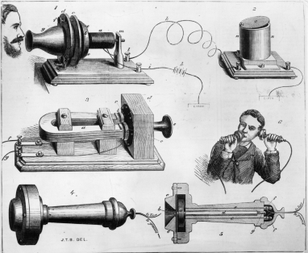
Alexander Graham Bell
Telephone (1876)

Slide 26
Thomas Alva Edison
“Wizard of Menlo Park”

Slide 27
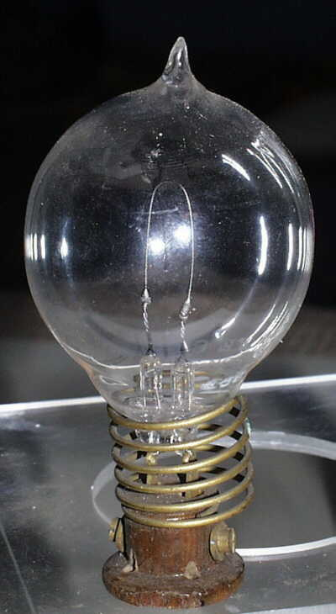
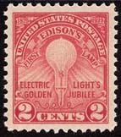
The Light Bulb

Slide 28
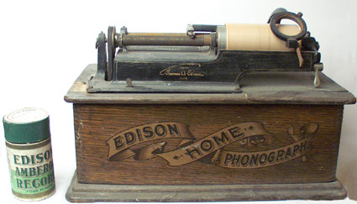
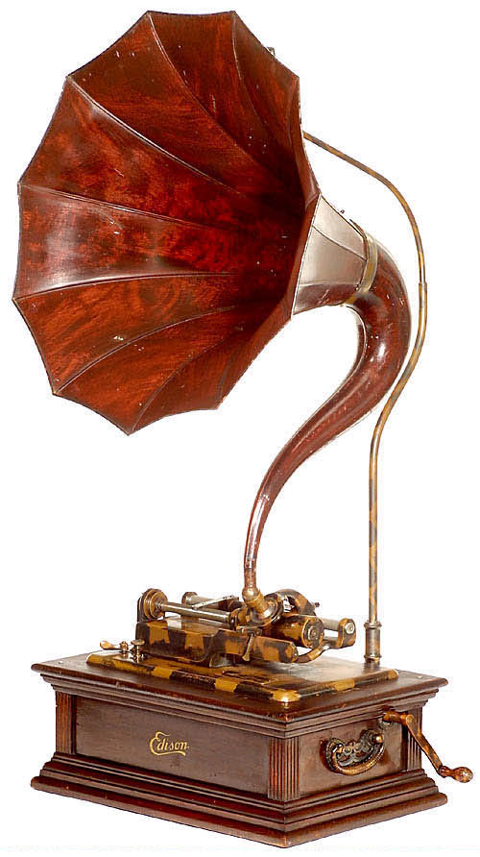
The Phonograph (1877)

Slide 29
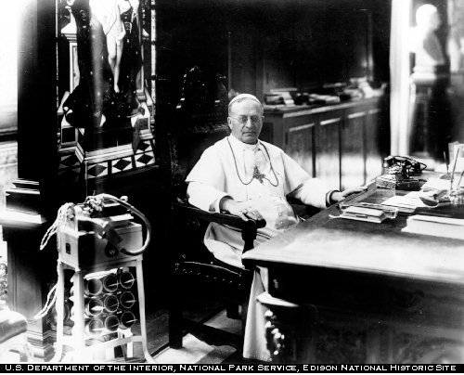
The Ediphone

Slide 30
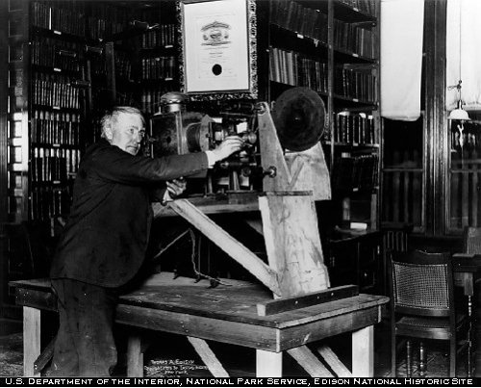
The Motion Picture Camera

Slide 31
Alternate Current
George Westinghouse

Slide 32
The Airplane
Wilbur Wright
Orville Wright
Kitty Hawk, NC – December 7, 1903

Slide 33
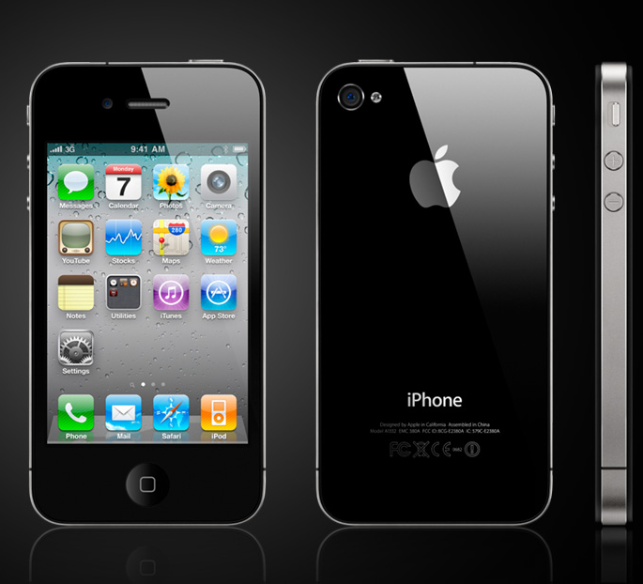
11. boom – a sudden increase, as in growth, wealth or popularity.

Slide 34
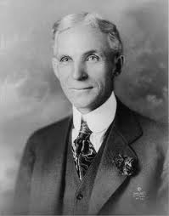
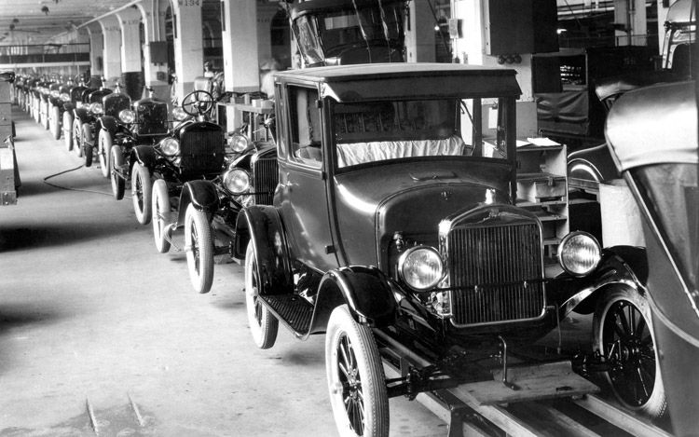
Henry Ford – moving assembly line

Slide 35
“Model T” Prices & Sales

Slide 36
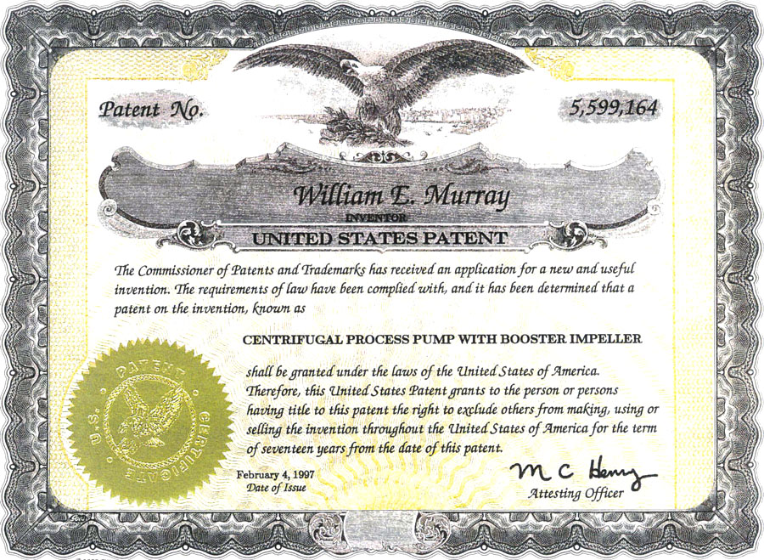
12. patent – the exclusive (no one else can legally do it) right to make or sell an invention.

Slide 37
U.S. Patents Granted
1790’s 276 patents issued
1990’s 1,119,220 patents issued

Slide 38
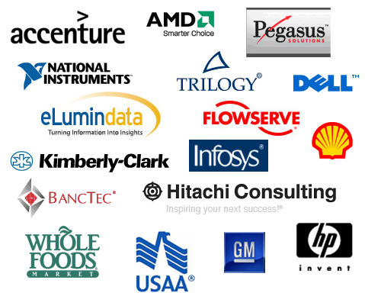
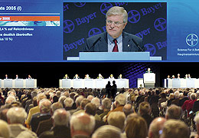
13. corporation – a business or company that sells parts of its ownership (called “stocks”) to others.
14. stockholder – someone who owns a part of a corporation

Slide 39
15. vertical integration – the ownership of businesses involved in each step of a manufacturing process.
16. horizontal integration – owning all businesses in a certain field

Slide 40
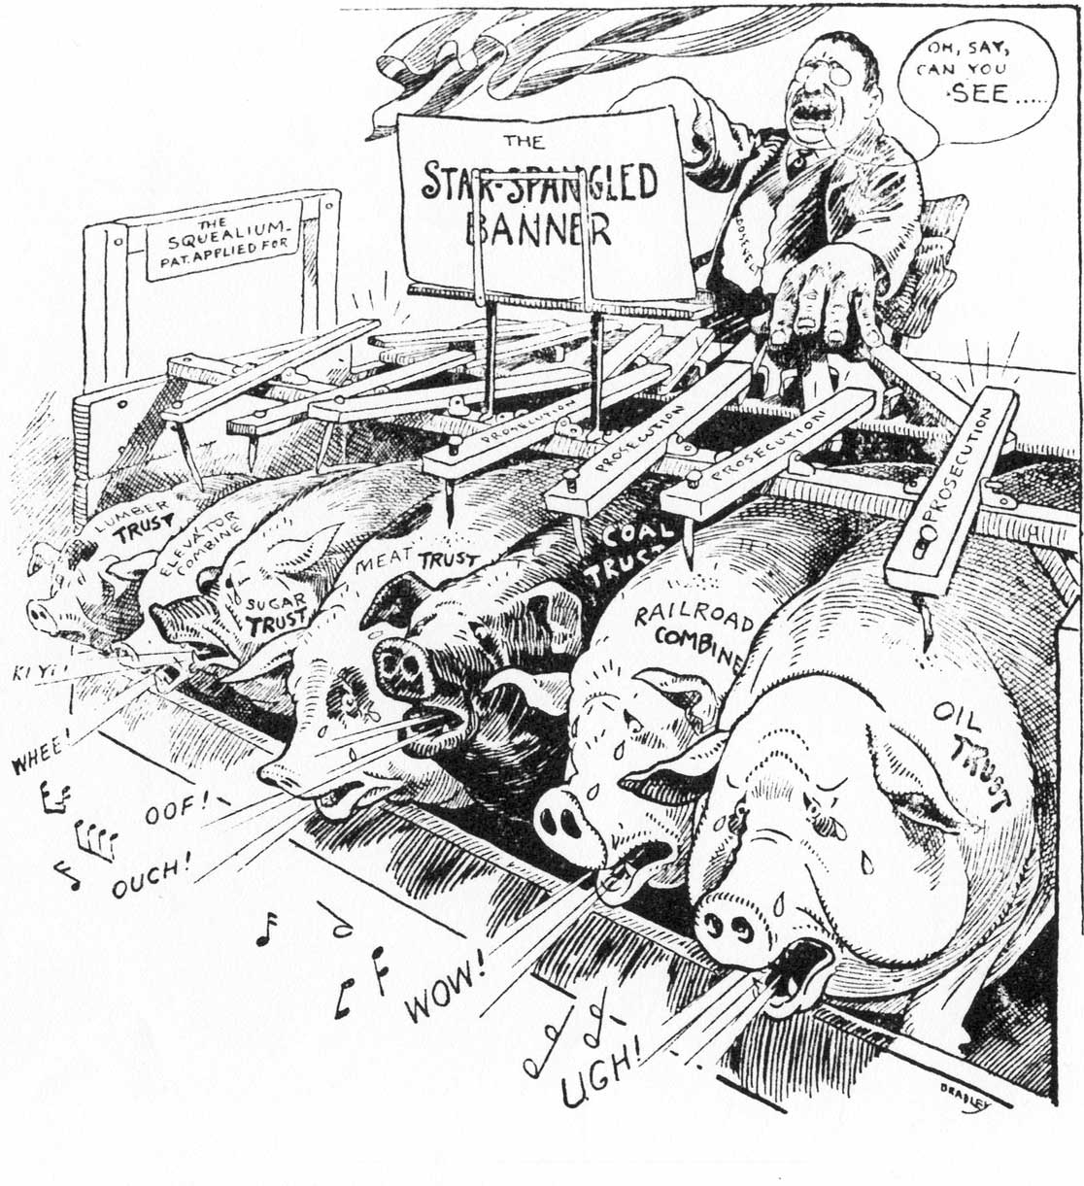
17. trust – a legal arrangement in which a number of companies that make the same product are grouped together under one board of directors.

Slide 41
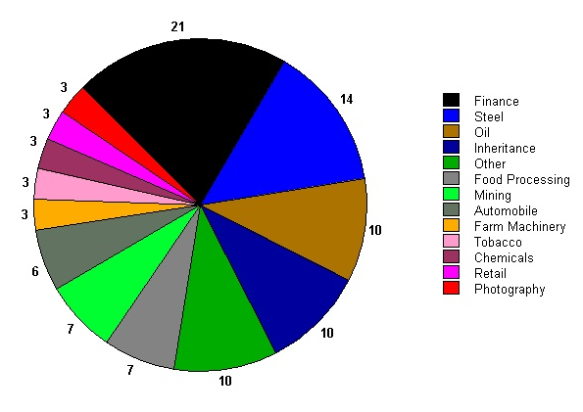
% of billionaires in 1900
% of billionaires in 1918

Slide 42
18. conglomerate – a group of non-related or indirectly related companies under the control of one board of directors.

Slide 43
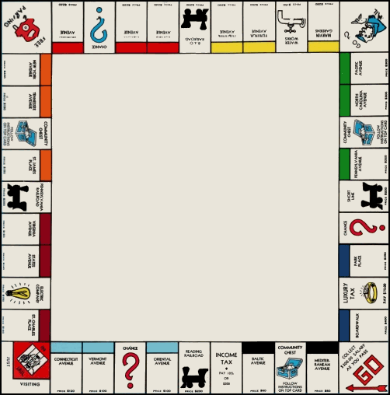
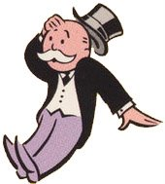
19. monopoly – the total ownership of a product or service
“Rich Uncle Pennybags”

Slide 44
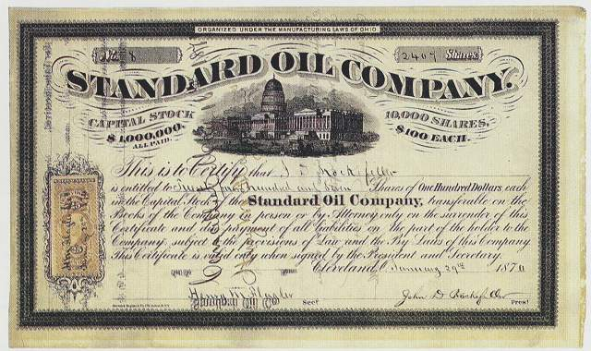
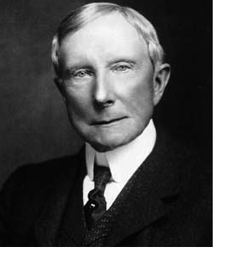
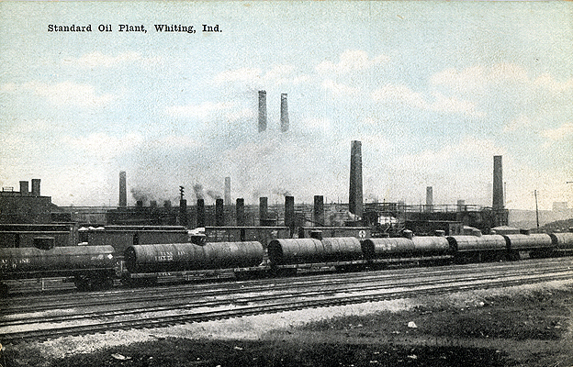
John D. Rockefeller
Rockefeller’s Standard Oil Company used both vertical and horizontal integration to outwit and bully his competitors. His monopoly controlled 80-90% of oil refineries in America.

Slide 45
Standard Oil Co.

Slide 46
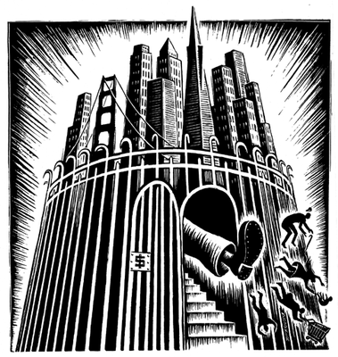
20. Social Darwinism – a belief in the survival of the fittest; that the “strongest” (meaning strong character and ambition) people would be the successful people in business and in life.

Slide 47
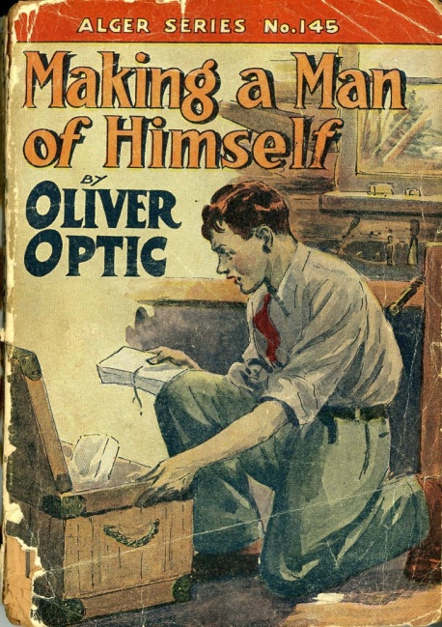
“The American Dream”
Horatio Alger Jr. wrote more than one-hundred novels to inspire young people to be bold and independent – “The Self-Made Man”
(“The Protestant (Puritan) Work Ethic”)

Slide 48
21. collective bargaining – negotiations between an employer and a group of employees to make sure that fair wages and proper working conditions are provided.

Slide 49
22. strike – a work stoppage by employees as a protest in order to get better wages and/or working conditions.
A strike usually takes places after negotiations with a company have failed.
Pullman Strike 1894

Slide 50
The “Public Perception” of Big Business

Slide 51
“The Bosses of the Senate”

Slide 52
The “Robber Barons” of the Past

Slide 53
Cornelius (“Commodore”) Vanderbilt
James “Diamond Jim” Fisk was one of the directors of the Erie RR. Fisk helped to oust Vanderbilt from Erie’s board of directors!
“Can’t I do what I want with my money?”

Slide 54
William Vanderbilt:
“The public be damned!”
“What do I care about the law? H’aint I got the power?”

Slide 55
A modern attitude toward business?

Slide 56
The Upside of Big Business…

Slide 57
23. philanthropy – the belief that rich people have a duty to aid the less fortunate and poor people. People like Andrew Carnegie, John Rockefeller, Leland Stanford and many others gave millions for libraries, concert halls, educational grants, colleges and many other charities.

Slide 58
24. tax incentive– takes place when the government collects fewer taxes in order to make something good happen.
Examples: If the government wants companies to hire more young adults, it will reduce the taxes that it charges the companies which employ more of them. If it decides that buying a home is a good thing for people to do, it will allow people to subtract the interest from the loan they took out to buy a house. This will encourage more people to buy a house, which has a lot of effects like…?

Slide 59
So, why do we have taxes?
What happens if people stop paying their taxes?

Slide 60
Please make this a flash card note:
25. Q. What was the “Second Industrial Revolution”?
A. It was a period of rapid growth in U.S. manufacturing in the late 1800’s
You should have 25 flashcards by now!

