Slide 1
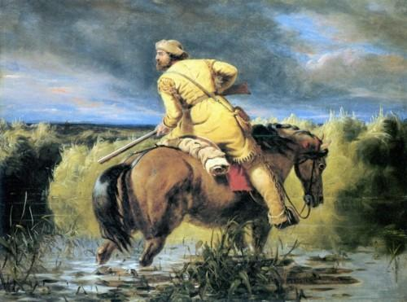
Part One:
Mountain Men, Trappers
and Explorers
1

Slide 2
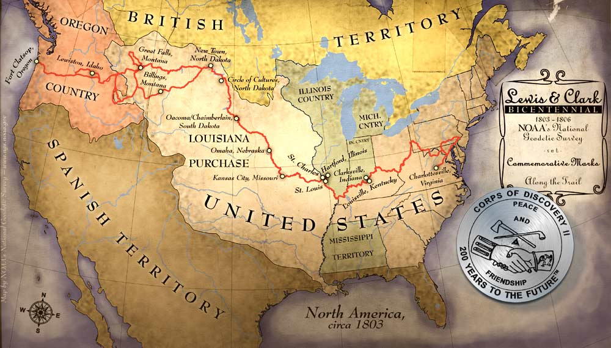
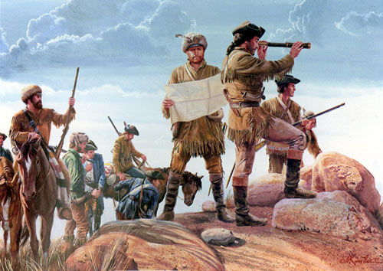
The Lewis and Clark Expedition directed the minds of Americans toward the settlement of the West.
2

Slide 3
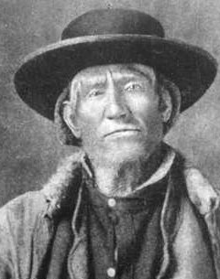
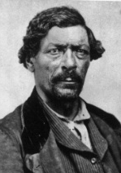
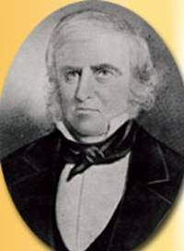
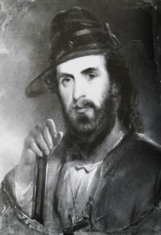
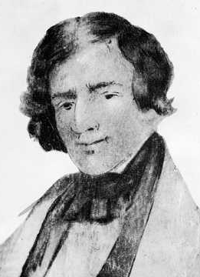
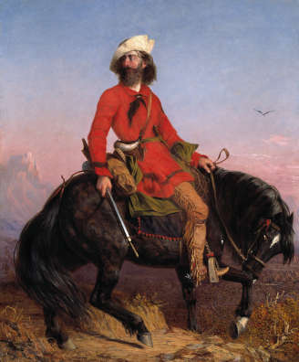
But even before the Expedition returned, rugged mountain men and fur traders had already began to make their way into the West.
Jim Bridger
Built Fort Bridger (Wyo.) to supply west-bound pioneers.
Jim Beckwourth
Discovered a pass through the Sierras
Peter Ogden
First to explore northern NV
Joseph Walker
Made maps and journals which encouraged westward travel.
Jedediah Smith
First to:
-travel overland to CA
-cross the Sierras (West to East)
-cross the center of the Great Basin
Long Jakes, "the Rocky Mountain Man“ by Charles Deas (1844)
3

Slide 4
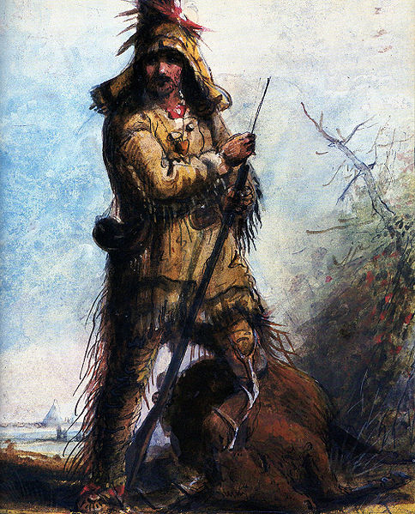
In order to better survive on the frontier and to get along with the many different tribes, mountain men adopted Native American Indian clothing.
“Louis, Rocky Mountain Trapper”
by Alfred Jacob Miller
4

Slide 5
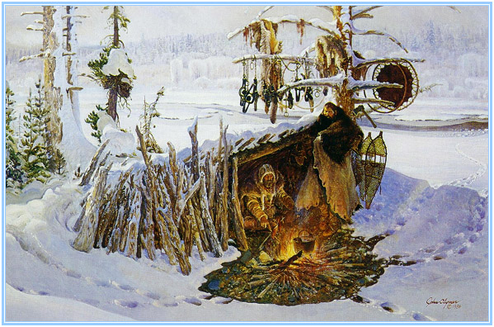
-to make a living
-to seek freedom and adventure
-to prove something to himself or others
-to forget the past
-to escape the law
-too crazy to live among “civilized people”
There were a number of reasons why someone would want to lead the dangerous and often solitary life of a trapper.
“Trappers’ Tree”
by John Clymer
5

Slide 6
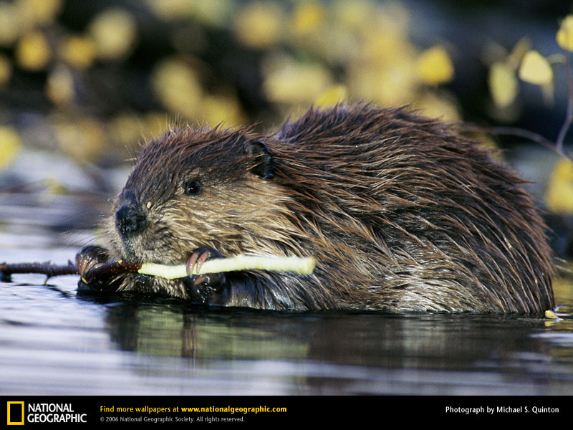
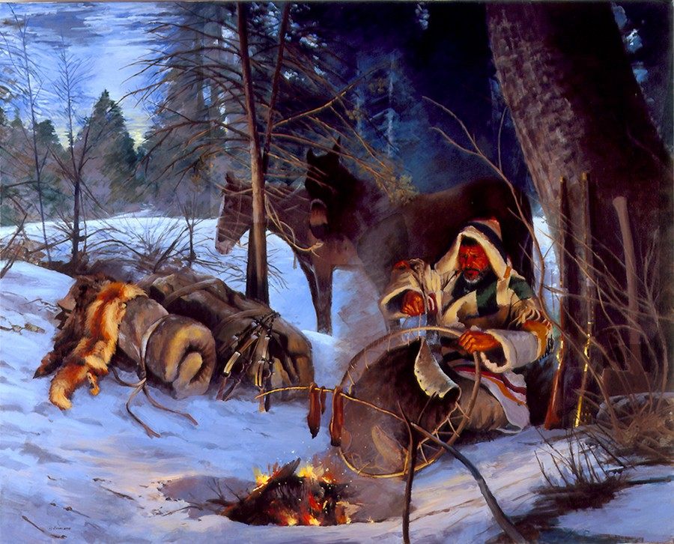
Mountain men trapped beaver for their pelts (hides), the fur of which
was used to make fancy hats.
6

Slide 7
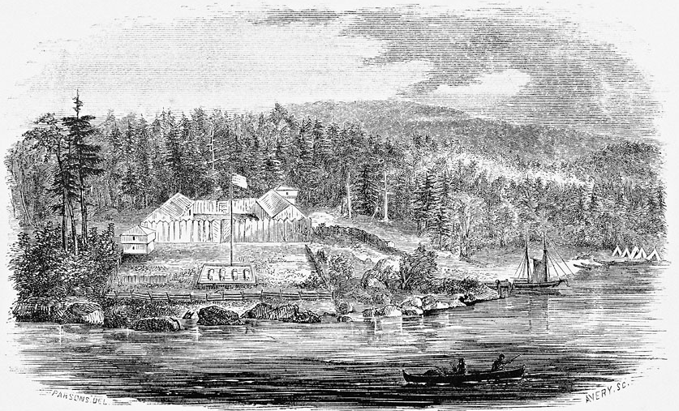
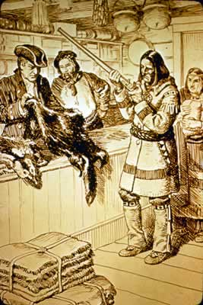
One of the first settlements in Oregon Country was a fur-trading post called Astoria.
It was named for John Jacob Astor, who built a fur-trading empire in America and became its first multi-millionaire.

Slide 8
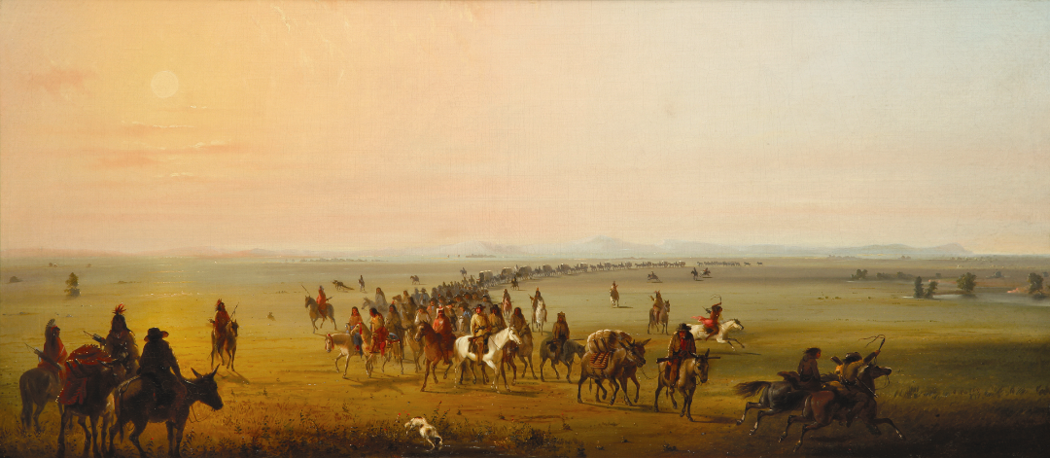
Between 1825 and 1840, St. Louis trade caravans would come out once a year to meet up and trade with the trappers at an event called a “rendezvous”.
“Caravan on Route”
by Alfred Jacob Miller
c1835
8

Slide 9
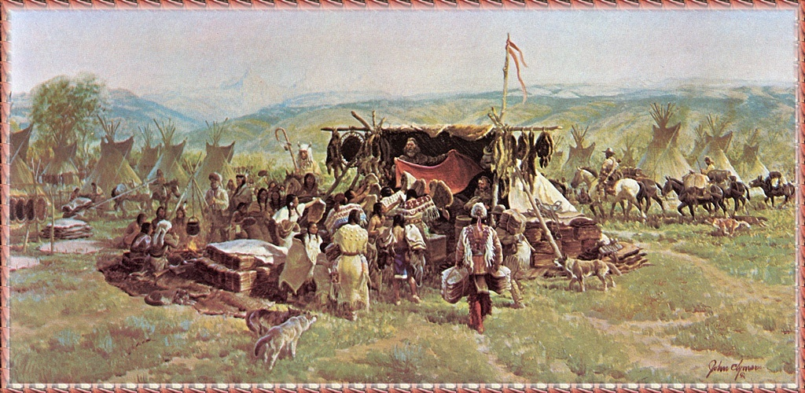
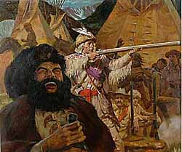
At each rendezvous, mountain men and Native Americans would “peacefully” gather together to trade and compete in a variety of contests.
The men would sell the furs they had trapped during the past season and buy supplies for the next one.
If they had any money left over, they would often drink and gamble it away!
“Mountain Man Rendezvous”
By Shannon Stirnweis
9

Slide 10
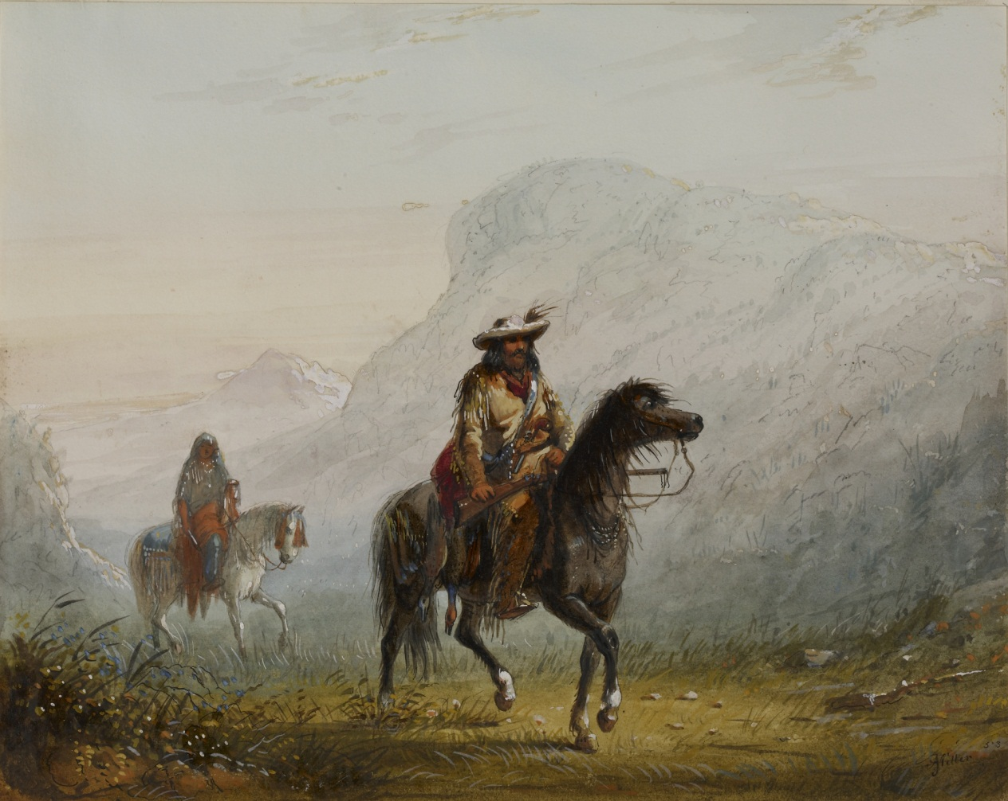
Even the roughest of trappers would stop and stare when Joe Walker rode into a rendezvous.
Walker was the first celebrity of the West.
His many adventures and his calm, confident leadership earned him the title of “King of the Mountain Men.”
“Bourgeois and Squaw” by Alfred Jacob Miller c1837
10

Slide 11
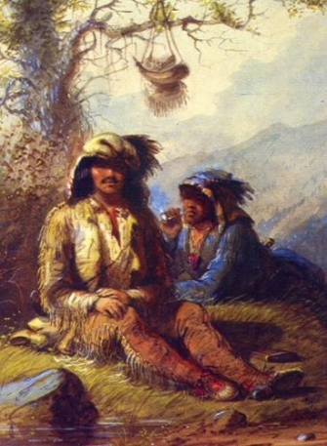
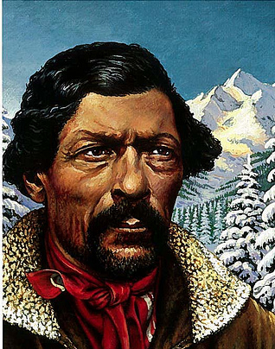
Although not in large numbers, African American trappers could be found throughout the West.
Moses “Black” Harris (left) was one of the first and most famous explorers of the Oregon Territory.
Jim Beckwourth, the son of a Southern slave owner, came west in 1819, and became a living legend as a Rocky Mountain trapper.
From a painting by Alfred Jacob Miller
c1835
11

Slide 12
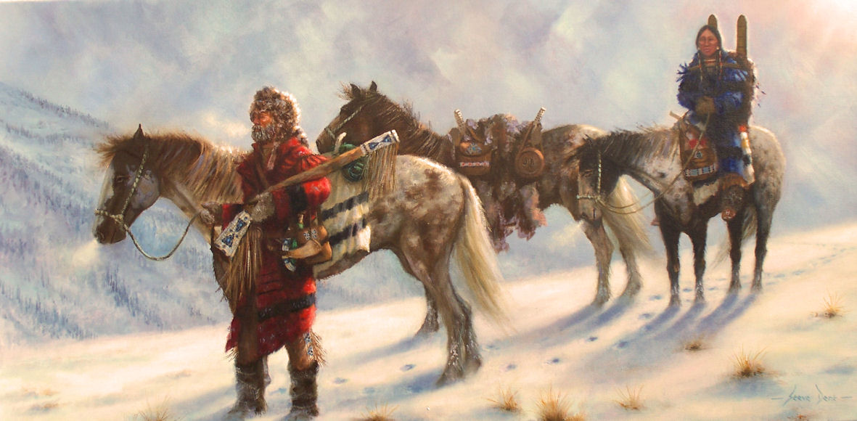
The life of a trapper was often difficult and very dangerous…
“Searching for Her People”
By Steve Dent
12

Slide 13
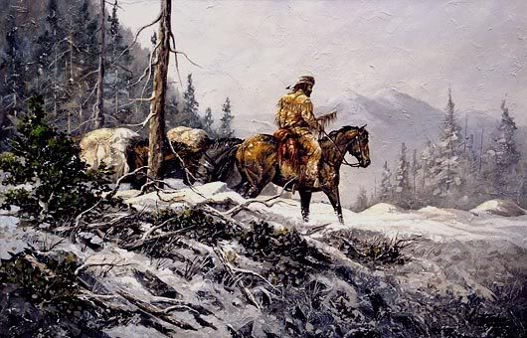
LONELINESS
Never seeing another person for months upon end.
13

Slide 14
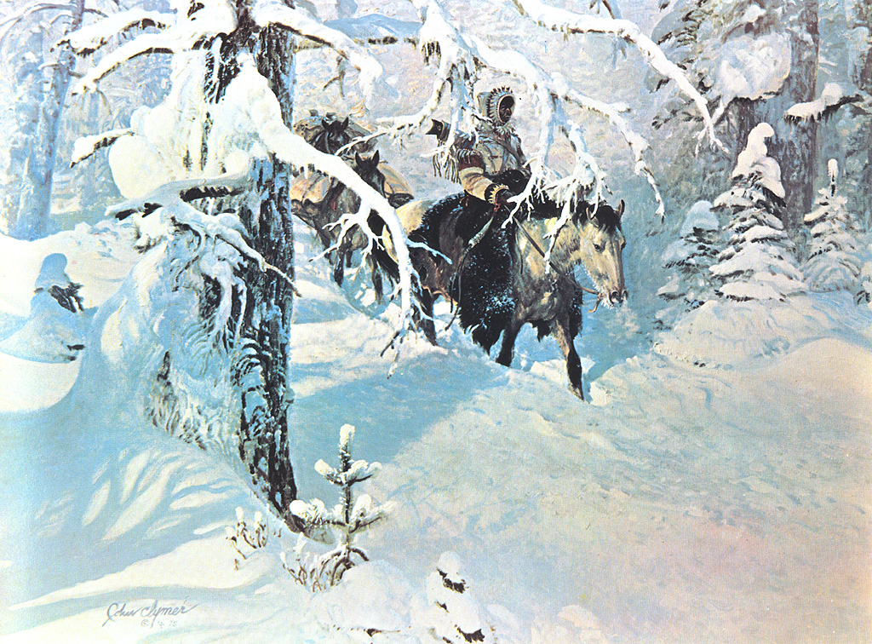
HEAVY SNOW AND FREEZING TEMPERATURES
Sleeping on a bed of coals, sometimes you would wake up in the morning to find your horse, dead…frozen.
“Out of the Silence”
by John Clymer
14

Slide 15
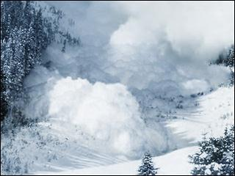
AVALANCHES
Always watching the cliffs above you—you were always careful not to make a loud noise which might send tons of snow down upon you.
15

Slide 16
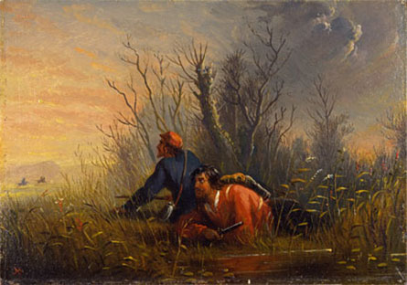
Many tribes viewed the “white eyes” as trespassers, come to take their lands. The simple solution was to kill them.
UNFRIENDLY INDIAN TRIBES
“A Narrow Escape”
By Alfred Jacob Miller
c1835
16

Slide 17
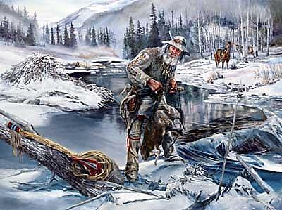
WADING IN ICY STREAMS TO SET BEAVER TRAPS
Their legs cramped and their backs were strained from the constant bending over to set their iron traps.
“Keeping An Eye” by Marian Anderson
17

Slide 18
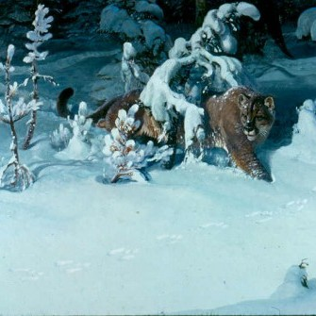
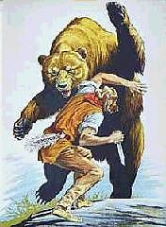
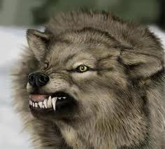
DANGEROUS AND WILD ANIMALS
Stealthy, hungry predators, searching for food shared the mountain man’s world and were ever present.
18

Slide 19
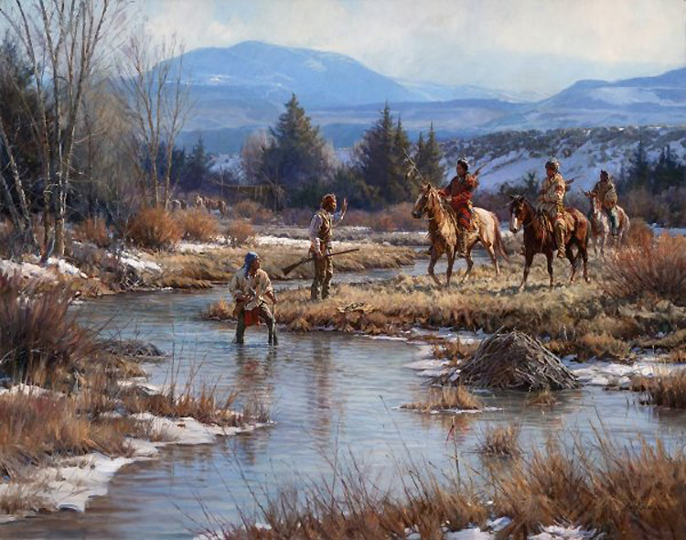
If you trapped a stream without getting permission from a tribe and/or not giving them gifts as payment, they often would kill a trapper as a warning to others.
TRYING NOT TO OFFEND LOCAL TRIBES
“Trappers in the Wind River”
By Martin Grielle
19

Slide 20
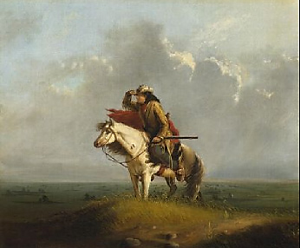
Although it happened frequently, no self-respecting mountain man would ever admit to being “lost”!
GETTING LOST
“The Lost Greenhorn”
by Alfred Jacob Miller
c1837
20

Slide 21
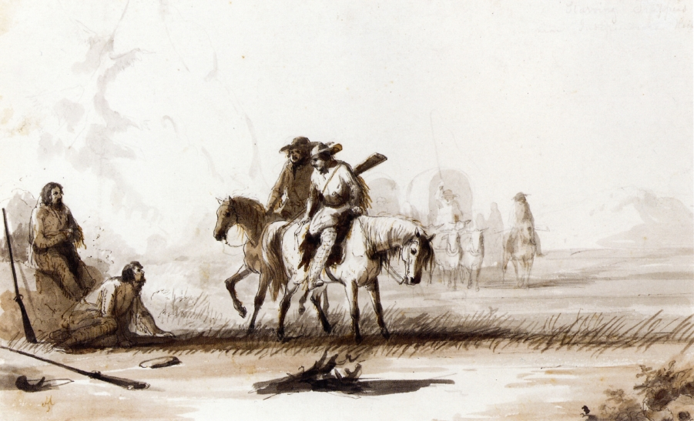
DESERT HEAT AND STARVATION
Joe Walker’s men ran out of food and water crossing the Great Basin and only survived by slowly cutting the throats of their horses so they could drink the blood, and then eating the animals.
“Starving Trappers”
by Alfred Jacob Miller
21

Slide 22
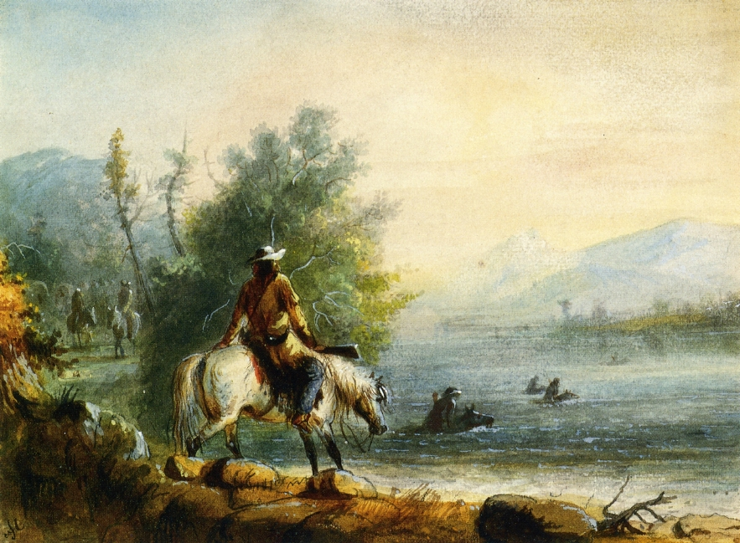
One false move and you could be swept off your horse by the strong current, losing horse, traps and pelts.
Crossing Swollen Rivers
“Fording the River”
By Alfred Jacob Miller

Slide 23
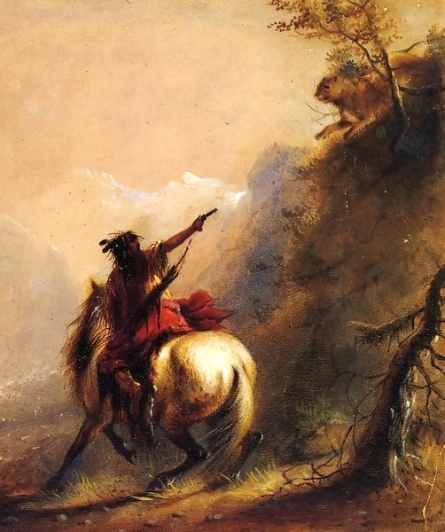
ALWAYS HAVING TO BE ON THE ALERT
There was danger around every bend of the trail. If you led down your guard for only a moment, it could cost you your life!
“Shooting a Cougar”
by Alfred Jacob Miller
23

Slide 24
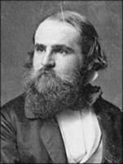
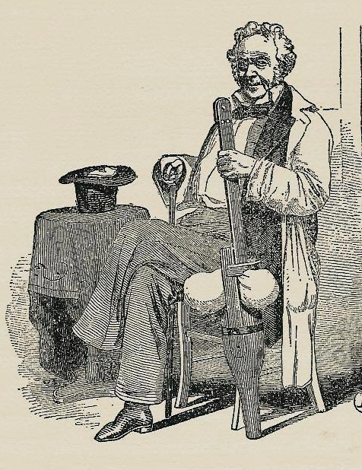
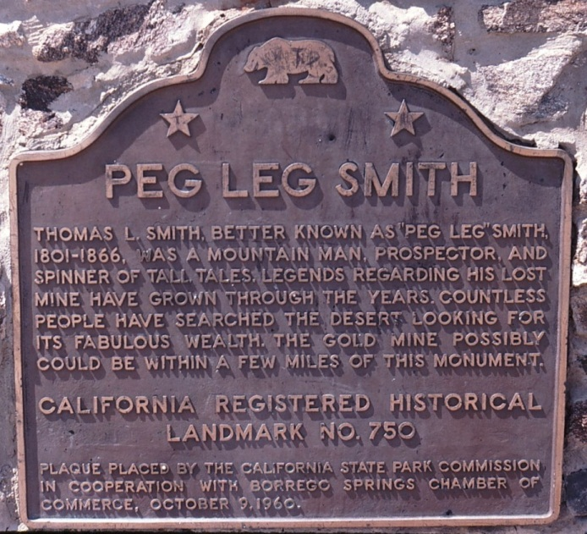
ACCIDENTS and INJURIES
-a fierce fighter
- shin bone was shattered by a bullet
- sawed off his leg just below the knee with hunting knife
- carved a new one out of a tree branch
- nicknamed “Peg Leg” Smith
Thomas Smith
24

Slide 25
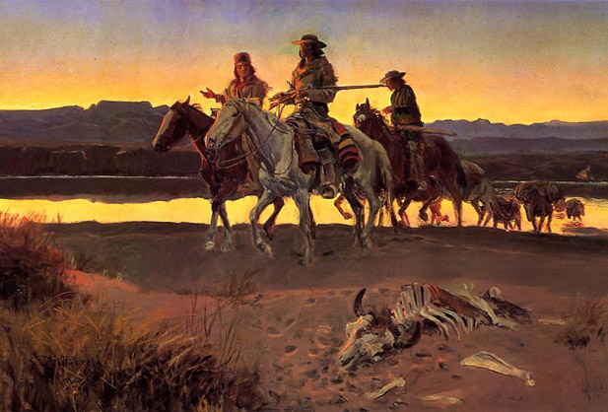
The fur trading era began to fade in the 1840’s.
- demand for beaver fell
- silk hats became more popular
- beavers were over-trapped
“Carson’s Men”
by Charles M. Russell
(1913)
25

Slide 26
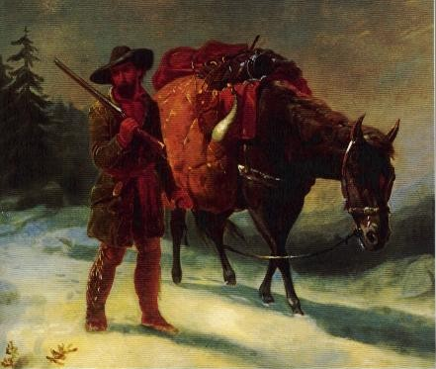
But these strong and independent men left an important mark on America’s history…
Cover Illustration from After Lewis and Clark:
Mountain Men and the Paths to the Pacific
by Robert Utley (2004)
26

Slide 27
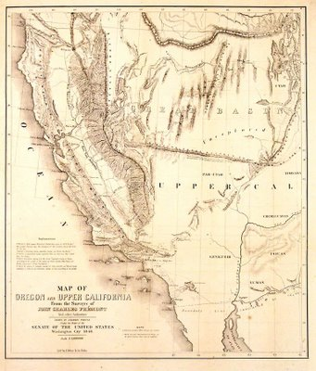
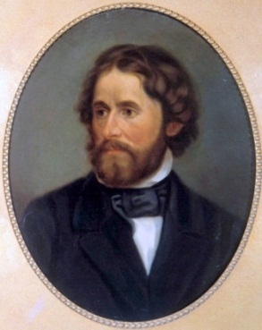
The maps they made
and journals they wrote…
Joe Meek
- talked about all the open land,
- convinced people to go west,
- showed them how to get there,
- and helped to settle an entire
continent.
John C. Fremont
27

Slide 28
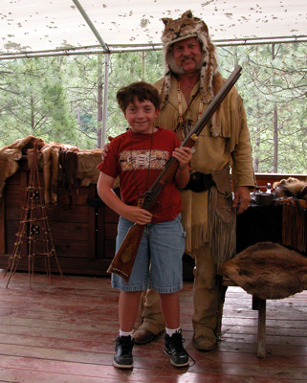
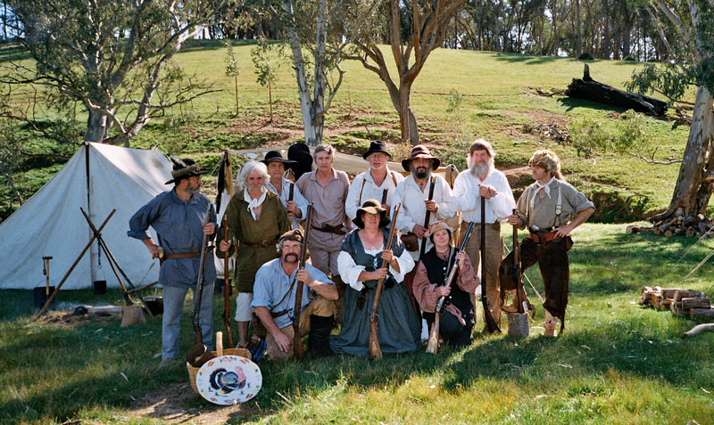
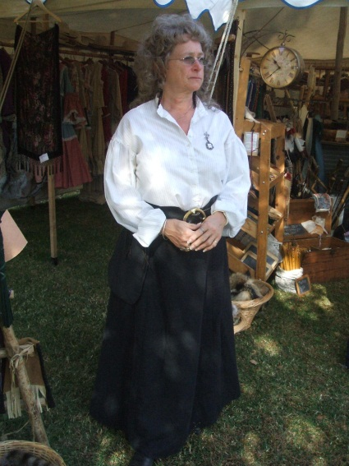
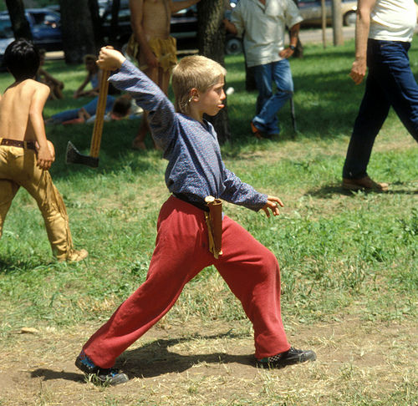
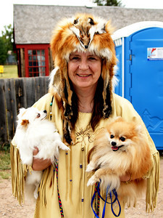
The Mountain Man has not been forgotten…
To this day, thousands of people from across America and other countries reenact the era of the mountain man in rendezvous gatherings all over the West, passing along the traditions of our history.
28

