Slide 1
1

Slide 2
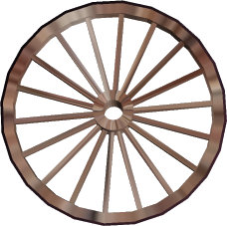
for a change.
Let’s try peace
Tie Dye Productions
A
History Dept.
Power Point
2

Slide 3
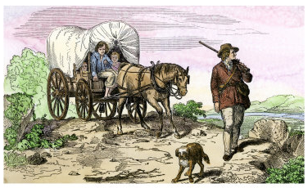
The Pioneer Experience:
3

Slide 4
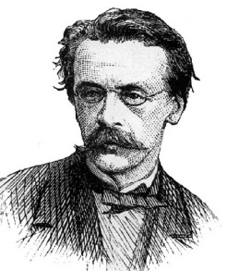
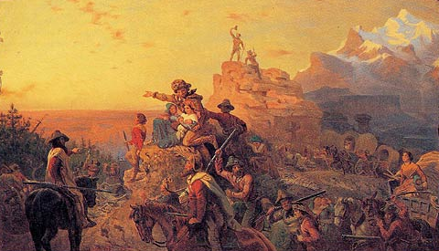
“Manifest Destiny”
The term was first used by journalist John L. O’Sullivan in 1845.
“Manifest Destiny was the belief that the U.S. had the right to control all the land between the Atlantic and Pacific Oceans.”
“Westward the Course of Empire Takes Its Way”
Emanuel Leutze
(1861)
4

Slide 5
Reasons for Westward Expansion
America’s fear that the Spanish, French, English, and Mexican governments
would try to expand their control of the continent .
a desire to spread democracy and the American way of life.
a desire to spread slavery
an escape from religious persecution (Latter Day Saints or Mormons)
a chance to start over and prosper in a new land, full of promise
5

Slide 6
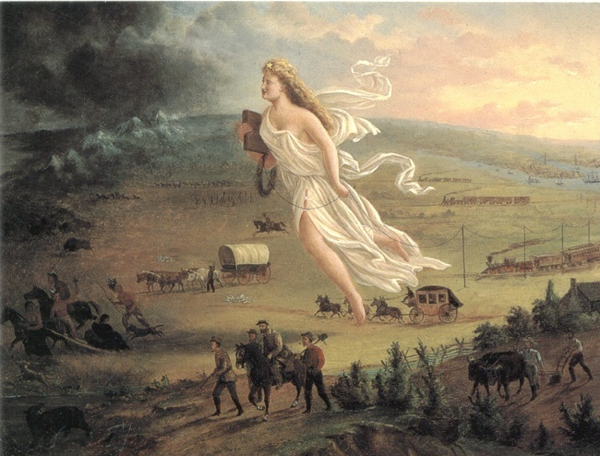
“American Progress”
By John Gast (1872)
Can you interpret this painting?
6

Slide 7
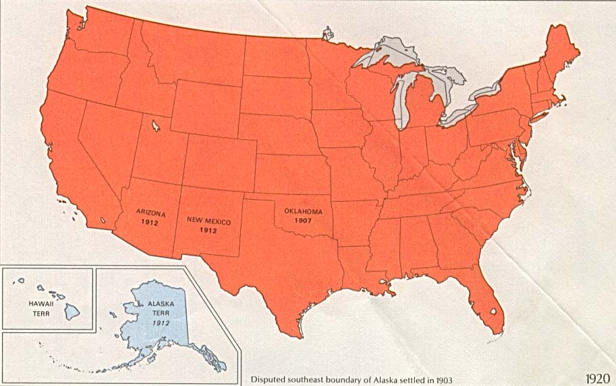
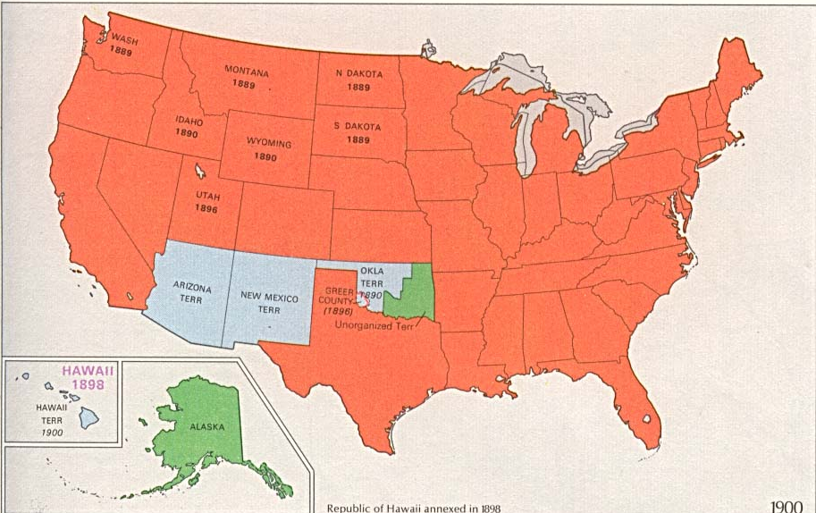
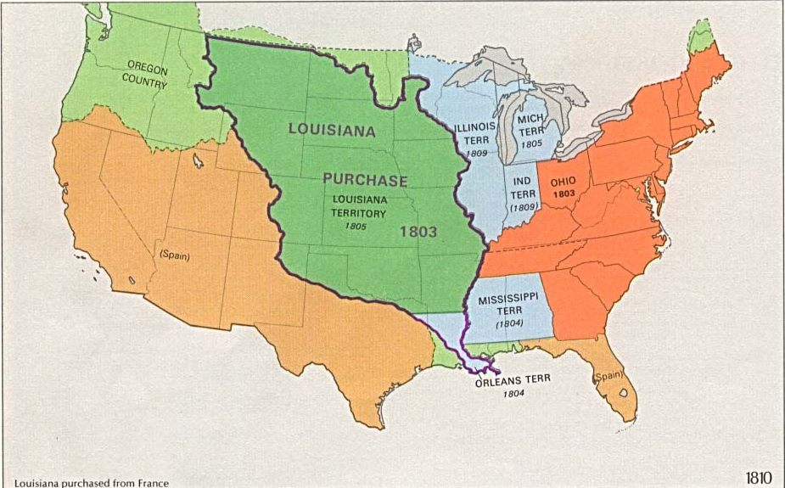
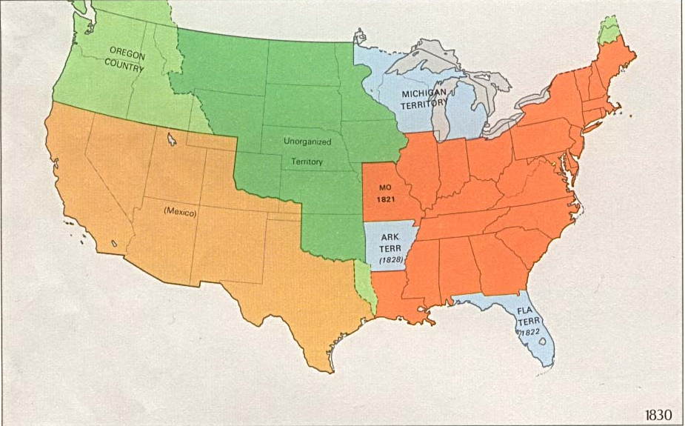
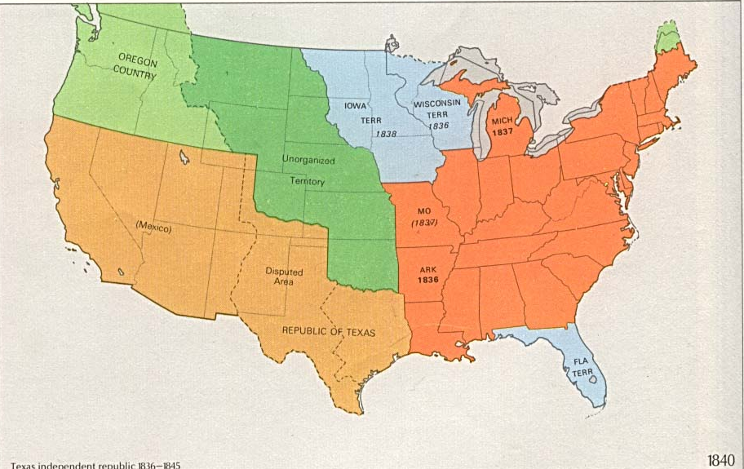
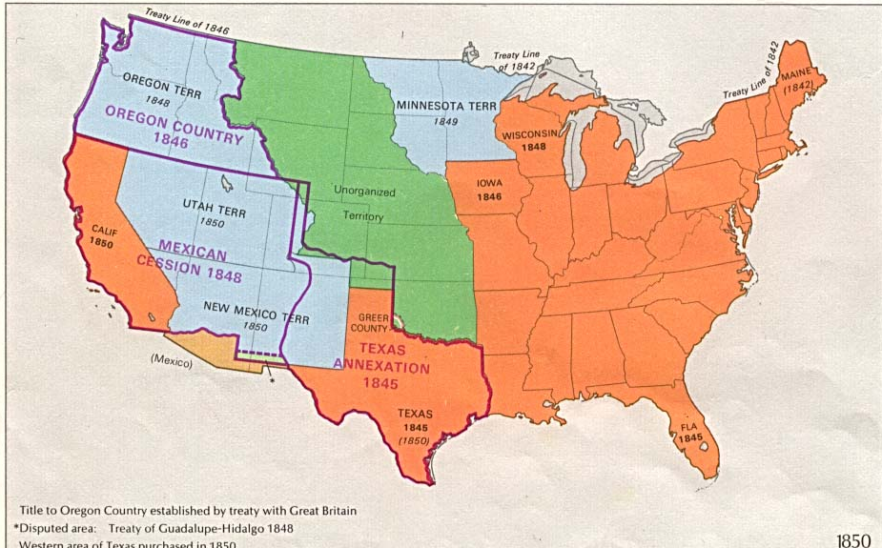
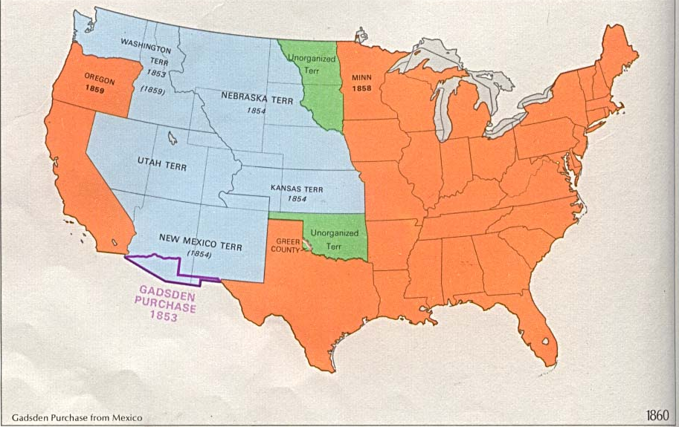
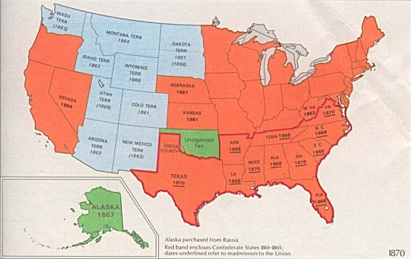
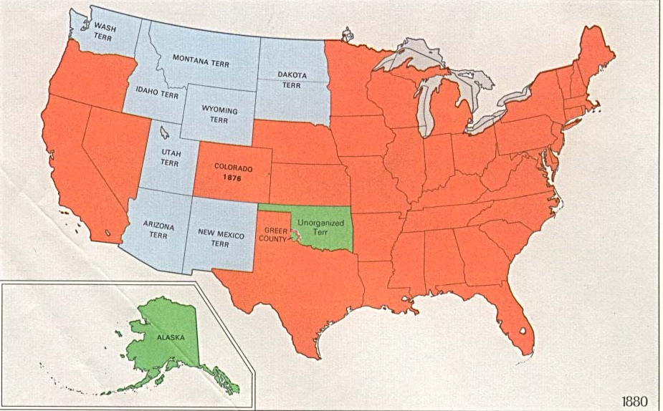
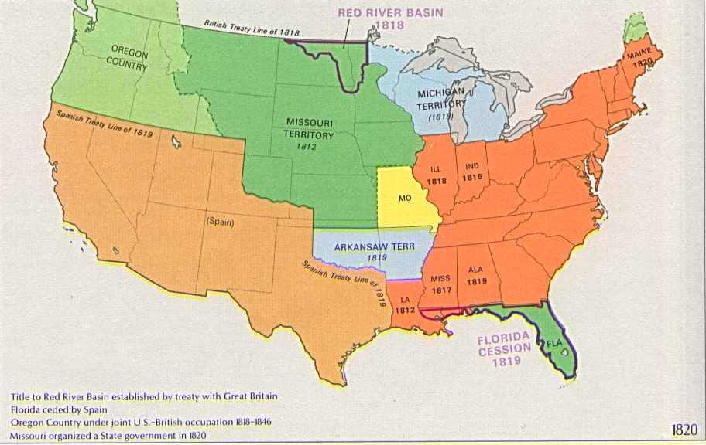
America’s Westward Expansion
1775
1790
1810
1820
1830
1840
1850
1860
1870
1880
1900
1920
7

Slide 8
emigrant-
someone who travels from one region to another one with the idea of staying in the new location
8

Slide 9
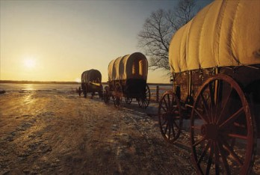
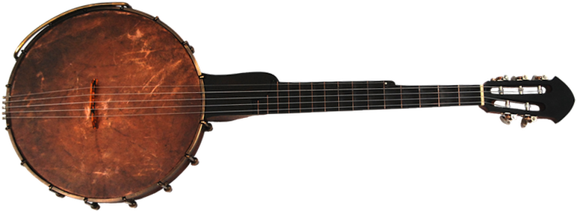
“Trails to the West”
9

Slide 10
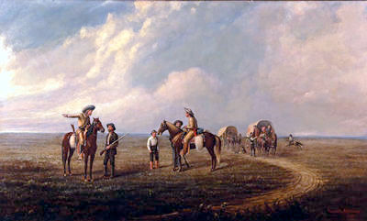
After the fur trade began to fade, former mountain men like Joseph Walker and Joe Meek began leading emigrants across the Great Plains to the West.
10

Slide 11
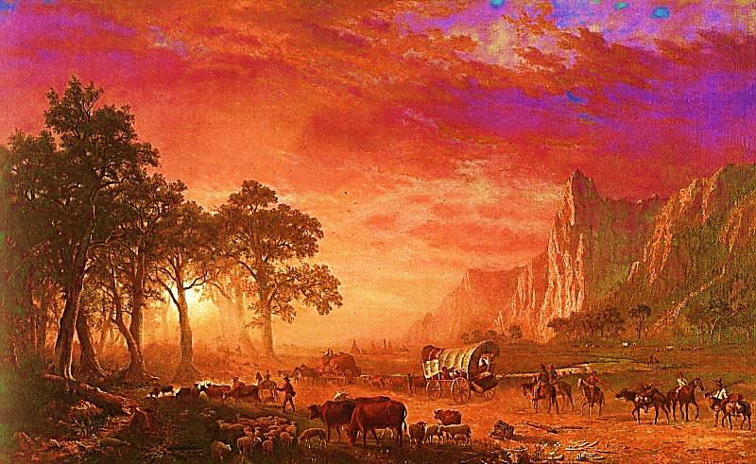
1840 - Americans were restless, curious and eager to be on the move . Some were looking for wealth and adventure while others dreamed of rich farmland and new homes.
“Emigrants Crossing the Trail”
Albert Bierstadt (1867)
11

Slide 12
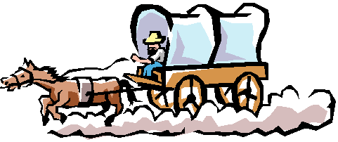
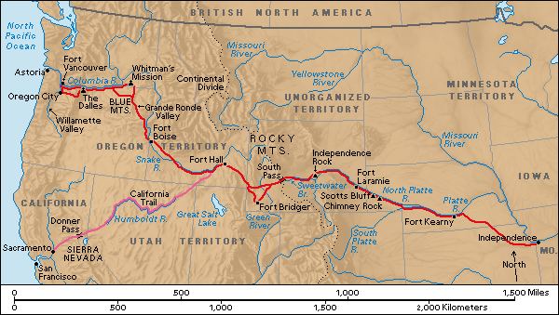
Overland Travel
12

Slide 13
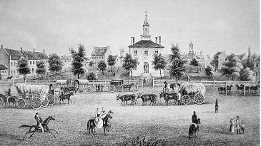
Independence, Missouri was the “jumping off” place to most western travelers.
13

Slide 14
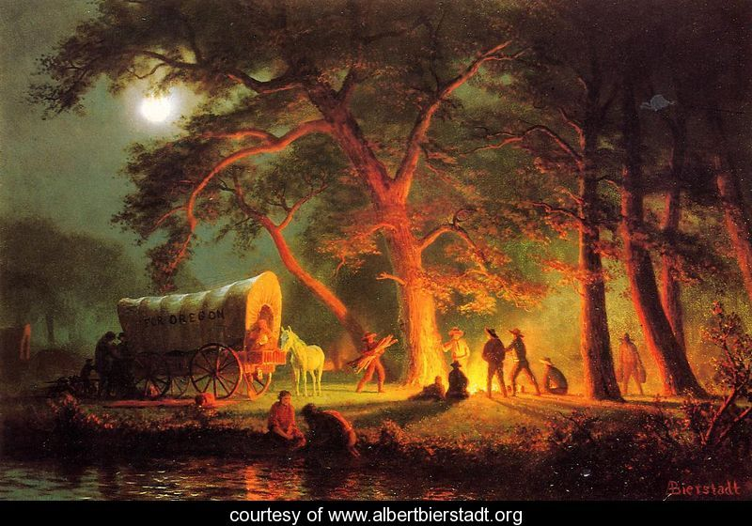
THE OREGON TRAIL
Before gold was discovered in California, most westward pioneers traveled to Oregon Country.
“Oregon Trail”
Albert Bierstadt
14

Slide 15
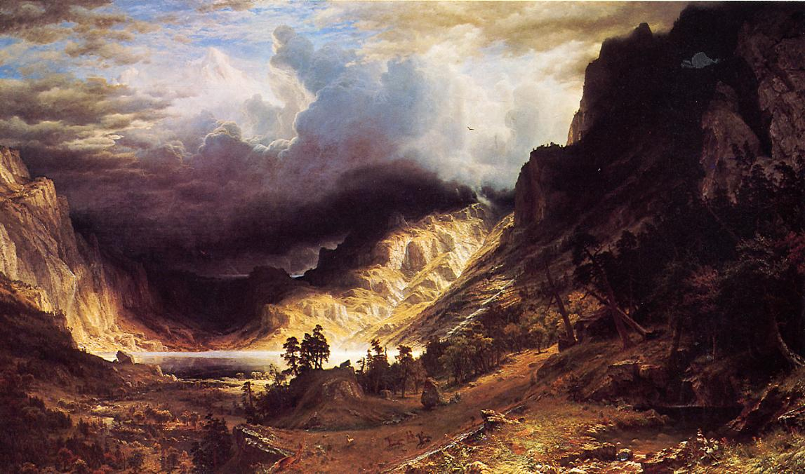
THE OREGON TRAIL
The trail was 2,000 miles long. At the Rocky Mountains, the trail forked, allowing people to go northwest to Oregon…
“A Storm in the Rockies”
Albert Bierstadt (1866)
15

Slide 16
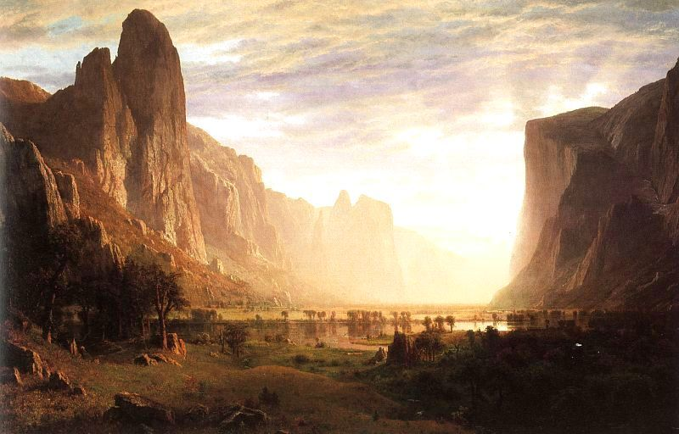
or southwest to California.
“Yosemite”
Albert Bierstadt
16

Slide 17
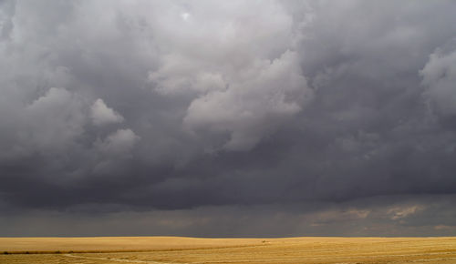
The journey usually began after the rainy season in late spring and lasted between five and six months.
Why wait until late spring to start?
17

Slide 18
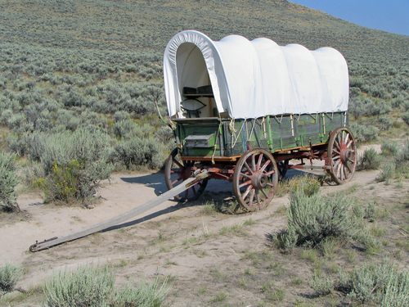
The pioneer wagon:
- cheapest method of travel
- cost of wagon: $100-$200+
- cost of trip - $600 -$1,000 +
( could take years to save up!)
- five-month, 2,000-mile journey
- could carry family possessions
- slow (averaged 2 mph)
- pulled by oxen, mules or horses
- frequent breakdowns
- a difficult, uncomfortable trip

Slide 19
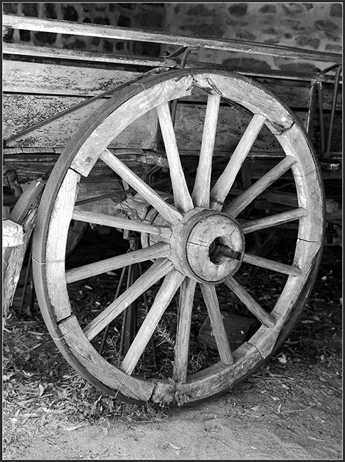
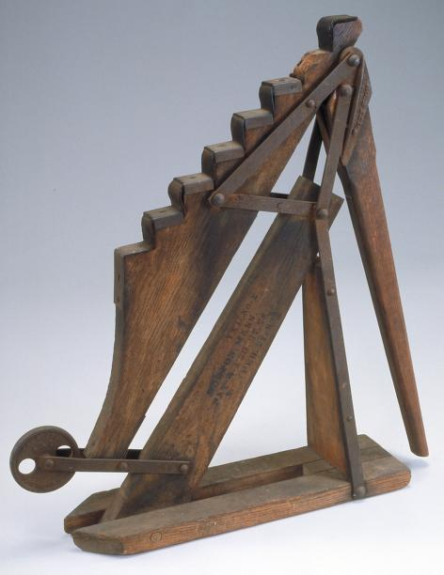
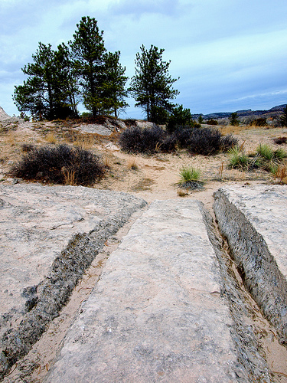
A wagon wheel had to be soaked in
water every so often to keep its
“iron tire” from falling off!
At each stream and river, wheels were pulled off the wagons and soaked in the water!
A wagon “jack”
So many wagons crossed over the same tracks along the trail that deep ruts were worn into the earth. These ruts were cut into solid rock!

Slide 20
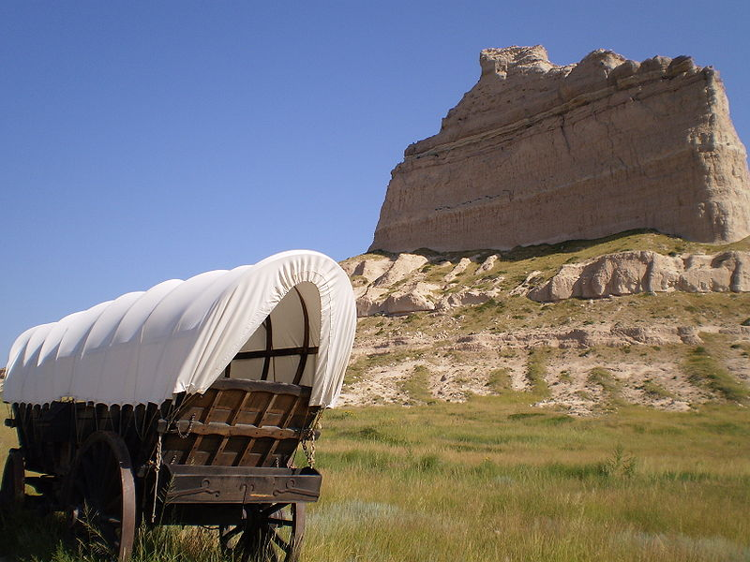
“PIONEER CIPHERING”
“ARITHMETIC ON THE WAY WEST”

Slide 21
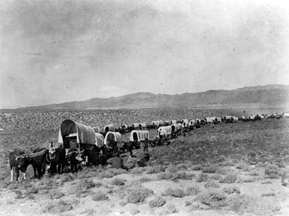
Your wagon string is in Council Bluffs, Iowa and about to leave for the West. Your destination is Oregon City. You hire a guide for the journey and agree to pay him the sum of $250 for the entire trip. Some of the members of your party are upset and argue that you are being overcharged. The total distance you will travel is 1,924 miles. How much money per mile is your guide going to cost? (Round to the nearest whole cent!)
ANSWER:____________________
.129¢ or 13¢ per mile
250 ÷ 1924 =
Dollar Amount Number of miles
What question do you need to answer?
What information do you need to solve
the problem?
What sort of math operations do you
have to make?
÷
Divide what by what?

Slide 22
Pioneer Note Quiz #1

Slide 23
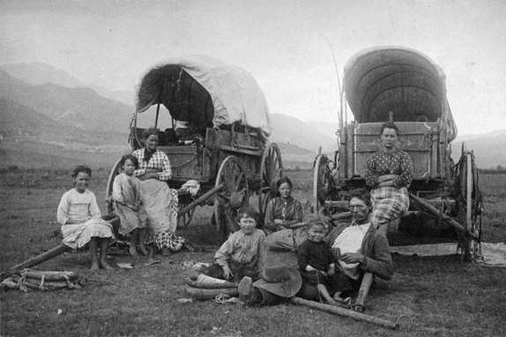
Most groups of settlers to the West were made up of families with younger children.
Having your picture taken back in these days was a very important event!
Note how all three women sit with their arms crossed. Is this just a relaxed pose, or do they disagree with something? The males are all grouped at center, a man, a young boy and a toddler—while the females sit behind them in three separate areas. Does this mean anything? There are no animals hitched to the wagons. What does this mean? Do you notice any other things?
23

Slide 24
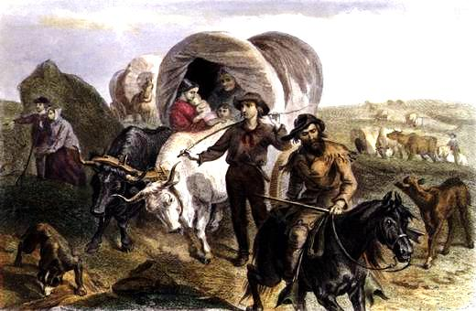
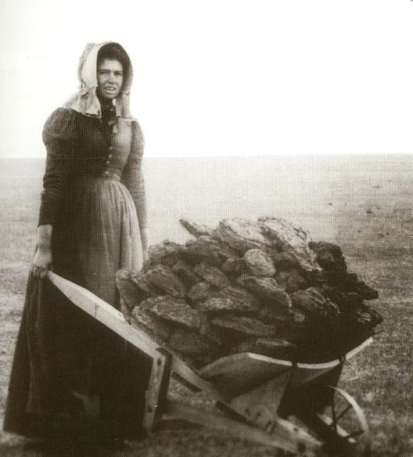
Most people walked along the trail!
The older children walked in front of the wagon and rolled large rocks out of the way to keep them from damaging the wagon wheels.
Since there were no sources of firewood on the Great Plains, the Pioneers gathered “buffalo chips” to use as fuel for campfires!
24

Slide 25
“PIONEER CIPHERING”
“ARITHMETIC ON THE WAY WEST”

Slide 26
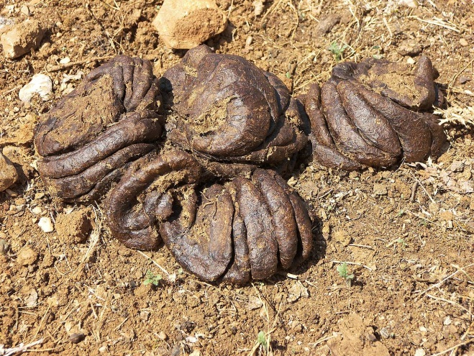
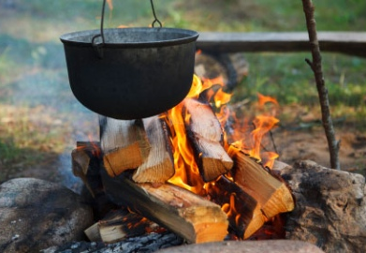
4. One of the common chores for pioneer children to do along the treeless expanse of the Great Plains was to gather dried buffalo dung to use as fuel for the cooking fires.
It takes 22 average -sized “chips” to cook a full meal and there are two full meals cooked each day. If an average chip weighs ½ pound and if it takes 120 days to cross the Great Plains, how many pounds of buffalo chips will you have to pick up?
What question do you need to answer?
What information do you need to solve the problem?
What sort of math operations do you have to make?
multiplication
1. number of chips used to cook a meal X number of meals per day.
2. number of chips per day X weight per chip
3. weight of chips per day X number of days of travel
1. 22 chips X 2 meals= 44
2. 44 chips X ½ pound = 22 pounds
3. 22 pounds X 120 days = 2,640 lbs.

Slide 27
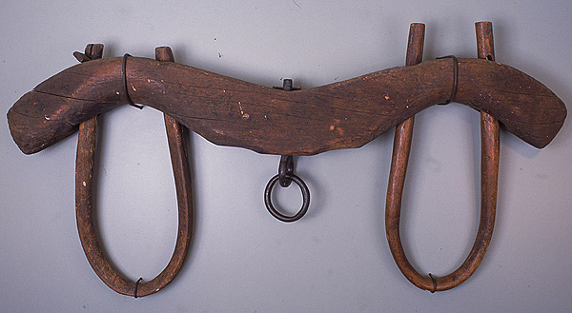
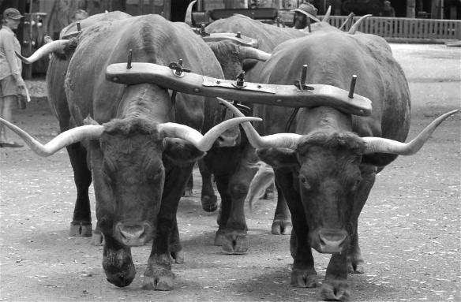
What is this thing called and what is it for?
Oxen wearing an “ox yoke”
Just what is an ox?
An ox is a steer, about 4 yrs. old that is trained to “push” a wagon!
27

Slide 28
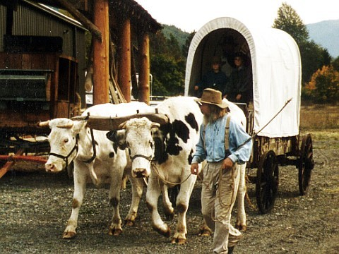
Can you explain why a yoke of oxen doesn’t “pull” a wagon, but instead, “pushes” it?
28

Slide 29
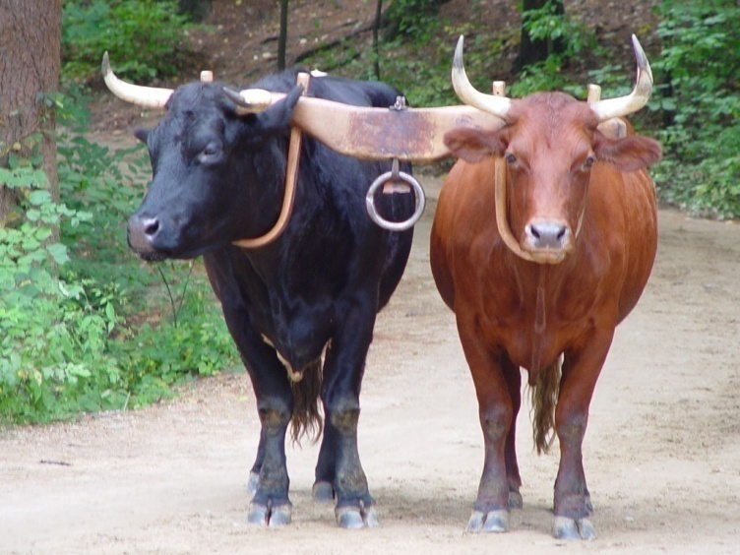
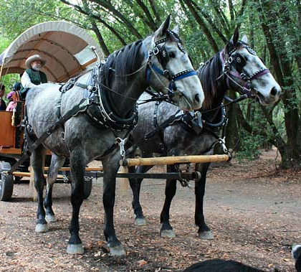
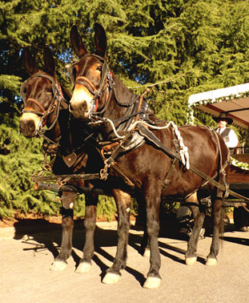
Which is better: ox, horse or mule?
“Mules move faster."
"Yes, but oxen pull more."
"Oxen don't stampede so easy."
"But when they do they run worse."
“Oxen can live on prairie grass.”
"Mules bog down in mud."
“But they can live on cottonwood bark”
“The Sioux steal mules and horses, but
don’t want oxen.”
“Horses are faster than oxen and pull
more than mules.”
“But a horse needs good feed.”
"Oxen get sore feet when mules don't."
“A mule costs $100 , a horse at least twice
as much, while one ox is only $25."
Later, as trails turned into roads and travel became easier, horses became the choice for most pioneers.
29

Slide 30
You have become very close to your oxen and have discovered that each matched pair (yoke) is better at leading the others during different conditions on the trail.
Tip and Dobie lead during wet weather, Hob and Sam lead on dry, level ground and Billy and Tom lead in uneven and mountainous areas.
Tip and Dobie lead during wet weather, Hob and Sam lead on dry, level ground and Billy and Tom lead in uneven and mountainous areas.
Let’s say that your journey takes 120 days.
Let’s say that your journey takes 120 days.
During this trip, the trail is wet 8% (.08) of the time; dry 62% (.62) of the time and
uneven or mountainous; 30% (.30) throughout the rest of the trip.
During this trip, the trail is wet 8% (.08) of the time; dry 62% (.62) of the time and uneven or mountainous; 30% (.30) throughout the rest of the trip.
How many days will each yoke (pair) of oxen be in the lead? (Round answers to the nearest whole number.)
How many days will each yoke (pair) of oxen be in the lead? (Round answers to the nearest whole number.)
ANSWERS:
Tip and Dobie: ______ days
Hob and Sam: ______ days
Billy and Tom: ______ days
Step 1: Read the entire story problem.
Step 2: What question do you need to answer?
Step 3: What information do you need to solve
the problem?
Step 4: What sort of math operations do you
have to make?
9
74
36
Total 119
Multiplication:
Multiply 120 by 8% (.08) for Tip and Dobie,
62% (.62) for Hob and Sam,
and 30% (.30 for Billy and Tom.
Multiply what by what? Why?
How do you check your answers?
Add the number of days each yoke was in the lead. It should add up to close to 120!

Slide 31
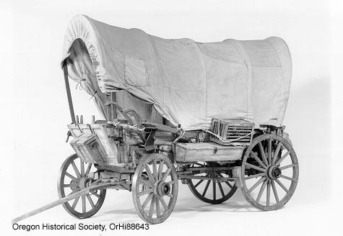
Typical Wagon -1840’s
- 4 ft. X 10 ft. farm wagon ($100-$300)
- canvas top (aka “prairie schooner”- Scottish “schoon” or “to glide”)
- carry up to 2,000 pounds
Most of the wagons did not have a brake, nor did they carry a spare wheel.
Why not?
Note the extra storage boxes fastened to the outside of the wagon.
What do you think is in the slatted box?
31

Slide 32
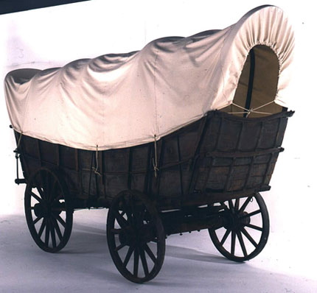
The Conestoga Wagon
- 18 feet long, 11 feet high and 4 feet wide
- carry up to 12,000 pounds
These were very impractical to use to travel west in the early days.
Why?

Slide 33
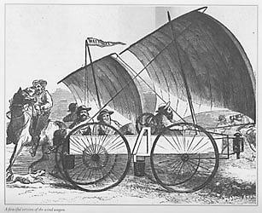
A few of these strange vehicles were built in the 1860’s to travel across the mostly flat lands of Kansas.
“Kansas Wind Wagons”
Built like a small boat, some were about 8’ long and 3’ wide, and it had four large wagon wheels. Weighing about 350 pounds, they could hold 4 people..
It was reported that some of them hit speeds of up to 40 mph!.
When the wind wasn’t blowing, a hand crank was used to turn the wheels!.
What are the pros and cons of such vehicles?
33

Slide 34
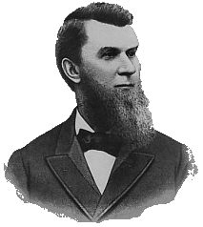
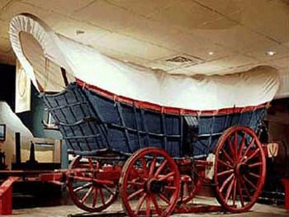
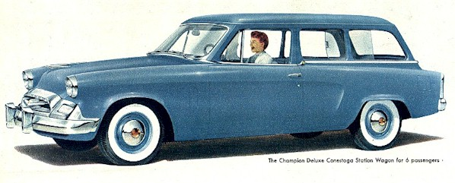
John Studebaker started building Conestoga wagons in the 1850’s.
One hundred years later the Studebaker Company was still providing transportation.
This 1955 model was called “The Conestoga”!
34

Slide 35
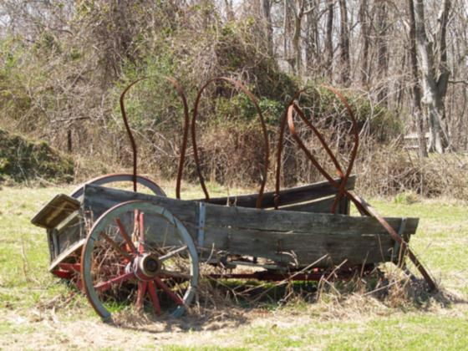
Pioneers often walked to save their animals' strength. Some of the hardships faced on the trail were shortages of food, supplies and water. Rough weather and mountains sometimes forced pioneers to abandon their wagons.
35

Slide 36
“PIONEER CIPHERING”
“ARITHMETIC ON THE WAY WEST”

Slide 37
3. Your wagon train is the last of the season to leave for the West. You are 100 miles west of Fort Laramie and your rear wagon wheel shows signs of weakness. It is too late to go back. You decide to push on to Fort Bridger where there is a blacksmith who can make repairs. Your wheel squeaks once with every rotation as your worry begins to grow. You have 345 more miles to travel. Your wagon wheel covers 14 feet with each complete rotation. If there are 5,280 feet in a mile, how many squeaks will you have to hear before you reach Fort Bridger?
(Round your answer to the nearest whole number!)
130,065 squeaks
5,280 ft. ÷ 14 ft.
= 377.14 or 377 wheel revolutions per mile
feet in a mile distance traveled with one wheel revolution
345 miles X 377 revolutions per mile =
distance to Fort Bridger
What question do you need to answer?
What information do you need to solve the problem?
What sort of math operations do you have to make?
÷
and X
Divide what by what?
Multiply what by what?

Slide 38
Pioneer Note Quiz #2

Slide 39
Film Clip: “Centennial”

Slide 40
“Death Along the Trail”
40

Slide 41
The most common illnesses came from drinking bad water.
41

Slide 42
“Alkali Water”
Alkali (al-kuh-lye) water was water that was full of chemical salts left behind as the water holes began to dry up in the hot weather.
If you drank it, you got an upset stomach and then diarrhea, which left you dehydrated from the loss of fluids.
42

Slide 43
“cholera”
A disease known as cholera (caw-ler-uh) was especially devastating.
It was spread largely from drinking impure water and from not properly washing your hands while preparing or eating food.
It was horrible: diarrhea, vomiting, cramps and then death—a serious attack of cholera could kill in a single day!
The strange thing about cholera was that the doctors in those days knew that dirty water had something to do with the disease, but they didn't know exactly what it was.
43

Slide 44
What saved a lot of pioneers was the fact that they drank strong coffee at every meal.
“cholera”
They did this because the water along the trail was usually pretty disgusting tasting and the only way they could disguise the taste of the water was with lots of coffee.
So, when they boiled their coffee they were actually destroying the germs that caused cholera!
44

Slide 45
“drug overdose”
Believe it or not, a lot of people died from drug overdoses.
This may sound strange, but it really wasn't unusual.
It happened because at the first sign of an illness the pioneers tended to take great quantities of medicine.
They figured that the larger the dose of medicine the faster they would recover.
45

Slide 46
“drug overdose”
Unfortunately, one of the most common medicines of the day
was called "laudanum" (lawd-num).
Laudanum (lawd-num) was a mixture of alcohol and
opium (oh-pee-um),
…and opium (oh-pee-um) is a very dangerous narcotic.
Just imagine a mother who thinks she is doing the right thing
by giving her children a strong dose of laudanum (lawd-num)
to help them get better.
The little ones would drift off to sleep and....
never wake up again.
How horrible to have accidentally killed your own children!
46

Slide 47
“Death Along the Trail”
Many emigrants contracted measles, as well as dysentery (dis-un-tary)…
which is a disease of the intestines brought upon
by bad water...
not to mention smallpox, typhoid and
“mountain fever”.
Besides all of this, there were numerous accidents that claim other lives…
47

Slide 48
“PIONEER CIPHERING”
“ARITHMETIC ON THE WAY WEST”

Slide 49
A group of 25 travelers from Illinois crossed into the Great Basin. Before long, they ran low on clean water and some of them began to drink alkali water. The next morning, fifteen of the travelers continued on their journey. The rest of the travelers stayed behind in their camp with stomach cramps from drinking the bad water. What percentage of the group continued on the trip?
Problem to Solve?:
“What is the percentage of travelers who continued on the trip?”
Method?:
“I subtracted the number of people who stayed behind from the total number of travelers.”
25 – 15 = 10
“I took that number and divided it by the total number of travelers to get the answer.”
10 ÷ 25 = .40
Answer?:
Forty percent of the travelers continued on the trip.

Slide 50
“PIONEER CIPHERING”
“ARITHMETIC ON THE WAY WEST”

Slide 51
2. You reach the Sweet Water River in the central part of what will become the state of Wyoming. The only safe water crossing is blocked by an enormous herd of buffalo that doesn’t seem to be in any hurry to cross the river. You tried to stampede the herd, but that didn’t work. You have to wait. If the herd contains 30,000 buffalo and only 250 wander across the river each hour, how much time is it going to take before your wagons can cross? ANSWER: _____________________________
= 120 hours or 5 days!
30,000 ÷ 250
Number of buffalo which cross each hour
Total number of buffalo
What question do you need to answer?
What information do you need to solve
the problem?
What sort of math operations do you
have to make?
÷
Divide what by what?

Slide 52
But even for all the troubles they had…
the emigrants saw the most incredible sights…
52

Slide 53
A “Soddy”
- Some families homesteaded on the Great Plains
- shortage of wood and stone
- homes built out of thick chunks of prairie sod
- lined with canvas or plaster
- damp, lots of insects
53

Slide 54
Pioneer vs. American Indian
In the beginning, American Indians:
-acted as messengers and guides
-traded goods for foods
-rarely attacked settlers
Later, when miners and railroaders came west, there was more trouble.
54

Slide 55
Pioneer Note Quiz #3

Slide 56
Film Clip: “Centennial”

Slide 57
“Name That Landmark”
“Shiprock,” in northern New Mexico

Slide 58
“Teapot Dome”
“?”
58

Slide 59
“Devil’s Tower”
“?”
59

Slide 60
“Jail Rock” “Courthouse Rock”
“?” “?”
60

Slide 61
“?”
“Devil’s Gate”
61

Slide 62
“?”
“Split Rock”
62

Slide 63
“?”

Slide 64
“Chimney Rock”
Rising nearly 300 feet above the surrounding North Platte River valley in Western Nebraska, it served as a landmark along the emigrant trails.
The first recorded mention of 'Chimney Rock' was in 1827 by Joshua Pilcher, who had journeyed up the Platte River valley to the Salt Lake rendezvous of the Rocky Mountain fur trappers.
One curious emigrant took ten thousand forty steps to walk around it!
64

Slide 65
“?”
65

Slide 66
“Scott’s Bluff”
The first large rock formations along the river where the Great Plains started giving way to the foothills of the Rocky Mountains, the bluff became a regular landmark emigrants bound for Oregon and California.
It was named after a fur trader named Hiram Scott, who died near the bluff in 1828.
830 feet high!
66

Slide 67
“?”
67

Slide 68
“Independence Rock”
A large granite rock, approximately 130 feet high, it became an important stopping place along the trail.
It was said that you needed to reach this place by the Fourth of July in order to make it to your destinations before the first mountain snowfalls.
During their rest at the rock, many emigrants carved their names into the rock to record their passing.
68

Slide 69
Another important path west was the Santa Fe Trail, which led from Independence, Missouri to Santa Fe , New Mexico.
Wagon tracks on the Santa Fe Trail are still visible today!
69

Slide 70
This path was dangerous because of, but traders took it because of the lure of high profits.
WHY WERE THE PROFITS SO HIGH?
70

Slide 71
LATTER-DAY SAINTS
Latter-day Saints were also known as Mormons. Their church was founded by Joseph Smith and its writings were called the Book of Mormon. One of their beliefs that caused them to be "persecuted" (harassed) was polygamy, in which one man is married to several women at the same time.
Joseph Smith
71

Slide 72
After their leader was murdered in 1844, a man named Brigham Young led the Saints to a new home in the West, near the Great Salt Lake in Utah, where they prospered.
72

Slide 73
The Donner Party
Delayed by series of mishaps, they
were trapped in Sierras winter of 1846–47.
73

Slide 74
The emigrants were slowed by following a new route called the Hastings Cutoff.
Lansford Hasting wrote a guide book for the emigrants heading west.
Lansford Hastings
James and Margaret Reed
(Members of the Donner Party)
74

Slide 75
The cut-off crossed Utah’s Wasatch Mountains and the Great Salt Lake Desert.
75

Slide 76
They also had trouble traveling along the Humboldt River and the Forty-Mile Desert in Nevada.
76

Slide 77
They became trapped by an early, heavy snowfall near Truckee (now Donner) Lake, high in the mountains.
77

Slide 78
- food supplies ran low
- no rescue for four months
- some members resort to
cannibalism
Lewis Keseberg is singled out as the most vile of cannibals!
78

Slide 79
Of the 87 people of the Donner Party, 39 died.
Georgia and Eliza Donner were adopted by Mary Brunner after their parents perished in the mountains.
Memorial at Donner Lake campsite.
79

Slide 80
The discovery of gold in California brought not only hundreds of thousand more people to the West, but changed the lives of all Americans in many different ways.
“Colorado Gold Rush”
by Alfredo Rodriguez
2004
80

Slide 81
Settlements
grew into towns…
and then into cities.
81

Slide 82
To be continued….

