Slide 1
Civil War Brainstorm
In groups of four:
(Need a Recorder)
Brainstorm: List as many isolated names, dates, facts, etc. as can you can from your personal knowledge of the Civil War.

Slide 2
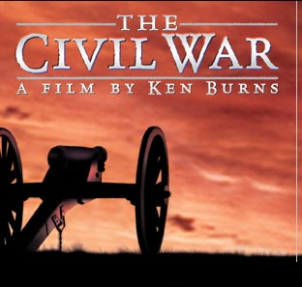

Slide 3
for a change.
Let’s try peace
Tie Dye Productions
A
History Dept.
Power Point

Slide 4
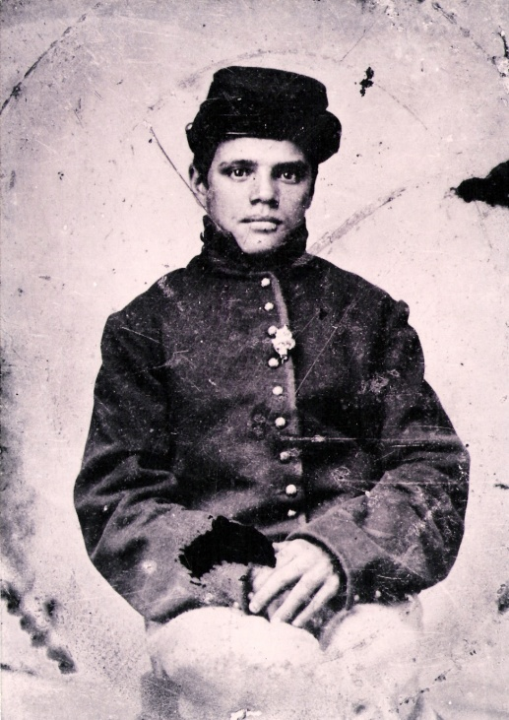
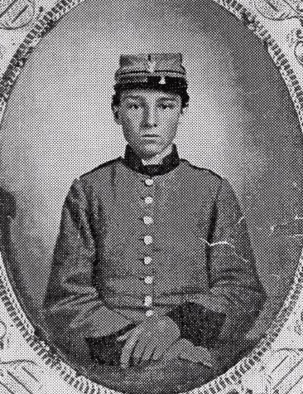
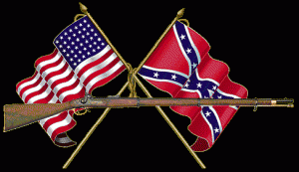
“THE CIVIL WAR”
A Nation Divided
Private James Hickson lied about his age to join the 16th Pennsylvania Cavalry and survived a serious wound at the Battle of Richmond. He returned home, married his sweetheart and moved West to work for the Union Pacific Railroad.
Young Georgia Private Edwin Jennison was killed in the Seven Days Battles at Malvern Hill – the face of a lost generation

Slide 5
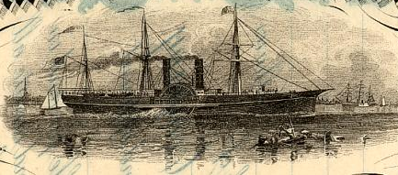
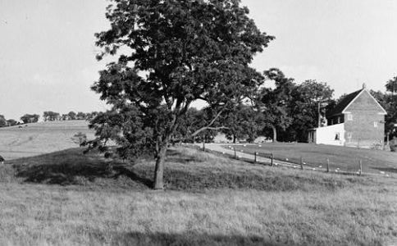
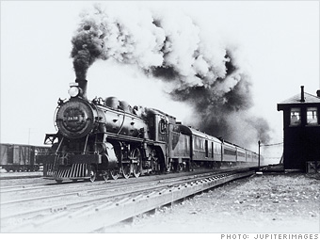
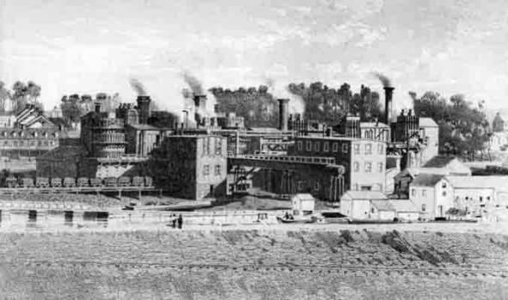
I. The North
A. industrial society
1. factories, cities, family farms,
shipping and trade

Slide 6
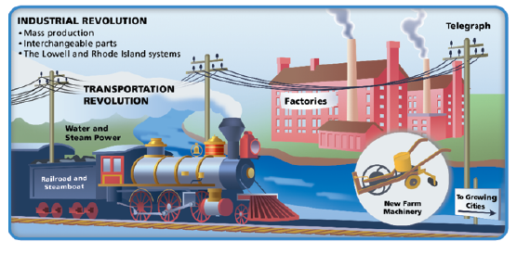
The Industrial Revolution affected all of America, but it took hold much more quickly in the North than in the South.

Slide 7
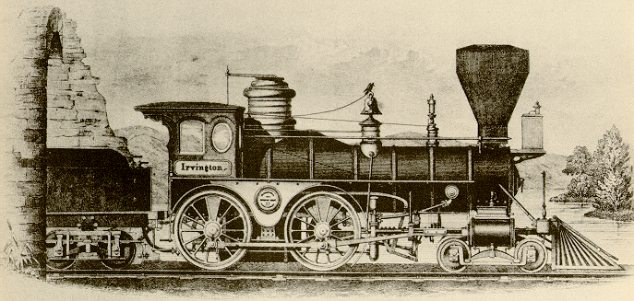
Pair-Share: Compare the difference in railroad between North and South. What effect could this have in the upcoming war?

Slide 8
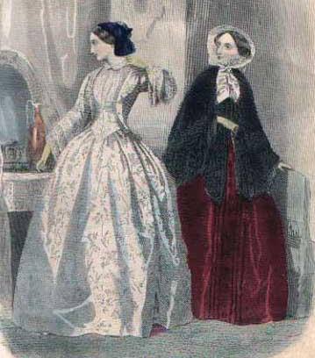
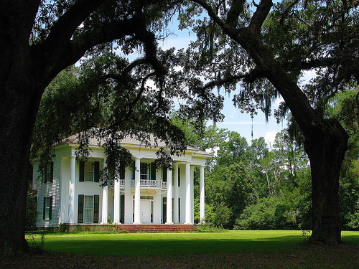
II.
“The South”
8

Slide 9
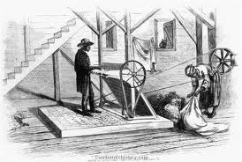
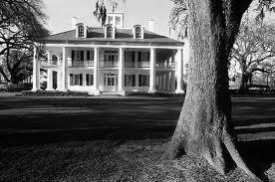
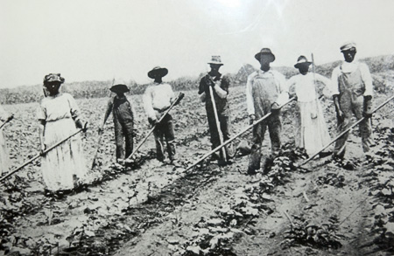
A. Rural Society
1. large farms based on cash crops
2. use of slavery
3. wealthy planters, poor white farmers and slaves

Slide 10
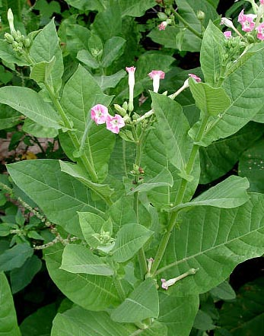
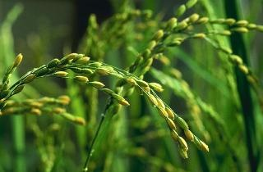
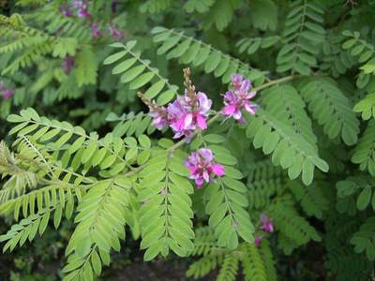
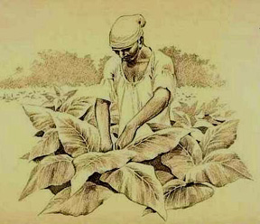
B. Agriculture
1. Before the American Revolution, three crops dominated
southern agriculture.
a. tobacco
b. rice
c. Indigo
2. All three crops required slave labor to harvest.
?
?
?

Slide 11
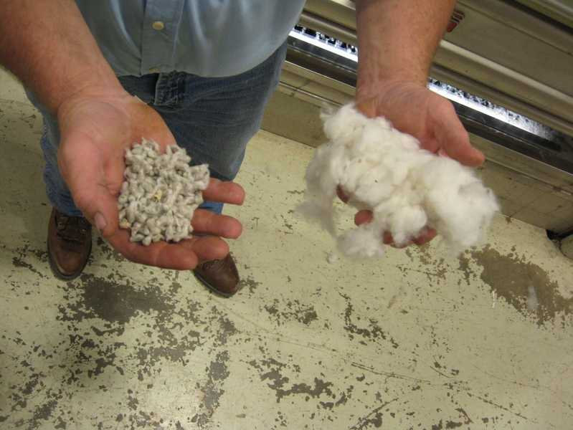
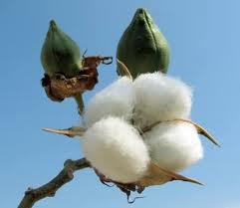
3. After the Revolution the prices for these crops dropped.
a. demand for and price of slaves went down
b. farmers begin to grow cotton
i. difficult to process cotton
ii. removing the seeds was time-consuming and expensive.

Slide 12
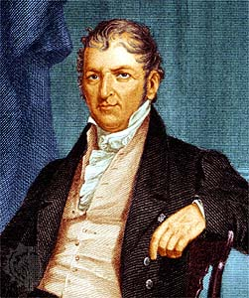
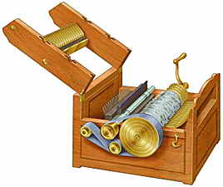
4. Eli Whitney’s “Cotton Gin” (1797)
a. greatly reduced the time needed to process cotton
i. crank turned roller with teeth & stripped seeds from
cotton fiber
ii. brushes on second roller lifted seedless cotton off teeth
and dropped it out of gin
iii. belt connected rollers so they would both turn with crank

Slide 13
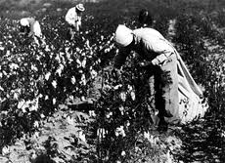
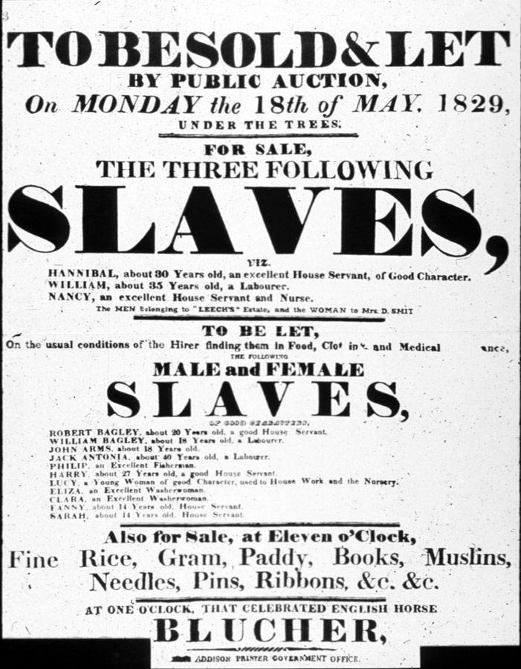
b. The cotton gin revolutionized (completely changed) the
cotton industry.
i. encouraged the growth of slavery
ii. more workers needed to pick increased amount of cotton
which could be processed

Slide 14
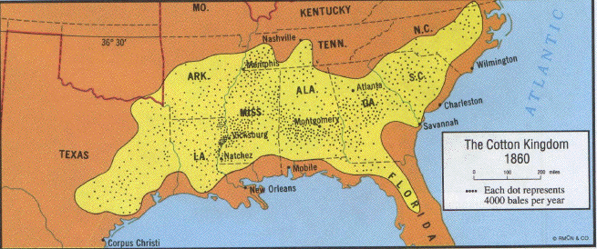
The “Cotton Kingdom”
How many of these states fought against the North in the Civil War?

Slide 15
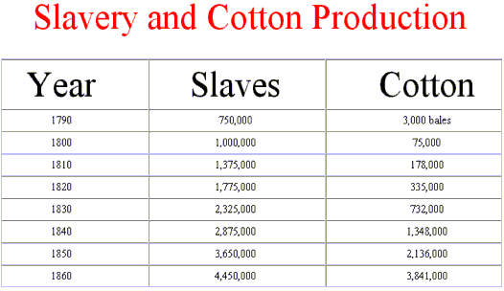
c. Because the South made so much money with cotton, it did
not focus on building factories to produce other goods.
i. made it difficult to fight the industrialized North when
war broke out

Slide 16
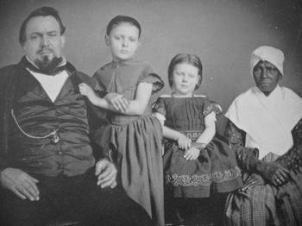
C. Southern Society
1. Social Class
a. most important are wealthy plantation owners
b. largest group were small farmers
c. 1/3 of population owned slaves

Slide 17
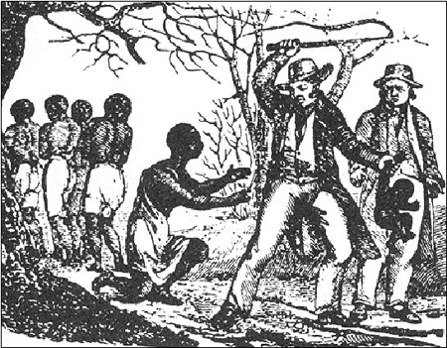
2. Attitude/justification toward slavery
a. Economic
i. necessary part of the workforce
b. Religious
i. wealthy white southerners argued that God created
some people, like themselves, to rule others.
c. Social
i. whites generally looked at slaves as ignorant children,
unable to take care of themselves

Slide 18
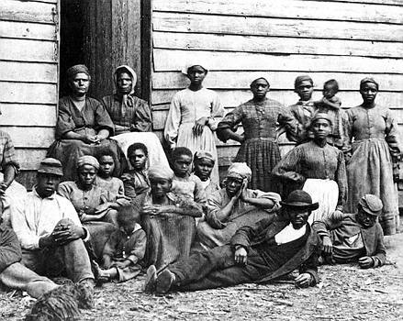
3. Slave Codes
a. strict laws that many states passed to control
slaves’ actions.
i. illegal for slaves to travel far from their homes
ii. illegal to educate them

Slide 19
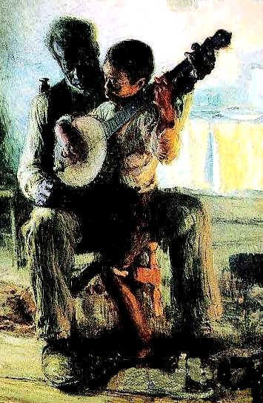
D. Slave Culture
1. maintained traditions and beliefs
a. made time for social and family activities
b. passed down family histories
c. practiced their religion
d. sang spirituals

Slide 20
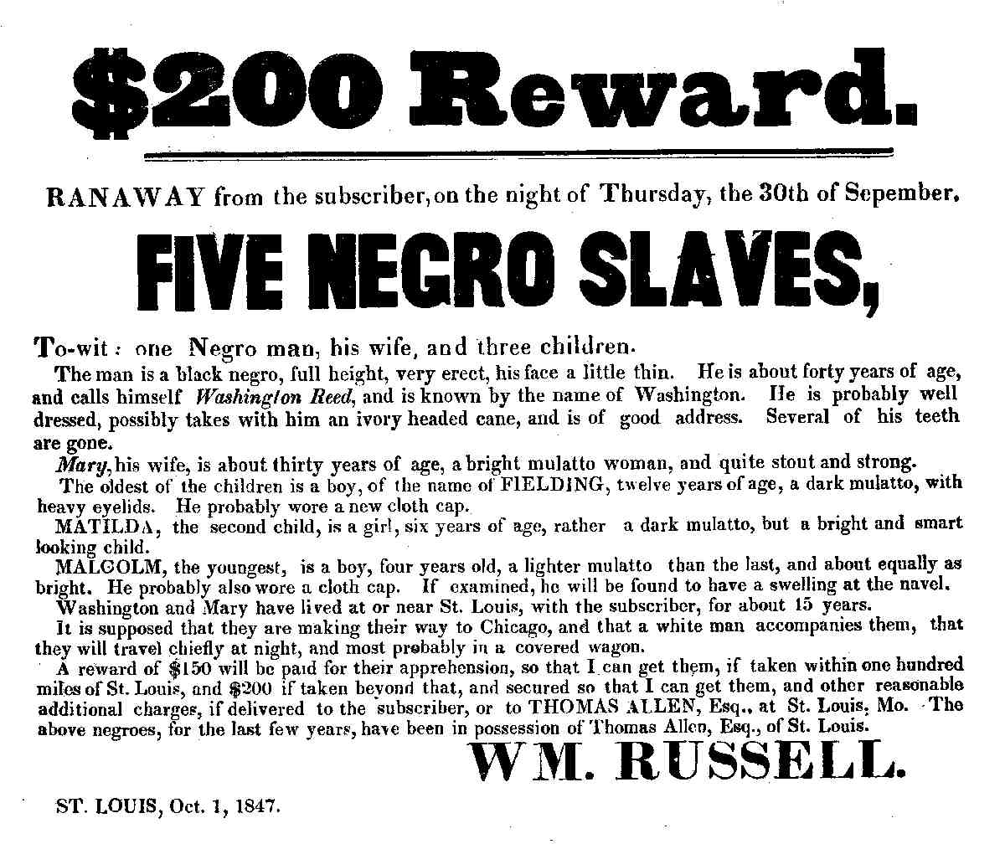
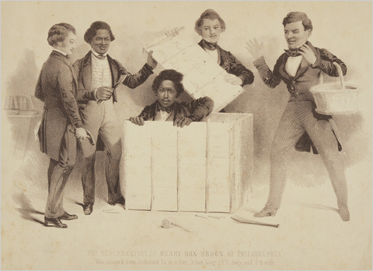
2. Non-violent Resistance
a. maintain religious beliefs/practices
b. working slower/pretended ignorance
i. led to stereo typing
c. running away
i. recapture = punishment
Henry “Box” Brown
March 23, 1849
“mailed” himself to freedom
Virginia to Philadelphia (express mail)
wooden box 3 ft. long, 2’ 8” deep, 2’ long
arrived upside down

Slide 21
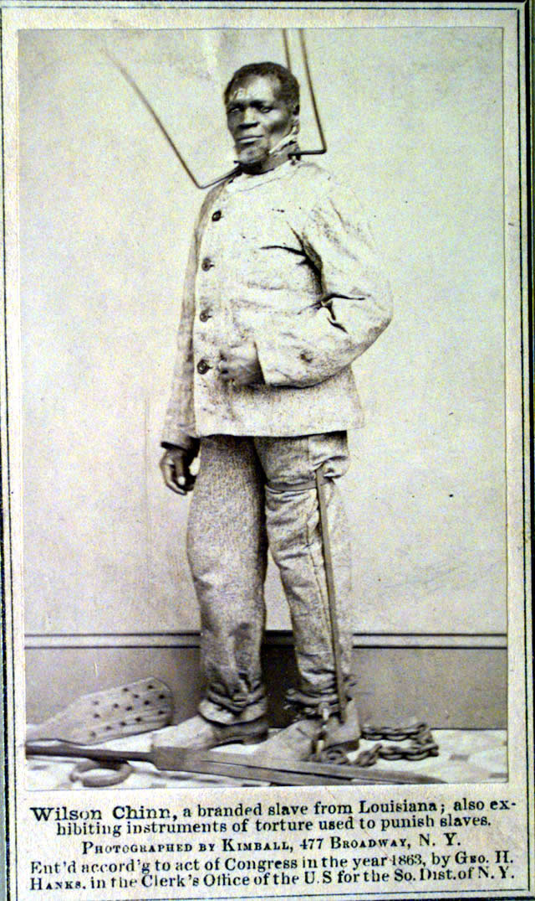
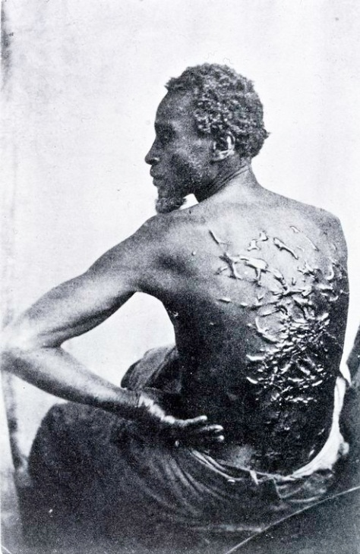
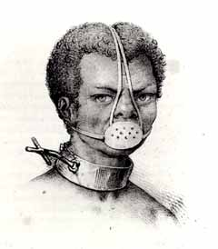
Runaway and obstinate slaves were often severely punished!
Discuss: So why keep resisting?

Slide 22
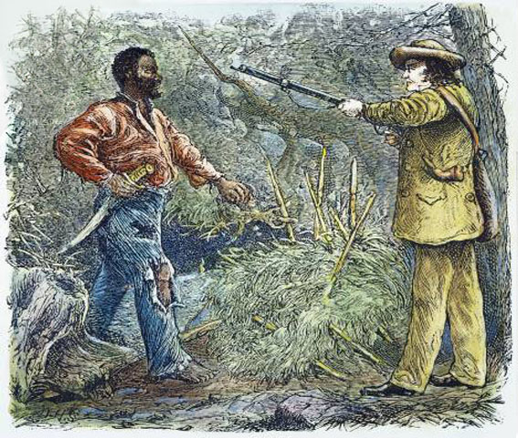
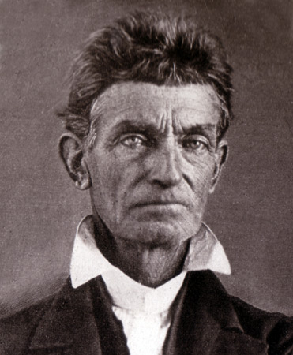
3. Armed Rebellion: Nat Turner’s Rebellion (1831)
a. Believed God had sent him to end slavery
b. kill all slaveholders and family in Southhampton Co. VA
c. Outcome:
i. 60 whites killed
ii. 100 innocent slaves killed
iii. many states strengthened
slave codes
Twenty-eight years later, Southern fears about a slave uprising would be revived by an abolitionist named John Brown

Slide 24
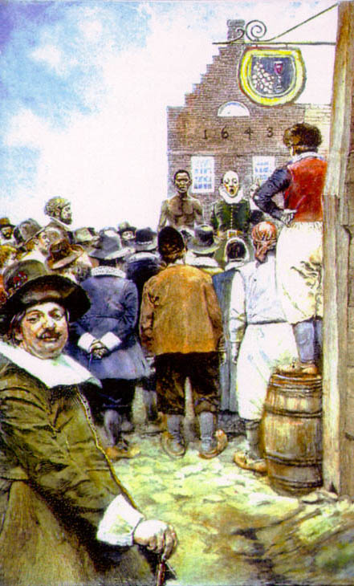
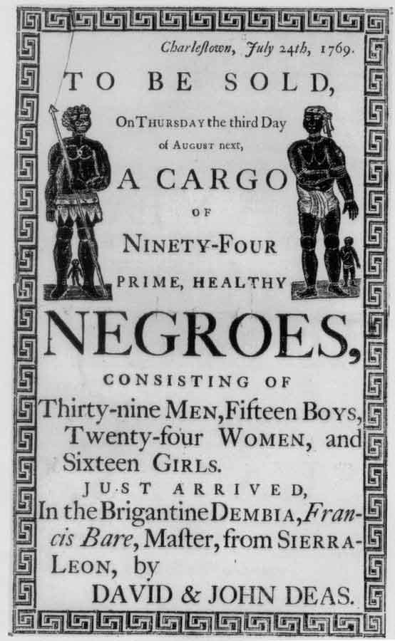
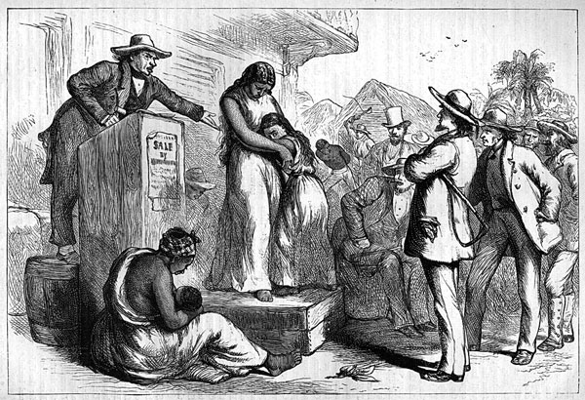
III. Battle Over Slavery
A. Slavery had existed in America since
Jamestown (1607)
Handbill for slave auction in Charlestown, South Carolina

Slide 25
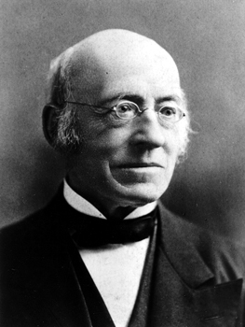
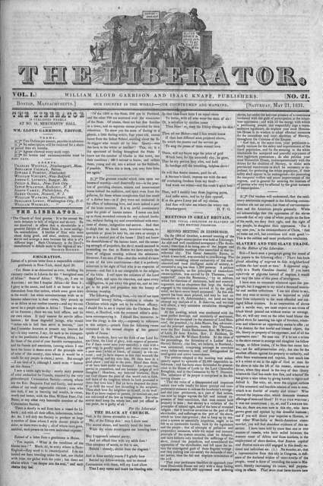
B. Abolitionist
1. a person who struggled to end slavery
a. William Lloyd Garrison: early
Abolitionist leader
i. By 1831, started his own abolitionist
newspaper, The Liberator.
ii. called for an immediate end to
slavery
iii. Said “slavery is sin and those
who maintain it, criminals.”
You’re a wealthy Southern slave owner. What is Garrison saying should happen to you?

Slide 26
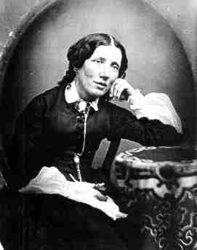
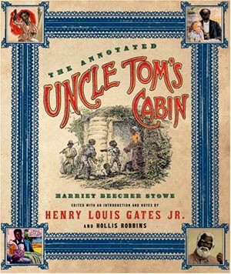
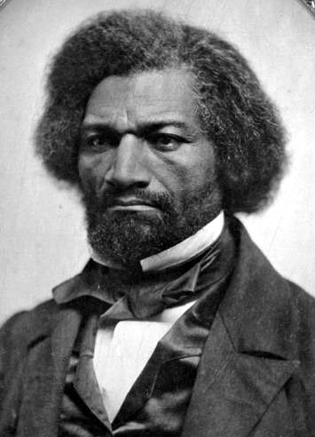
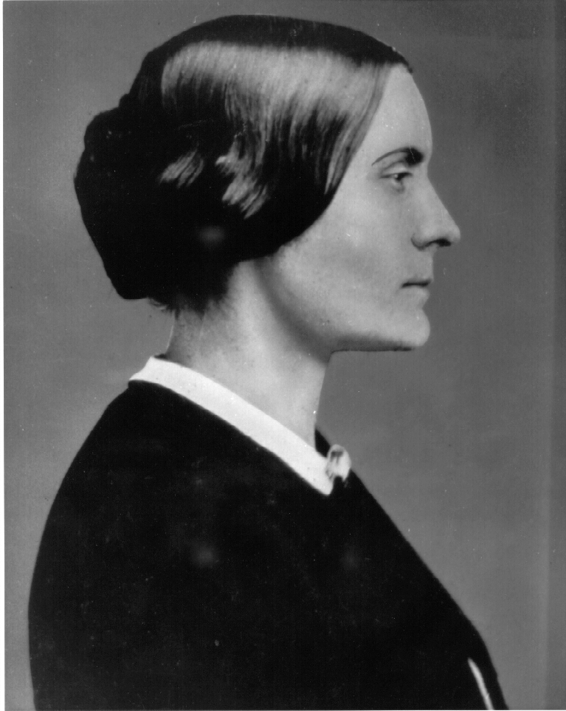
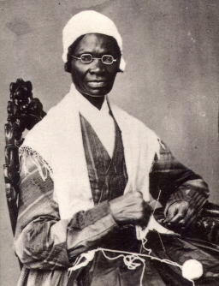
C. Many abolition supporters
1. Harriet Beecher Stowe wrote
“Uncle Tom’s Cabin” in 1852
a. sold over 300,000 copies the
first year
2. Frederick Douglass, Sojourner
Truth and Susan B. Anthony
were other well-known Abolitionists
Douglass
Truth
Anthony

Slide 27
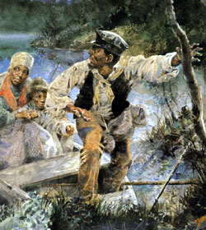
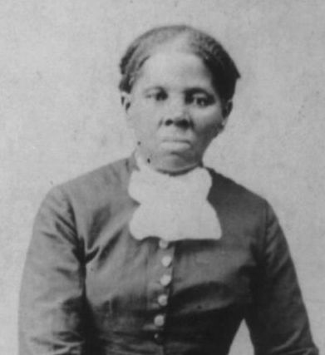
D. Underground Railroad
1. system of trails and safe
houses to help slaves
escape to the North
2. One of the “Conductors”
was Harriet Tubman

Slide 29
The Underground Railroad
An iron jockey, in a secret way, pointed to safe houses along the Underground Railroad.
"These statues were used as markers on the Underground Railroad throughout the South into Canada. "Green ribbons were tied to the arms of the statue to indicate safety; red ribbons meant to keep going."
A “Safe House” in Quincy, Illinois

Slide 30
IV. The Government Tries to Keep It Equal
A. The Missouri Compromise (1820)
1. Missouri is slave state and Maine is a free state
a. must have equal representation in Congress
2. Northern Louisiana Purchase area will be free states

Slide 32
B. The Compromise of 1850
1. California is a free state, slavery
outlawed in D.C.
2. Fugitive Slave Law passed
a. appease the South
i. Any runaway slave may be captured and
returned to the South

Slide 33
The Fugitive Slave Act
- forced return of runaways to the North regardless of time spent
there
- “Commissioners” (legal slave catchers) can force people to help catch runaways.

Slide 34
The Fugitive Slave Act
- captured runaway could not testify on his own behalf and was not entitled to a court trial.
-Commissioners received 10 dollars for every slave returned, so if a black person did not have any papers proving freedom, even if he was actually a free person by birth or purchase, he was swept up with the rest.
-The more that were taken south, the more money the commissioners would make!
North Carolina 1859 badge

Slide 35
C. The Dred Scott Case (1857)
1. lived in the free North for nearly ten years
a. with master Maj. John Emerson
2. Emerson returns to Missouri
a. dies
3. Scott claims freedom for time spent in North
a. Missouri court frees Scott
4. Emerson’s wife (Isabell Sanford) sues
a. case ends up in U.S. Supreme Court
5. Dred Scott v. Sanford:
a. Supreme Court rules African Americans aren’t citizens so they
cannot bring a lawsuit before a court.
i. Chief Justice Roger Taney said: “A black man had no rights a
white man was bound to respect.”

Slide 36
D. Kansas/Nebraska Act of 1854
1. Each territory would decide the issue of slavery
a. Repealed the Missouri Compromise of 1820
b. Kansas to vote on slavery issue
c. Nebraska to join Union as free state

Slide 37
E. Territory called “Bleeding Kansas” due to
many violent disagreements & bloodshed
1. “Pro-Slavery” vs "Free- Soilers"
a. each create separate governments
WHAT IS GOING ON HERE?

Slide 39
2. "Sack of Lawrence", Kansas by pro-slavery ruffians
a. anti-slavers killed/town ransacked & burned
Cannon used by pro-Slavers

Slide 40
3. Pottowattame Massacre (May, 1856)
a. Abolitionistohn Brown & others kill
5 pro-slavers
i. hack them to death with broadswords
ii. retaliation for "Sack of Lawrence"
4. violence continues for 2 more years
a. one more step towards a civil war

Slide 41
F.
1. Brown led a small force in an attack on the
Federal Arsenal at Harper's Ferry, VA (Oct. 1859).
a. steal weapons
i. hoped to rally and arm local slaves and abolitionist whites
ii. hoped to terrify Southern slave holders
An “arsenal” is a weapons storage site.

Slide 42
2. Outcome:
a. raid was unsuccessful
b. Brown wounded and captured,
c. convicted of treason and hanged.
3. Effect:
a. further angered abolitionists in the North
b. alarmed the South even more
c. Southern militias begin to seriously train
Harriet Tubman was kept from participating in the raid because of an illness!

Slide 43
G. Election of 1860
1. Abraham Lincoln (R) vs. Stephen Douglas (D)
a. All about slavery
b. North outvotes the South; Lincoln wins.
What do you notice about the different political parties?

Slide 44
V. The South Secedes
A. South Carolina first (Dec. 1860)
1. Based secession on States Rights argument
a. States can leave the Union because they had joined
voluntarily
B. Six more states quickly follow:
1. Mississippi, Florida, Alabama, Georgia, Louisiana and
Texas
Confederate “Stars and Bars”

Slide 45
C. “Border States”
1. Slave states that did not join the rest in secession.
a. Delaware, Kentucky, Missouri and Maryland
2. Slave states that did not join Confederacy until after
the attack on Ft. Sumter
a. Virginia, North Carolina, Arkansas and Tennessee
i. Secessionist groups in Kentucky and Missouri
joined the Confederacy
ii. given stars on the “Confederate Battle Flag.”

Slide 47
D. Confederate States of America established
1. President: Jefferson Davis
2. Capital: Richmond, Virginia
In describing Jefferson Davis, Texas governor Sam Houston said, “He’s as cold as a lizard and as ambitious as Lucifer.”

Slide 48
E. Fort Sumter, South Carolina (April 12, 1861)
1. First conflict of the war
2. Confederate victory
Fort Sumter Flag

Slide 49
Explosion at Fort Sumter

Slide 50
F. Lincoln & Lee
1. Lincoln offers command of entire
Union Army to Robert E. Lee .
a. Lee refuses
i. cannot fight against his home state of
VA.
ii. resigns from U.S. Army
iii. accepts command of Army of N. Virginia
Arlington House, home of Robert E. Lee overlooks the U.S. Capitol

Slide 51
"I cannot raise my hand against my birthplace, my home, my children.”
R.E. Lee

Slide 52
VI. The Call to Arms
A. Divided loyalties
1. Family members sometimes chose
different sides
Mary Lincoln had four brothers in the Confederacy
Maj. Gen. Thomas L. Crittenden (left) fought for the Union, and his brother Maj. Gen. George B. Crittenden for the Confederacy.

Slide 53
B. Volunteers
1. Confederacy: initial call of 100,000
a. one-third of those who initially
volunteered were turned away.
i. hoped for quick victory or help
from Europe

Slide 54
2. Union: initial call for 75,000 men
3. Both sides expected to win within
90 days.
a. Neither thought they would
need permanent armies.

Slide 55
A SOLDIER’S PAY
$25.50 /mo. with clothing and rations to men with wife and two or more children
$23.50 /mo. with clothing and rations to men with wife and one child
21.50/ mo. with clothing and rations to men with wife only
15.50 /mo. with clothing and rations to single men
Military pay differed between North and South

Slide 56
Why would soldiers bring their families to live with them in camp?
While wealthy civilians could avoid military service, poorer men were drafted to serve in the Union army. This member of the 31st Pennsylvania Infantry brought his family along with him. His wife probably helped the soldier with many daily chores such as cooking and laundry.

Slide 57
C. The Draft
1. began in 1862
2. Each Union state was required to
send men to fight.
a. 18-45 years old
3. avoiding the draft
a. pay $300
b. hire a substitute to fight for you
4. Thousands of Irish immigrants fresh off the boat
signed up.
a. no other jobs available
b. suffered highest number of casualties in the
War.

Slide 58
Secret Soldiers
About 250 women are thought to have served in the Confederate army disguised as men, with about 400 women serving in a similar manner in the Union Army. Frances Clayton was one such female. She allegedly served in Minnesota artillery and cavalry units along with her husband. According to contemporary newspaper reports, "the better to conceal her sex, she learned to drink, smoke, chew and swear with the best, or worst, of the soldiers."

Slide 59
General
P.G.T. Beauregard
West Point Class of 1838
VII. Resources
A. South
1. Advantages
a. fighting a defensive war
b. skilled to use guns and ride horses
c. Many officers had attended West Point Military Academy

Slide 60
2. Disadvantages
a. few factories
b. few railroads
c. Small, mostly rural
population
i. 9 million with 3.5 million
of them slaves

Slide 61
B. North
1. Advantages
a. larger population
i. 22 million
b. industry
i. 86% of all factories are in the North
c. Railroad networks
i. controlled 75% of all railways
d. Strong Navy
i. able to blockade southern ports

Slide 62
2. Disadvantages
a. Had to invade and conquer the South
b. Poor training and survival skills
c. No real leadership early in war
d. Lincoln fired a number of
generals because they
weren’t aggressive leaders
Joseph Hooker
George Meade
George McClellan
Irvin McDowell
George Halleck
John Pope
Ambrose Burnside

Slide 63
VIII. The Fight is On!
A. Battles often given two names
1. North – named them for nearby landforms, water
2. South – named for nearest towns or man-made landmark
First Manassas ------------------------ Bull Run
Elkhorn Tavern------------------------ Pea Ridge
Shiloh------------------------------------ Pittsburgh Landing
Cold Harbor---------------------------- Chickahominy
Ox Hill----------------------------------- Chantilly
Sharpsburg----------------------------- Antietam
Murfreesboro -------------------------Stones River

Slide 64
B. Leaders
1. Confederacy – Robert E. Lee
2. Federal – No initial leader
a. George McClellan named commanding general
after the first battle had been fought
3. Most commanders were West Point Academy graduates.
a. All had been taught the same battle strategies.
b. 1/3 of all officers went to the South

Slide 65
IX. Early Battles
A. First Battle of Bull Run (Manassas Junction)
(July, 1861)
1. Just outside Washington, DC
a. People came to picnic and watch

Slide 66
2. Battle showed that both sides needed training
a. “The Great Skedaddle”
i. term used to describe the disorganized retreat of panicked
Union troops back to Washington
b. Confederate victory
BULL RUN | # of troops | Killed or Wounded | Missing/ Captured
 | 28,450 | 1,492 | 1,400
 | 32,230 | 1,752 | ?
McDowell
Johnston
Beauregard

Slide 67
In this photo, local children observe Union cavalry soldiers across Manassas Creek. In August 1862 , a second great battle would be fought on this site.

Slide 68
3. Facts of Interest
a. During the battle, Gen. Thomas Jackson was given the nickname
“Stonewall”.
i. He and his men stood firm during the battle of Bull Run, inspiring
other soldiers to do the same.
ii. “There is Jackson standing like a stone wall.”
b. The “Rebel Yell” was used by the Confederate forces as they
led charges against the Union.
4. Confederate forces had many early victories
In May, 1863, Jackson was accidentally shot in the left arm by a Confederate guard while returning to camp during the Battle of Chancellorsville. The arm was amputated and given a solemn burial near the field hospital. Jackson died a week later. His death was a great loss to the Confederacy.

Slide 69
5. Improved Communication
a. telegraph
i. developed by Samuel Morse
ii. allowed for faster spread of war
news to the public
iii. orders and information sent rapidly by both sides!
Message sent by Lincoln to bring more troops to stop trouble at Fort Sumter, days before the Confederate attack.

Slide 70
B. Antietam (Sharpsburg, Maryland)-Sept. 16-18, 1862
1. Gen. Lee invaded Maryland
2. Bloodiest day of the war (Sept. 17)
a. Over 25,000 killed or wounded
3. Union victory (basically a stalemate)
4. Gen. Ambrose Burnside becomes commander
of Union forces
Lee
McClellan
Burnside

Slide 71
ANTIETAM | # of troops | Killed or Wounded | Missing/ Captured
 | 75,000 | 11,640 | 753
 | 38,000 | 9,298 | 1,018

Slide 72
Lincoln meets with Gen. McClellan at Antietam

Slide 74
C. The Emancipation Proclamation
1. Took effect January 1, 1863
2. Only freed slaves in the states of
rebellion (In name only)
a. Slave escapes increased with the news.
b. At least 20,000 were made free in
areas of the South under Federal
control.

Slide 76
D. African American Soldiers
1. Nearly 200,000 African Americans
fought for the Union during the war.
a. paid less than white soldiers
i. late in the war received equal pay
b. Best Known: 54th Massachusetts Regiment
i. led by Col. Robert Gould Shaw
ii. protested unequal pay
iii. made heroic attack of Fort Wagner (S.C.)
iv. suffered highest number of casualties of any
regiment in the war
Col. Shaw

Slide 77
Civil war artifacts

Slide 78
Cavalry Kit: Civil War cavalryman gear includes boots, boot hook, spare shoes, kepi, gauntlets, pin-fire pistols, a hoof knife, a leather cartridge case for pistol, a pair of hoof trimmers and a horse shoeing hammer. (Photo Credit: Tria Giovan/CORBIS)

Slide 79
Medical Kit: Included in this Civil War medical kit are scissors, gauze and needles. (Photo Credit: Tria Giovan/CORBIS)

Slide 80
Civil War Currency and Coin

Slide 81
Hygiene Items: Example of personal items used during the era of the Civil War. Included in the picture are lye soap, a toothbrush, toothpaste, razor, combs, and a brush. (Photo Credit: Tria Giovan/CORBIS)

Slide 82
Selection of Pistols: Variety of Civil War handguns including a Pepperbox (top) and on the far right a Model Colt .36 navy Revolver. (Photo Credit: Tria Giovan/CORBIS)

Slide 83
Camp Artifacts: Civil War camp objects include a coffee boiler, ladles, mess plates, a salt or sugar shaker, a combination knife-fork-spoon, tin cups, and a coffee bean roaster. (Photo Credit: Tria Giovan/CORBIS)

Slide 84
Civil War Rifles and Carbines: From top to bottom: a Colt Model 1853 rifle used by sharpshooters, a Sharps carbine and a Burnside carbine, invented by Union General Ambrose Burnside. (Photo Credit: Tria Giovan/CORBIS)

Slide 85
Soldier's Shoes: Closeup of a Civil War soldier's shoes. (Photo Credit: Tria Giovan/CORBIS)

Slide 86
America's First Custom-Built Attack Submarine
U.S.S. ALLIGATOR, LAUNCHED IN 1862. 47 FEET LONG- HAD
NUMEROUS PROBLEMS. SANK IN 1863 DURING A STORM OFF
COAST OF CAPE HATTERAS AND NEVER SAW ACTION!
THE SEARCH FOR IT IS STILL ACTIVE!

Slide 87
X. War in the West
A. Battle of Shiloh (Tennessee) (Pittsburgh Landing) April 6-7, 1862
1. Confederacy winning early on but the Union brought in
reinforcements using the Tennessee River
Grant
Johnston
Beauregard

Slide 88
The Confederates made 11 charges against the Union defenders of what was called “The Sunken Road”
The Rebels nicknamed this area the “Hornet’s Nest” because of the stinging shot and shell they had to face.
“The Sunken Road”

Slide 89
2. Union victory
The Battle of Shiloh takes its name from a Methodist log church that stood during the battle. (recent reconstruction)
SHILOH | # of troops | Killed or Wounded | Missing/ Captured
 | 66,812 | 10,162 | 2,885
 | 44,699 | 9,740 | 959

Slide 90
B. The “Minie Ball”
1. During the battle at Shiloh, General Albert Johnston
was hit in the leg by a stray Federal minie ball.
2. The bullet struck an artery and without a surgeon
nearby, he quickly bled to death.
3. The minie ball was named after one of its developers,
Claude-Étienne Minié
a. Union soldiers used a three-ring minie ball, while
Confederates used one with two rings.
Gen. Johnston
Minié

Slide 91
b. much more efficient than the traditional musket ball
i. allowed for faster loading
ii. The bullet came through the barrel much faster.
iii. Large numbers of potential recruits were turned away
because they did not have six opposing upper and lower
front teeth to bite off the end of the tough, paper powder
cartridges!
A Civil War paper cartridge
The rings on the minie ball allowed the bullet to grip the inside of the barrel tighter, so that less of the combustion gasses escaped past it and propelled it with more speed and accuracy.

Slide 92
Reconstructed Femur (thigh bone)
Minie Ball Damage
(Photo Credit / Armed Forces Institute of Pathology)
Amputation Kit
3. more killing power!
a. The minie ball was so destructive that it
shattered bones beyond repair, which
usually led to amputation.

Slide 93
The Battle of Spotsylvania, Virginia, in May 1864 pitted 100,000 Union troops against 52,000 Confederates.
The fiercest fighting occurred in pouring rain on May 12.
For 23 hours straight the two sides fought hand-to-hand in a field near fortifications known as the Mule Shoe, and afterward as the “Bloody Angle”.
The intensity of the fight at the Bloody Angle is reflected in this 22 inch oak stump that was shredded by bullets.
Bodies five feet deep after each charge and repulse.
Casualties were severe on both sides – the Union with 18,000 and the Confederates with 12,000.

Slide 94
With so many bullets flying through the air and cannon shells exploding across a battlefield, soldiers knew it was only a matter of time before they were killed.
"Cold Harbor. June 3rd. I am dead.”
-A note with those words on it was found on a Union soldier, pinned to the inside of his jacket.
Many Union soldiers had placed final notes to their loved ones inside their jackets prior to leaving their entrenchments in a suicidal attack at the Battle of Cold Harbor on June 3rd, 1864.

Slide 95
C. Siege of Vicksburg (Mississippi) ( May-July, 1863)
1. The city of Vicksburg backed up to the Mississippi River.
2. Grant’s forces surround and push Confederates towards city
3. Porter’s Federal gunboats take control of river.
a. no supplies and no escape
4. Rebels surrender after 40 days.
a. Union victory
Gen. Grant
April 16, 1863: Federal gunboats transports tried to sneak past with lights blackened and smokestacks muffled. The Confederates, of course, saw them and opened fire. The fiery display of night battle lasted only a short time. Only one ship, the transport in the center of the painting was lost. Grant's plans were successful and Vicksburg was eventually taken. The strategy is now considered a classic and required study at West Point.
Commodore Porter
“Battle of Vicksburg” by Andy Thomas

Slide 96
During the siege of Vicksburg, townspeople took refuge in caves against the constant shelling by Federal cannons

Slide 97
Civil War cannon and mortar:
Some cannon balls were filled with large musket balls to increase the killing power!

Slide 98
Vicksburg commander, Confederate Gen. Pemberton, was captured and later exchanged for federal prisoners.
Examples of Bitterness:
The city of Vicksburg would not celebrate Independence Day for about eighty years as a result of the siege and surrender.
When Pemberton died in Philadelphia in 1881, his original burial site in Laurel Hill Cemetery was protested by families of several famous people, such as General George Meade, Thomas McKean (Signer of the Declarartion of Independence) and Admiral John Adolphus Bernard Dahlgren, who didn’t want a rebel buried next to such important Americans. Pemberton was then buried on the outskirts of the cemetery.
Interesting note:
Pemberton’s nephew, John, a southern soldier, would later invent a drink called:
VICKSBURG | # of troops | Killed or Wounded | Captured
 | 75,000 | 4,835
 | 38,000 | 3,202 | 29,495

Slide 99
D. 1863: Ulysses S. Grant becomes
commander of all Union armies
1. failure in private life
2. bold and stubborn military leader
3. Many call for his removal after 13,000 troops
killed during Union loss at Shiloh (1862)
4. President Lincoln refuses to remove him :
a. A. Lincoln: "I can't spare this man; he fights.”
5. nicknamed “Unconditional Surrender Grant”

Slide 100
XI. Later Battles
A. Battle of Gettysburg (PA) July 1-3, 1863
1. Lee’s armies invade the North
a. hoped to threaten Philadelphia, Baltimore and Washington
i. force an early end to the war
b. 166,000 men participate
Lee
Meade

Slide 101
2. Confederates initially push back the Federal Troops.
a. reinforcements arrive—Federals make a stand
July 1
July 3

Slide 102
3. Many deadly “see-saw” engagements:
a. “Cemetery Ridge”
i. Confederate attack driven back

Slide 103
b. “Little Round Top”
i. 20th Maine defends with bayonet charge
Col. Joshua Chamberlain

Slide 104
Film Clip: Gettysburg: “Little Round Top”
http://www.youtube.com/watch?v=OGcFxcQwTfk

Slide 105
c. “Pickett’s Charge”
i. failed last Confederate attempt to break the Union lines
George Pickett
One of Pickett’s
commanders, Lewis
Armistead, leads the
famous charge. Wounded, he dies the following day.

Slide 106
4. Union victory
a. Lee loses for the first time
b. casualties: nearly 50,000 (killed, wounded, missing, taken prisoner)
c. last invasion attempt by the South
GETTYSBURG | # of troops | Killed or Wounded | Captured/ Missing
 | 93,921 | 17,686 | 5,369
 | 71,699 | 17,401 | 5,830

Slide 107
5. The Gettysburg Address (Nov. 19, 1863)
a. Given by Pres. Lincoln at the dedication of the cemetery
at Gettysburg, PA
i. talked about a new nation with equality for all citizens
ii. “Four score and seven years ago…”
Taken as Lincoln was leaving

Slide 108
B. Grant’s Offensive Plan
1. “Total War”
a. Destroy everything that could not be
consumed by Federal forces
i. factories, fields, railroads,
livestock, etc.
b. relentless pursuit of Confederate armies
c. “Sherman’s March to the Sea”
i. Gen. Sherman’s army marched
through through Georgia to the
Atlantic coast
William Tecumseh Sherman

Slide 109
ii. Burned most of Atlanta, Georgia (Sept. 1864)
iii. Burned and destroyed homes, fields—everything
of value from Atlanta to the Atlantic Ocean
iv. anger and resentment remain to present day
A family flees Sherman’s army
Tearing up railroad tracks

Slide 110
4. South cut in half
a. No food, no supplies
i. The Confederacy begins to crumble
5. Gen. Sheridan
a. harasses Lee’s forces in the Shenandoah Valley
of Virginia
i. does his share of destruction as well.
b. blocks Lee’s escape
i. forces the surrender

Slide 111
XII. The Surrender (April 9, 1865)
A. Appomattox Court House, Virginia
1. Lee to meet with U.S. Grant at McLean House
The Wilbur McLean House
Federal troops waiting for Lee’s arrival

Slide 112
B. Lee surrenders to Grant
1. Lee dressed in his finest uniform.
a. Grant arrived in a mud-spattered uniform—a government-
issue flannel shirt with trousers tucked into muddy boots
* A few days earlier, Sheridan’s cavalry had been so close to capturing Lee’s headquarters wagon that it had to be destroyed. Besides the important documents and plans, the wagon also contained Lee’s dress uniform. Lee didn’t want to lose it so he put it on instead, otherwise he would have been wearing his older, warn uniform as well!

Slide 113
2. Generous terms
a. Confederates not imprisoned or prosecuted for treason
b. Lee’s army given food rations
c. soldiers leave guns but keep horses and mules
i. needed for spring planting back home.
3. “Grant’s Gesture”
a. halts Union soldiers’ cheering celebration as Lee
rides away
Later writes: "The Confederates were now our
countrymen, and we did not want to exult over
their downfall.”
-Visits the Confederate troops
- Sits with Lee on McLean home’s porch, greet visitors
together and talk of the old days before the war.
Lee never forgot Grant's polite generosity during the surrender, and for the rest of his life would not tolerate an unkind word about Grant in his presence.

Slide 115
CLICK THROUGH NEXT SEGMENT AT YOUR OWN PACE…

Slide 116
4. Combined death total: 625,000
a. more than in WWI, WWII, Korea and Vietnam
combined
Soldiers’ Cemetery, Alexandria, VA

Slide 117
B. The South was devastated
1. 285,000 men dead

Slide 118
2. economy destroyed
a. major cities in ruins
b. 90% of bridges gone

Slide 119
c. Railroad system destroyed

Slide 120
d. farms and crops ruined &
livestock gone or dead

Slide 121
e. slavery no longer legal

Slide 122
Edmund Ruffin: A Southern “Fire-eater”
- farmer, slaveholder, Confederate soldier, political activist.
- advocated states’ rights, secession and slavery
moved from Virginia to South Carolina because he was angry
that Virginia had not been the first to secede from the Union
- fired one of the first shots on Fort Sumter
- decides to kill himself after Lee surrenders rather than live
under Northern rule.
- final diary entry:
“I here repeat, & would willingly proclaim, my unmitigated hatred to Yankee rule—to all political, social and business connections with Yankees, & to the perfidious, malignant, & vile Yankee race.”

Slide 123
C. Anger and resentment toward the North becomes a way of life.
1. frustration is taken out on African Americans
2. The Ku Klux Klan
a. Organized by six angry Confederate soldiers in Pulaski, TN
i. “The Pulaski Six”
b. terrorist organization
i. to keep African Americans from using new rights
c. named after Greek word kuklos (“circle”)
i. “Circle of Brothers”
Former Confederate General, Nathan Bedford Forrest was the KKK’s first “Grand Wizard”

Slide 124
NEXT SEGMENT IS TIMED. DO NOT CLICK THROUGH IT…

Slide 125
Young men learned to kill
during the War, fighting
for both sides.
“HIGHWAYMEN”
The bitterness over the war and a natural greed caused some of them to use these “skills” against society.
“Bloody Bill” Anderson
Champ Ferguson
Clark Hockensmith

Slide 126
Men like the Younger Brothers and Jesse and Frank James gathered gangs of others like themselves.
They roamed through Kansas and Missouri robbing banks and trains and killing innocent people.
Frank and Jesse James
Cole and Jim Younger

Slide 127
Left to right: Cole Younger, Jesse James, Bob Younger, Frank James

Slide 128
Killed:
Bill Chadwell and Clell Miller
The James-Younger Gang bungled the robbery of a bank in Northfield, Minnesota and were shot to pieces.
Charley Pitts
The Younger Brothers were wounded, captured and sent to prison:
Bob
Jim
Frank and Jesse escaped…
Cole

Slide 129
Frank James spent some time in jail, but later changed his lifestyle and lectured to people about the evils of crime.
Joining him on tour was Cole Younger, who had been released from a Minnesota prison after 20 years.
Jesse was murdered by Robert Ford Apr. 3, 1882. with a single bullet to the back of his head.

Slide 130
XIII. Reconstruction
“The Rebuilding of the South”

Slide 131
A. The Freedmen’s Bureau
1. Created before end of War
a. aids former slaves and poor whites
i. legal problems, food and housing, education, health care and other issues
b. criticized by Southern whites
i. afraid it was organizing blacks against their former masters.
2. enforced by U.S. military “blue coats”
a. didn’t set well with former Confederates

Slide 132
B. Lincoln’s 10% Plan
1. Offers amnesty (pardon) for supporting the rebellion
a. In order to be readmitted to Union, 10% of voters in a state must:
i. swear oath of loyalty to U.S.
ii. agree that slavery is illegal
b. A “bitter pill to swallow” for many Southerners
i. too much, too soon after the War
ii. too much destruction to overlook

Slide 133
2. Radical Republicans thought Lincoln’s plan didn’t punish the
South enough.
Radical Republicans
- Led by Thaddeus Stevens
-Took a harsh stand against the South.
-Didn’t believe Southerners would actually change their ways.
-Didn’t believe they could be trusted.
Thaddeus Stevens

Slide 134
C. Lincoln assassinated on April 14, 1865
1. in Ford’s Theater by John Wilkes Booth
2. V. Pres. Johnson becomes President
Assassin John Wilkes Booth
Andrew Johnson
Ford’s Theater

Slide 135
D. Pres. Johnson’s Plan
1. Similar to Lincoln’s plan
a. quick return of South to the Union
b. wealthy southerners/Confederate officials need
presidential pardons
i. Johnson grew up in Southern poverty
ii. hated the wealthy Southern upper class

Slide 136
2. Johnson shows prejudice against African Americans.
a. Vetoed Freedmen’s Bureau & first Civil Rights Act
i. because it gave help and citizenship to former slaves
3. Began to fight with Radical Republicans
Johnson, in a letter to Gov. Thomas C. Fletcher of Missouri, wrote, "This is a country for white men, and by God, as long as I am President, it shall be a government for white men."

Slide 137
E. Radical Reconstruction (1866)
1. Radical Republicans gain power
2. Place U.S. Army in control of the South
a. divided South into military districts
b. held new elections
i. freed slaves could vote
ii. former Southern leaders could not vote or run for office
c. Southern states must make new constitutions
i. approved by Congress.

Slide 139
This bitter song was written by an ex-Confederate soldier and dedicated to Thaddeus Stevens.

Slide 140
1.
Oh, I'm a good old Rebel Now that's just what I am. For this here land of freedom I do not care at all.
I'm glad I fit ag’inst it I only wish we'd won. And I don't want no pardon For anything I've done.
3.
I hates the Yankee nation And everything they do. I hates the Declaration Of Independence too. I hates the glorious Union 'Tis dripping with our blood I hates their striped banner, I fit it all I could.
5.
Three hundred thousand Yankees Lie still in Southern dust We got three hundred thousand Before they conquered us. They died of Southern fever And Southern steel and shot. I wish we'd killed three million Instead of what we got.
2.
I hates the Constitution This great Republic too. I hates the Freedmen's Bureau In uniforms of blue. I hates the nasty eagle With all his brag and fuss. The lyin', thievin' Yankees, I hates' em wuss and wuss.
4.
I rode with Robert E. Lee, For three years, thereabouts. Got wounded in four places And starved at Point Lookout. I caughts the rheumatism A-camping in the snow. I killed a chance of Yankees I'd like to kill some mo‘
6.
I can't take up my musket And fight 'em now no more, But I ain't going to love 'em, Now that is sarten sure; And I don't want no pardon For what I was and am, I won't be reconstructed And I don’t care a damn.
THE DEPTH OF BITTERNESS REFLECTED IN THIS SONG IS NOT EASILY OVERCOME!

Slide 141
F. Constitutional Changes
1. 13th Amendment (1865)
a. Outlawed (MADE ILLEGAL) slavery
2. 14th Amendment (1868)
a. Citizenship to all persons born in the U.S.
i. except American Indians
ii. granted full citizenship in 1924
3. 15th Amendment (1870)
a. All MEN have the right to vote
i. Women given national vote in 1920
with the 19th Amendment

Slide 142
XIV. Results of Reconstruction
A. The Good
1. African Americans gain the vote
i. participate in government

Slide 143
B. The Bad
1. KKK intimidation and violence
a. Local officials looked the other way.
i. Some themselves were members.

Slide 144
“Lynchings”
Nearly 3,500 African Americans were lynched in the United States between 1882 and 1968. The majority of these incidents took place in the South
1911
1925
The term “lynch” comes from the Revolutionary War. Charles Lynch was a Virginia Justice of the Peace who ordered that Loyalists be hanged without regard for the law.
1930
1960’s

Slide 145
Another example of Racism in America
Just so you don’t think racism is a Southern invention:
Nearly every state has passed laws making it illegal for people of different races to marry each other!
No laws passed
Repealed before 1887
Repealed from 1948 to 1967
Overturned on 12 June 1967

Slide 146
2. “Black Codes” – South makes laws to keep
African Americans from voting.
a. literacy tests
i. -can’t read/write—can’t vote
b. poll taxes
i. can’t pay the tax—can’t vote
1855: Connecticut adopts the nation's first literacy test to keep Irish Catholic immigrants from voting. Massachusetts did the same in 1857!
The literacy test and poll taxes were not abolished until the mid-1960’s!

Slide 147
3. Sharecropping
a. Freedmen worked plantation owners land for small share of
the profits.
i. never made enough to get out of debt

Slide 148
4. Scalawags and Carpetbaggers
a. Scalawags
i. White Southerners who supported Reconstruction and
“helped” African Americans in order to gain political power.
Scalawags used African Americans to help gain control of some Southern legislatures

Slide 149
b. Carpetbaggers
i. Northerners who took advantage of the confusion in the South
ii. Carpetbaggers bought or leased plantations for next to
nothing and then hired freedmen to work the fields for
lower wages.
iii. Called “Carpetbaggers” because they were in such a rush
to get to the South, they just threw everything into a
traveling bag made of carpet scraps.

Slide 150
As may have been mentioned at the beginning of this unit, a great anger and resentment came out of the Civil War, which affected the direction of our nation.
The sectionalism, racism, economic, political and social unrest and the unwillingness to compromise which characterized that time period are still present today.
If we look for it, we’ll see it.
If we refuse to allow it to live within us, it will die.
If we ignore it, it will always be with us.

Slide 151
“Freedom is a gift that each person must give to others”.
“To me, freedom is an ‘action verb’- it must be put into motion or it’s just a word”.
“It’s funny, but one of the hardest things to do is to give others the same freedoms that we want for ourselves.”
“If we don’t protect the freedoms of others, we may be the next ones to lose our own.”

