Slide 2
“Progressivism: Where Will You Put Your Million Dollars?”

Slide 3
THE ONLY WAY TO EARN POINTS ON THE DISCUSSION PART OF THIS DBQ PROJECT IS TO PARTICIPATE IN CLASS. IF YOU VOLUNTEER TO RESPOND, YOU WILL EARN A PARTICIPATION TICKET. IF ONLY A FEW PAIRS ARE PARTICIPATING, I WILL BEGIN TO RANDOMLY CHOOSE A PAIR TO RESPOND
Write “DBQ” for the activity, the date, your name and class period and drop it off in the box on the corner of my desk as you leave class.

Slide 4
SO IF YOU WANT ANY SORT OF POINTS FOR THIS PROJECT, YOU’LL NEED TO…
VOLUNTEER!

Slide 5
Is there a VOLUNTEER to read while the rest follow along in their packets?
Overview: The year is 1900. Two years ago America won a splendid little war: with Spain and is feeling quite good about itself. However, successes outside the country leave nagging problems within. What, for example, should be done about dirty meat packing plants, or young children working in the mines? A reform movement called Progressivism is taking shape to work on these and other problems. You want Progressivism to succeed and have some money to help the cause. This “Mini-Q” asks you to think about where you will put your money.

Slide 6
A: Deforestation B: Child Labor C: Women’s Suffrage D: Food Safety
After doing some careful reading you will be asked to pick three causes from the list above and decide how much of your million dollars you will give to each one! (Yes, you have to donate ALL of it!)

Slide 7
Document A: Deforestation: John Muir Document B: Child Labor: Lewis Hine Document C: Women’s Suffrage: Jane Addams Document D: Food Safety: Upton Sinclair
Directions: Working with your partner, you will match the subject of each document to one of the pictures on the cover of the DBQ exercise.
Be prepared to give a “rationale” (reasons) for matching the subject of each title to one of the pictures.
BUT, DON’T START YET!

Slide 8
Look at the example on the next slide so that you can see how to make a proper rationale when you match a picture to a document title.

Slide 9
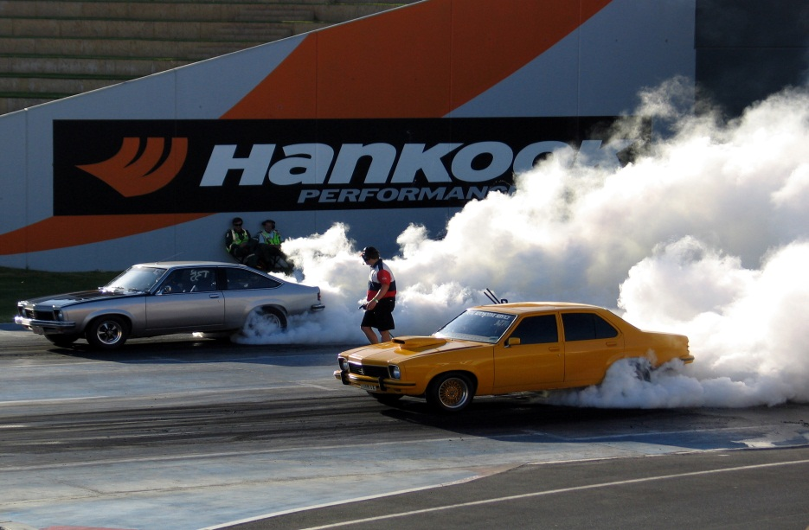
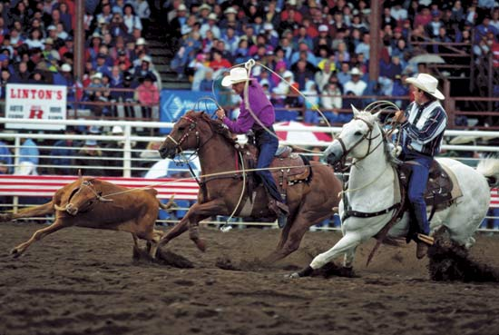
Document 1: Rodeo: Reliving the Wild West
A
B
Answer?
Q: Which picture matches the title of Document 1?
B
Rationale ?
There were cowboys who lived in the Wild West and they rode horses and worked with cows. The men are wearing cowboy hats, they’re riding horses and roping a cow, just like people did a long time ago. A crowd is watching them from grandstands, so this must be something called a rodeo.

Slide 10
Now, with your partner, match each document title on the bottom of Page 45 to its most appropriate picture, AND provide an intelligent rationale for your choice!

Slide 11
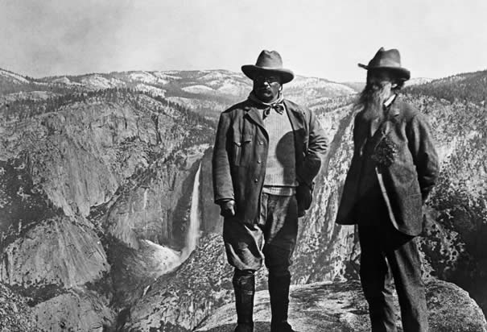
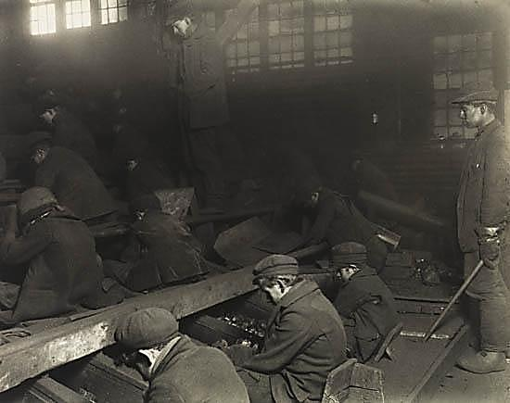
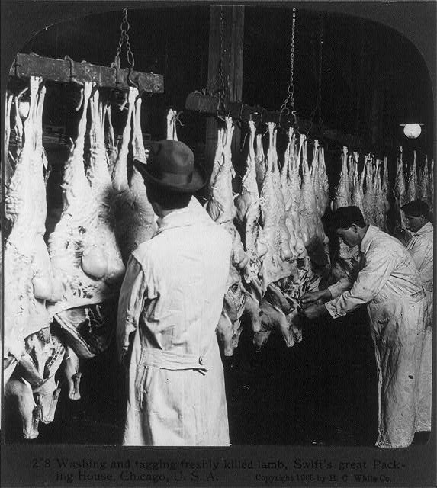
Document A: Deforestation: John Muir Document B: Child Labor: Lewis Hine Document C: Women’s Suffrage: Jane Addams Document D: Food Safety: Upton Sinclair

Slide 12
Document ?
“C: Women’s Suffrage-Jane Addams”
Rationale ?
Suffrage protest at the White House -1917

Slide 13
Teddy Roosevelt and John Muir: Yosemite -1906
Document ?
“A: Deforestation-John Muir”
Rationale ?

Slide 14
Document ?
“Document B: Child Labor:
Lewis Hine”
Rationale ?
Coal Breaker Boys, Pittston, Pennsylvania,
by Lewis Hine, 1911

Slide 15
Document ?
“Document D: Food Safety: Upton Sinclair”
Rationale ?
Washing and hanging freshly killed lamb.
Swift’s Packing House ©1906 by H.C. White Co.

Slide 16
Hook Exercise: Progressivism
Directions: The United States is a good country. It has had a democratic government longer than any other country on Earth. It is filled with many caring people. It is also true that the United States isn’t perfect. Below are ten problems that continue to nag America. With a partner, do these two tasks. Be prepared to share your thinking with the full class.
Is there a VOLUNTEER to read while the rest follow along in their packets?

Slide 17
Is there a VOLUNTEER to read while the rest follow along in their BRAINS?
Task One: Identify the number one problem you could solve on the list that would allow you to solve SIX of the nine other problems more easily.
Task Two: Explain how solving your number one problem would make it easier to solve SIX of the nine other problems on the list below.
BUT, DON’T START YET!

Slide 18
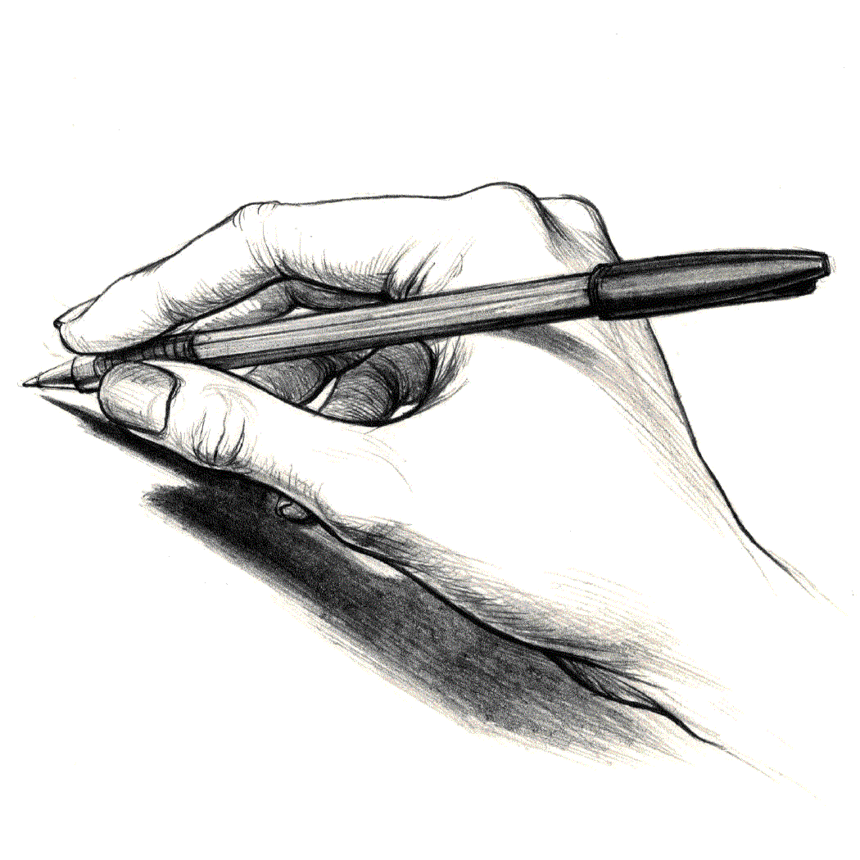
EXAMPLE:
Always start your answer out with a statement that identifies what you are going to discuss or prove…
I get to read!
Task One:
“If the problem of ____ could be solved first, then the problems of ____, ____, ____, ____, ____, and ____ would be easier to solve.
One person in each pair needs to write this example down so you don’t forget how to do it!

Slide 19
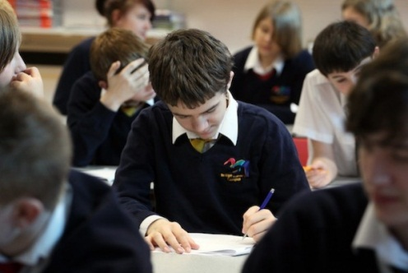
I get to read AGAIN!
EXAMPLE:
Number one problem to be solved?:
Task One:
If the problem of “weak schools” could be solved first, then the problems of high taxes, homelessness, dependence on fossil fuels like coal and oil, drugs, costly health care and gang violence would be easier to solve.
weak schools
Six other problems to be solved!

Slide 20
Is there a VOLUNTEER to read while the rest follow along in their BRAINS?
Task Two: Explain how solving your number one problem would make it easier to solve SIX of the nine other problems on the list below.
EXAMPLE ON
NEXT PAGE

Slide 21
Is there a VOLUNTEER to read while the rest follow along in their BRAINS?
PROBLEM #1: “HIGH TAXES”
If the problem of “weak schools” could be solved first, more students would graduate from high school and then college, which would help them get higher paying jobs. This would mean that more people would be able to pay taxes and so the government would lower the amount of taxes for everyone!

Slide 22
Is there a VOLUNTEER to read while the rest follow along in their BRAINS?
PROBLEM #2: “HOMELESSNESS”
Since more people are working because they stayed in school because the schools had improved, then more people would be able to buy homes, which would reduce the number of homeless people!

Slide 23
Is there a VOLUNTEER to read while the rest follow along in their BRAINS?
PROBLEM #3: “DEPENDENCE ON FOSSIL FUELS LIKE COAL AND OIL”
Since more people are going to college because the schools were better, then we would have more intelligent people who could get involved in finding ways to use new energy sources, which could lower our dependence on fossil fuels like coal and oil!

Slide 24
Is there a VOLUNTEER to read while the rest follow along in their BRAINS?
PROBLEM #4: “DRUGS”
Since more people are going to school because the schools were better, then they would have a better self image and there would be more intelligent people in the world. Truly intelligent people with a good self image know that drugs are bad and would not get involved with them in the first place and there wouldn’t be such a problem with drugs!

Slide 25
Is there a VOLUNTEER to read while the rest follow along in their BRAINS?
PROBLEM #5: “COSTLY HEALTH CARE”
The reason our health care is so costly is because there are many people who cannot afford to pay for health care because they don’t have jobs. This means that the health care companies charge higher prices for those people who are able to pay because they have good jobs. If the schools were improved, then more people would graduate and be able to get a good job so they could afford to pay for their own health care. Since more people would be able to pay, the cost of health care would go down for everyone!

Slide 26
Is there a VOLUNTEER to read while the rest follow along in their BRAINS?
PROBLEM #6: “GANG VIOLENCE”
If the problem of “weak schools” could be solved first, then more students would be successful and have a higher self image, which would keep more of them from joining gangs and gang violence would drop!

Slide 27
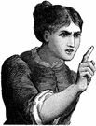
Any questions about how to complete this exercise?
Here’s the challenge:
YOU AND YOUR PARTNER WILL NEED TO BE READY TO SHARE YOUR RESPONSE WITH THE ENTIRE CLASS!
YOU CANNOT USE “WEAK SCHOOLS” AS YOUR #1 PROBLEM!

Slide 28
Remember to start your response like this:
My turn!
Task One:
“If the problem of ____ could be solved first, then the problems of ____, ____, ____, ____, ____, and ____ would be easier to solve.
PLEASE BEGIN THIS EXERCISE NOW!
YOU HAVE 20 MINUTES
TIME’S UP!

Slide 29
Let’s see how you and your partner are going to save our country!

Slide 30
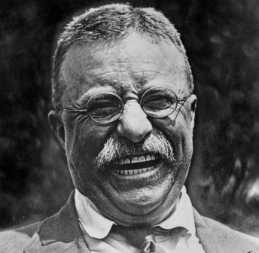
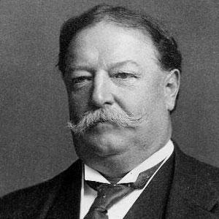
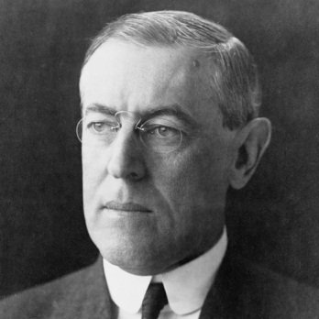
Background Essay:
My turn again!
Progressivism: Where Will You Put Your Million Dollars?
DIRECTIONS: As you read through this article, UNDERLINE each word with a RED PENCIL that you could not define if you were asked to do so on a quiz AND use a GREEN PENCIL to UNDERLINE each word that you think you might know.
You have 8 minutes to complete this task. PLEASE START NOW AND WORK QUIETLY BY YOURSELF SO THAT EVERYONE HAS A CHANCE TO COMPLETE THE EXERCISE!

Slide 31
TIME’S UP!
Take 5 minutes with your partner and come to an agreement on the unknown words.

Slide 32
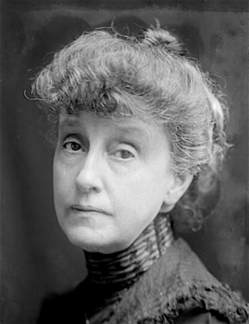
Are there still some words we need to discuss as a class?
I know you’ll do the right thing!
How does Aunt Bessie want you to spend her money?
$600,000 - most needy cause
$300,000 - second most needy cause
$100,000 – third most needy cause

Slide 33
p. 51: “BACKGROUND ESSAY QUESTIONS”
Please answer the “Background Essay Questions” on your own! (10 minutes)
TIME’S UP!

Slide 34
p. 51: “BACKGROUND ESSAY QUESTIONS”
Next, compare answers with your shoulder partner! (4 minutes)
If you found the answer and your partner didn’t, SHOW THEM WHERE YOU FOUND IT OR FOUND A CLUE WHICH HELPED YOU TO ANSWER THE QUESTION!
TIME’S UP!

Slide 35
Are there VOLUNTEERS to read the answers to the “Background Essay Questions”?
1. When was the Progressive Era?
2. What was the poverty level in dollars for a family
of six in 1900?
3. What were the average earnings of an American worker in 1900?
1900-1920
$600
less than $500 a year

Slide 36
Are there VOLUNTEERS to read the answers to the “Background Essay Questions”?
4. What three Presidents served during the Progressive Period?
5. What were two areas where Progressivism made little or no change?
6. Define the following:
“underside”
“muckraker”
“Progressivism”.
Roosevelt, Taft, Wilson
racial segregation & labor unions
a part of something or area that isn’t immediately noticed
writers who looked into the problems and voiced their opinions
a movement to reform America’s problems in the early 1900’s

Slide 37
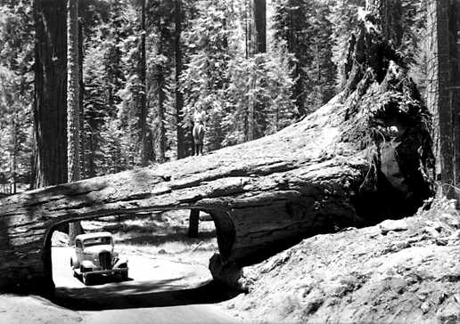
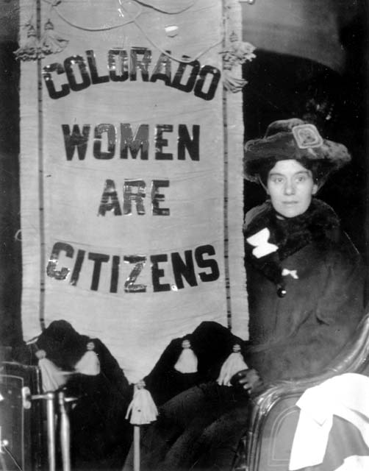
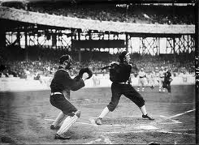
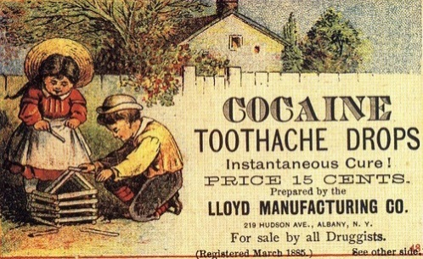
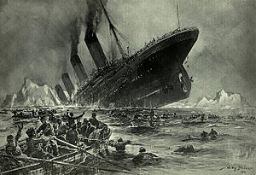
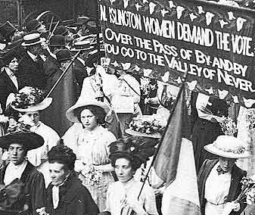
“Time Line”
1890- Sequoia National Park created in California
1893 - Colorado grants women the right to vote
1905 - World Series
1906 - Pure Food and Drug Act passed
1912 - Titanic sinks, 1,501 people die
1920 - Women’s Suffrage Amendment ratified by states

Slide 38
“Understanding the Question and Pre-Bucketing”
Understanding the Question:
What is the analytical question asked by this Mini-Q?
2. What terms in the question need to be defined?
3. Rewrite, using complete details, the task in your own words. The task is described in the last paragraph of the Background Essay.

Slide 39
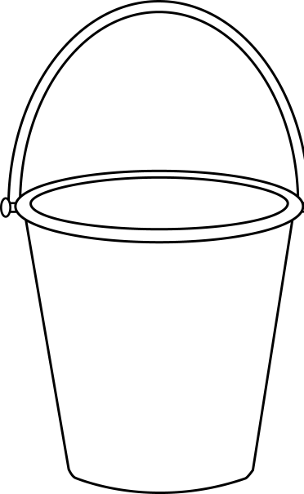
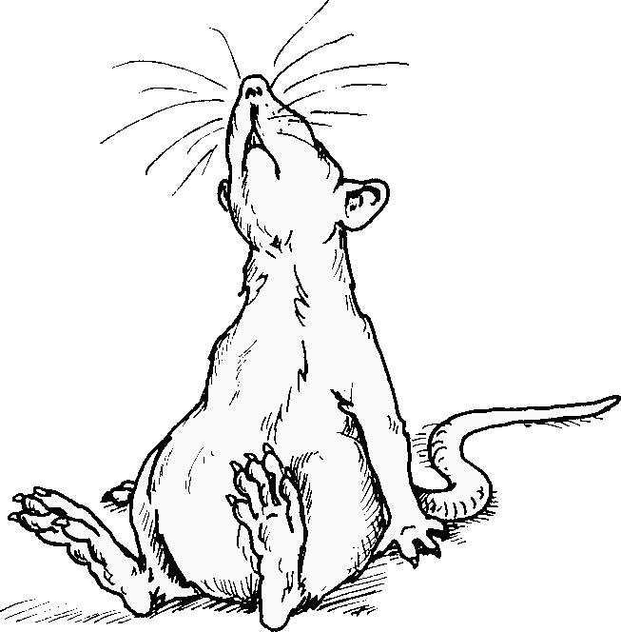
“Understanding the Question and Pre-Bucketing”
We won’t be doing any “pre-bucketing” this time!
Aw, rats!

Slide 40
Document Analysis Procedure
Directions: Number each line of the four documents you will be analyzing. This will allow you to give a clear source for the information you use to answer the questions.
EXAMPLE:
1.
2.
3.
4.
5.
6.
7.
8.
9.
With a horse-drawn plow, Fred Folkers produced nearly enough to stay afloat.
What changed everything for him, and other dryland farmers, was the tractor…
A tractor did the work of ten horses. With his new combine, Folkers could cut and
thresh the grain in one swoop, using just a fraction of the labor…. Folkers plowed
nearly his entire square mile, and then paid to rent nearby property and ripped up
that grass as well. By the late 1920’s, his harvest was up to ten thousand bushels of
wheat—a small mountain of grain. What’s more, there was now an easy way to get
the wheat of Fred Folkers… to the rest of the world. In 1924, a train finally
arrived in Boise City…

Slide 41
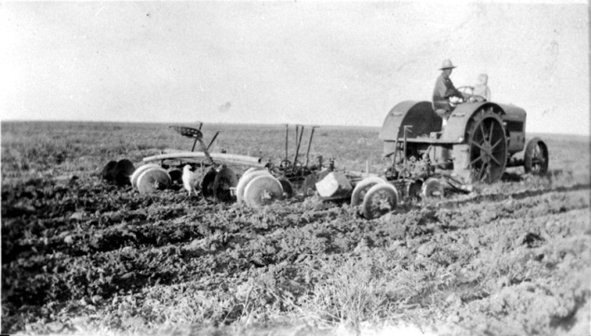
HERE’S HOW YOU GO ABOUT ANSWERING THE DOCUMENT QUESTIONS:
With a horse-drawn plow, Fred Folkers produced nearly enough to stay afloat.
What changed everything for him, and other dryland farmers, was the tractor…
A tractor did the work of ten horses. With his new combine, Folkers could cut and
thresh the grain in one swoop, using just a fraction of the labor…. Folkers plowed
nearly his entire square mile, and then paid to rent nearby property and ripped up
that grass as well. By the late 1920’s, his harvest was up to ten thousand bushels of
wheat—a small mountain of grain. What’s more, there was now an easy way to get
the wheat of Fred Folkers… to the rest of the world. In 1924, a train finally
arrived in Boise City…
1.
2.
3.
4.
5.
6.
7.
8.
9.
Q. The author says that the tractor “changed everything.” What does he mean?
A. “The author says that the tractor “changed everything.” because in line three, he says that “a tractor did the work of ten horses.” which meant that the tractor helped the farmer could save himself from doing a lot of the work on his farm.

Slide 42
“DOCUMENT ANALYSIS QUESTIONS”
(pgs. 55, 57, 59 & 61)
Please read Documents A-D and answer ALL FOUR SETS OF DOCUMENT QUESTIONS! (25 minutes)

Slide 43
BE SURE TO USE THIS PATTERN IN YOUR RESPONSES!
Q. The author says that the tractor “changed everything.” What does he mean?
A. “The author says that the tractor “changed everything.” because in line three, he says that “a tractor did the work of ten horses.” which meant that the tractor helped the farmer could save himself from doing a lot of the work on his farm.
TIME’S UP!

Slide 44
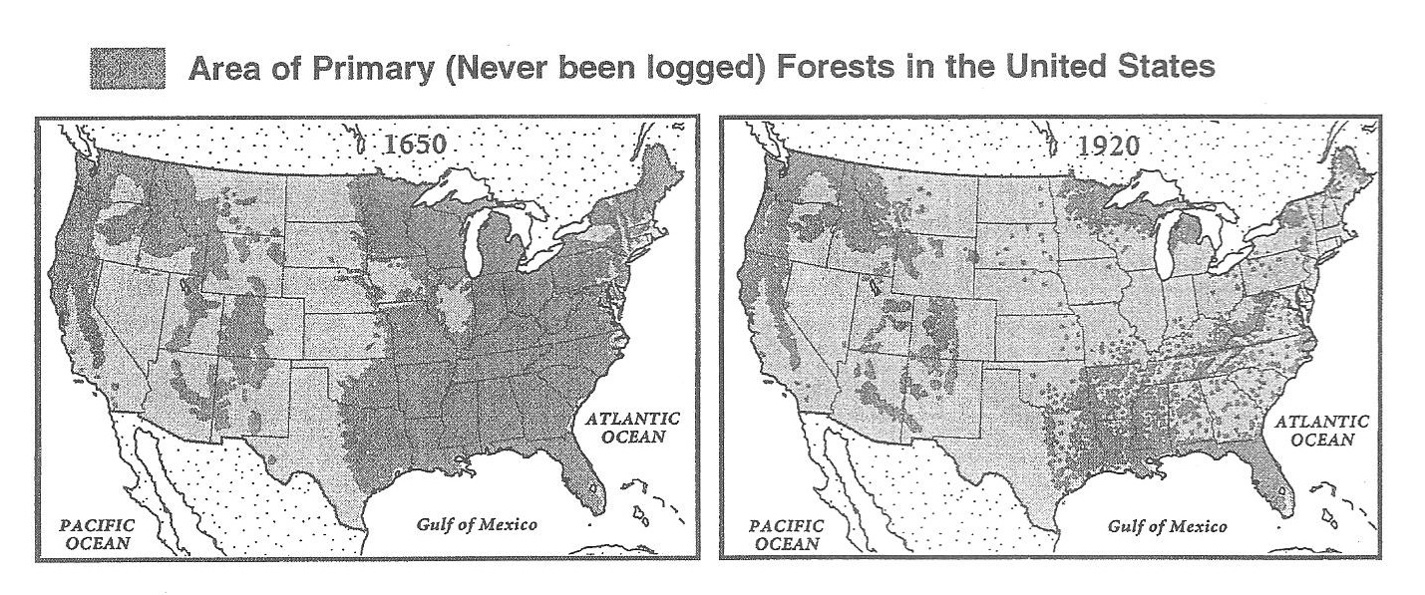
Are there VOLUNTEERS to read the answers to the “Document Analysis Questions”?
Document A:
Deforestation-John Muir
1. How old were the trees that Muir was describing?
2. According to Muir, why do people cut down trees?
3. What argument does Muir give for protecting the redwoods?
4. According to Muir, what is the only thing that can save the trees?
5. How do the maps help strengthen John Muir’s main arguments?

Slide 45
Are there VOLUNTEERS to read the answers to the “Document Analysis Questions”?
Document B:
“Child Labor-Lewis Hine”
1. What was a breaker boy?
2. How old were the two boys who were injured and killed at the Lee Breaker?
3. What is the main idea of the Lewis Hine report?
4. How does the photograph help support the report’s descriptions?

Slide 46
Are there VOLUNTEERS to read the answers to the “Document Analysis Questions”?
Document C:
“Women’s Suffrage: Jane Addams”
1. When did Jane Addams write her article for Ladies Home Journal?
2. What is “the ballot”?
3. Why does Jane Addams say that it is necessary for women to get the ballott?
4. In the photo, the sign being displayed reads, “Mr. President, How Long Must
Women Wait For Liberty?” The protesters were standing in front of the
White House. Do you think this was a good way for women to fight for the
vote? Why or why not?

Slide 47
Are there VOLUNTEERS to read the answers to the “Document Analysis Questions”?
Document D:
“Food Safety: Upton Sinclair”
1. What detail from Upton Sinclair’s book is the most disgusting to you?
2. If you were alive in 1906, and had just read this book, what might you decide to
do to change the situation?
3. How does the photo support Sinclair’s claims about the meat-packing industry?

Slide 48
“Bucketing: Getting Ready to Write”
Look over all the documents and organize them into your final buckets. Write final bucket labels under each bucket and place the letters of the documents in the buckets where they belong. It is ok to put a document in more than one bucket. Remember, your buckets are going to become your body paragraphs.
Use prior knowledge to add to your paragraphs!
“Most Needy Cause”
“Second Most Needy Cause”
“Third Most Needy Cause”

Slide 49
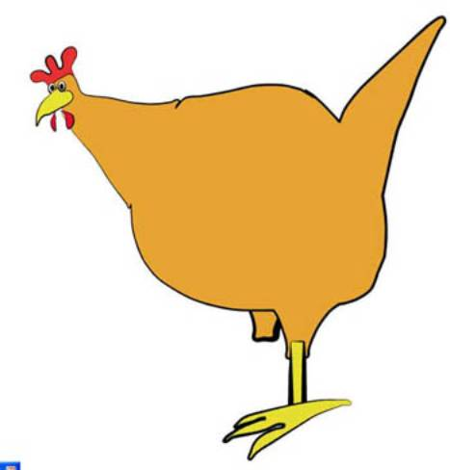
“Thesis Development and Roadmap”
Can I have it back when you’re finished?
On the “chickenfoot” below, write your thesis and your roadmap.
Your thesis is always an opinion, and answers the Mini-Q question.
The roadmap is created from your bucket labels and lists the topic areas
you will examine in order to prove your thesis.
BE SURE TO CITE YOUR INFORMATION WHEN YOU ARE SUPPORTING YOUR OPINION WITH FACTS! Ex: In line three of “Document A: Deforestation: John Muir”, the author states…
Starter Sentencee
Starter Sentencee
Thesis Statemente
Starter Sentence

Slide 50
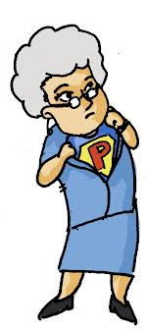
“From Thesis to Essay Writing”
You may use the “Mini-Q Essay Outline Guide” on p. 65 to further help you plan out your essay!
Mrs. Pikero will now take you the rest of the way!

