Slide 1
Turn on sound…

Slide 2
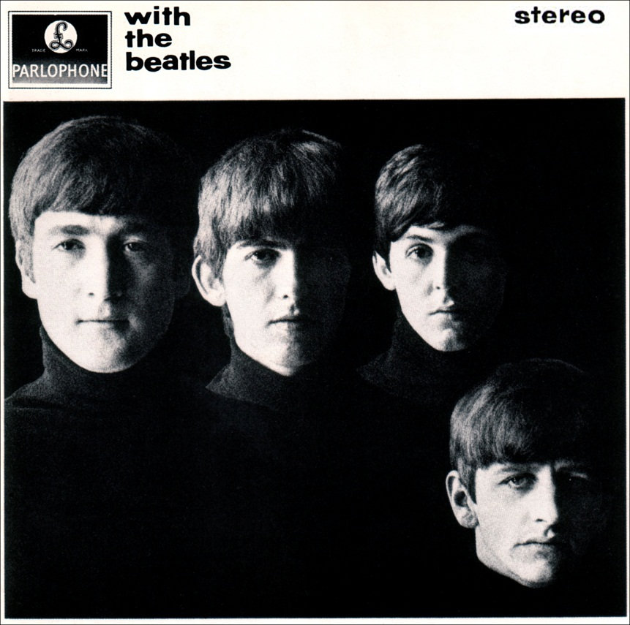
“Money”
The Beatles
Album: With the Beatles
(1963)

Slide 3
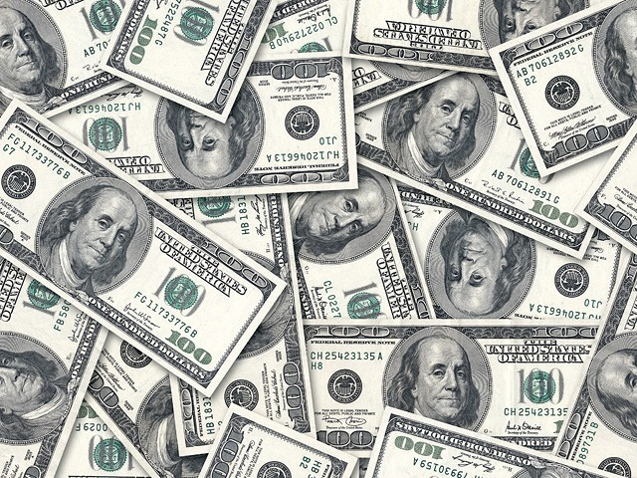
The 13 Richest Americans Of All Time
Dollar amounts are adjusted for inflation.
A Tie Dye Production

Slide 4
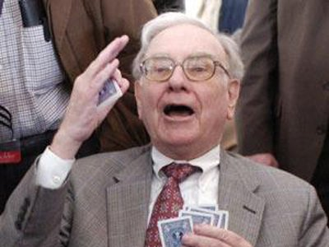
#13 Warren Buffet
Born: 1930
Peak fortune: $63.9 billion
The Oracle of Omaha joined Berkshire Hathaway as chairman in
1970 and hasn't looked back. He has pledged to give away 99 %
of his money.

Slide 5
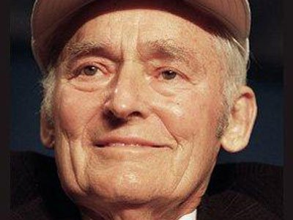
#12 Sam Walton
Born: 1918
Peak fortune: $64.5 billion
Founded Walmart in 1962 and lived a famously humble life. As
Walmart keeps growing, Walton's four children have individual
fortunes around $20 billion each.

Slide 6
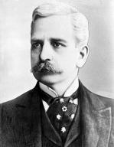
#11 Marshall Field
1834-1906
Peak fortune: $66.1 billion
He started the retail store chain “Marshall Field and Co.” in
Chicago during the Civil War.

Slide 7
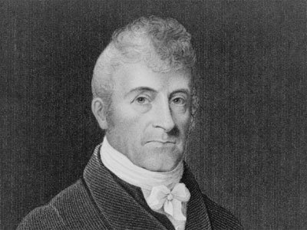
#10 Stephen Van
Rensselaer
1764-1839
Peak fortune: $68.5 billion
A member of the New York State Assembly, Rensselaer was
also heir to one of the most well-endowed estates in the US.
He founded the Rensselaer Polytechnic Institute with a
portion of his wealth.

Slide 8
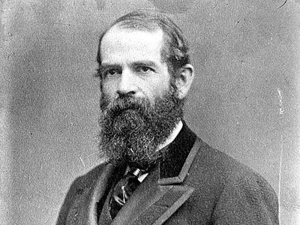
#9 Jay Gould
1836-1892
Peak fortune: $71.2 billion
Gould masterminded the 19th century transportation boom in
America. He and financier James Fisk also bought up enough shares
of the gold market that they were able to dominate it.

Slide 9
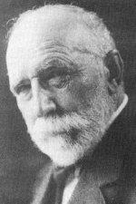
#8 Frederick Weyerhaeuser
1834-1914
Peak fortune: $79.4 billion
He founded Weyerhaeuser Company, one of the biggest timber
companies in the United States, after he arrived to America from
Germany in the 19th century.

Slide 10
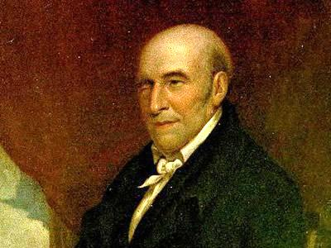
#6 Stephen Girard
1750-1831
Peak fortune: $105 billion
Successful in the shipping trade, he went into the banking business
later in his life, owning a bank that was called "Girard's Bank".

Slide 11
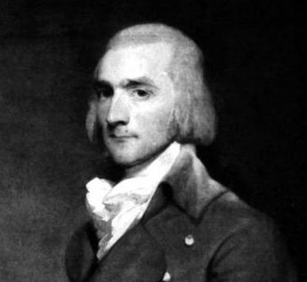
#5 John Jacob Astor
1763-1848
Peak fortune: $121 billion
A successful fur trader, he established a near monopoly within
the U.S. by around 1800. He went on to investing in real estate
in New York City.

Slide 12
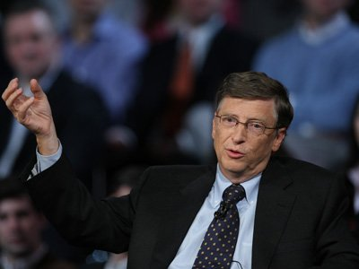
#4 Bill Gates
Born: 1955
Peak fortune: $136 billion
Founded Microsoft with Paul Allen in 1975. He held onto shares
as Microsoft dominated the age of computers, peaking in
personal wealth at the top of the Dot Com Bubble.

Slide 13
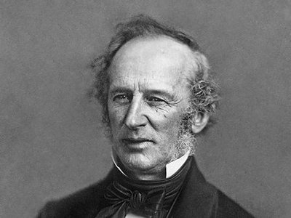
#3 Cornelius Vanderbilt
1794-1877
Fortune: $185 billion
In 1862, he began to buy railroad lines which led to his fortune.
Prior to that, he was known as a cold-blooded steam-boat
entrepreneur.

Slide 14
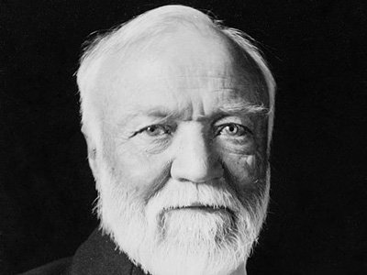
#2 Andrew Carnegie
1835-1919
Fortune: $309 billion
Carnegie invested in the steel business when the market was
booming, eventually ending up at the head of the U.S. Steel empire.

Slide 15
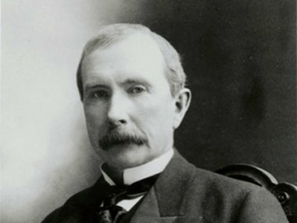
#1
John D. Rockefeller
1839-1937
Fortune: $336 billion
He founded Standard Oil in 1870, at the age of 31, and bought
up most of the oil refineries in the United States, eventually
controlling about 90% of the American oil business.

Slide 16
